Slide 1


Introduction to Optimization

Slide 2
Outline
Conventional design methodology
What is optimization?
Unconstrained minimization
Constrained minimization
Global-Local Approaches
Multi-Objective Optimization
Optimization software
Structural optimization
Surrogate optimization (Metamodeling)
Summary

Slide 3
Conventional Design Method
Initial design
Analyze the system
Is design
satisfactory ?
No
Change design based on
experience

Slide 4
Conventional Design Method
Depends on the designer’s intuition, experience, and skill
Is a trial-and-error method
Is not easy to apply to a complex system
Does not always lead to the best
  possible design
Is a qualitative design

Slide 5
What is optimization?
Optimization discipline deals with finding the maxima and minima of functions subject to some constraints.
Typical problem formulation:
Given p………………..parameters of the problem
Find d………………..the design variables of the problem
Min f(d,p)…………...objective function
Subject to g(d,p)≤0………..inequality constraints
h(d,p)=0………..equality constraints
d^{L}≤ d ≤ d^{U}………lower and upper bounds
Example: Point stress design for minimum weight
  Given w, N
  Find t
  Min t (i.e., weight)
  S.t. σ – σ_{crit} = N/(w t) – σ_{Y} ≤0
        t^{L}≤ t ≤ t^{U}
N
w
t
N

Slide 6
Definitions
Design variables (d): A design variable is a specification that is controllable by the
designer (eg., thickness, material, etc.) and are often bounded by maximum and minimum
values. Sometimes these bounds can be treated as constraints.
Constraints (g, h): A constraint is a condition that must be satisfied for the design to be
feasible. Examples include physical laws, constraints can reflect resource limitations, user
requirements, or bounds on the validity of the analysis models. Constraints can be used
explicitly by the solution algorithm or can be incorporated into the objective using Lagrange
multipliers.
Objectives (f): An objective is a numerical value or function that is to be maximized or
minimized. For example, a designer may wish to maximize profit or minimize weight. Many
solution methods work only with single objectives. When using these methods, the designer
normally weights the various objectives and sums them to form a single objective. Other
methods allow multi-objective optimization, such as the calculation of a Pareto front.
Models: The designer must also choose models to relate the constraints and the objectives to
the design variables. They may include finite element analysis, reduced order metamodels, etc.
Reliability: the probability of a component to perform its required functions under stated
conditions for a specified period of time

Slide 7
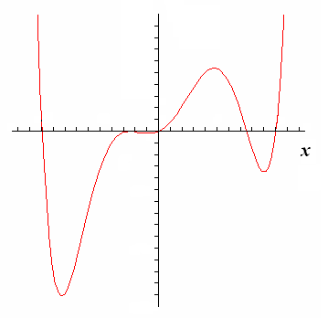
Unconstrained minimization (1-D)
Find the minimum of a function
Derivatives
  at local max or local min, f’(x)=0
  f”(x) > 0 if local min
  f”(x) < 0 if local max
  f”(x) = 0 if saddlepoint
f(x)

Slide 8

Unconstrained minimization (n-D)
Optimality conditions
  Necessary condition ∇f = 0
  Sufficient condition H is positive definite
  (H: Hessian matrix; matrix of 2nd derivatives)
Gradient based methods
  Steepest descent method Conjugate gradient method
  Newton and quasi-Newton methods
(best known is BFGS)
Hessian

Slide 9
Optimization Methods
Gradient-based methods
  Adjoint equation
  Newton’s method
  Steepest descent
  Conjugate gradient
  Sequential quadratic programming
Gradient-free methods
  Hooke-Jeeves pattern search
  Nelder-Mead method
Population-based methods
  Genetic algorithm
  Memetic algorithm
  Particle swarm optimization
  Ant colony
  Harmony search
Other methods
  Random search
  Grid search
  Simulated annealing
  Direct search
  IOSO(Indirect Optimization based
  on Self-Organization)
Commercial Tools
BOSS quattro (SAMTECH)
FEMtools Optimization (Dynamic Design Solutions)
HEEDS (Red Cedar Technology)
HyperWorks HyperStudy (Altair Engineering)
IOSO (Sigma Technology)
Isight (Dassault Systèmes Simulia)
LS-OPT (Livermore Software Technology Corporation)
modeFRONTIER (Esteco)
ModelCenter (PhoenixIntegration)
Optimus (Noesis Solutions)
OptiY (OptiY e.K.)
VisualDOC (Vanderplaats Research and Development)
SmartDO (FEA-Opt Technology)
MATLAB
Unconstrained: BFGS(fminunc), Simplex(fminsearch)
Constrained: SQP(fmincon)_
Visual DOC
  Unconstrained: BFGS, Fletcher-Reeves
  Constrained: SLP, SQP, Method of feasible directions

Slide 10
Evolutionary (Non-gradient) algorithms
Initialization: initialize population of solutions (physical & search parameter sets)
Reproduction: mutate and/or recombine solutions to produce next generation
Evaluate Fitness: compute objectives & fitness (DEA efficiencies) of new generation
Selection: Select which solutions survive to next generation and possibly reproduce
Termination: decide when to stop evolution

Slide 11
Termination - stall criteria
Specify a maximum number of generations past which the system cannot evolve
Retain best solutions in “elite” population; these are kept separate from solutions in “evolving”
population and consist of best solutions obtained regardless of age
Keep running averages of each objective of the solutions in elite population over a window of,
say, 50 generations
When running average stops changing by more
than some tolerance, terminate evolution

Slide 12
Characteristics of evolutionary algorithms
Very flexible; there are very many implementations of evolutionary algorithms
Choice of implementation is often dictated by the representation of the solution to a particular problem
Successful over wide range of difficult problems in nonlinear optimization
Constraints problematic – multiple objective methods often employed
Require many evaluations of objective functions but these are inherently parallel

Slide 13
Gradient-/Population-Based Methods
Gradient-based methods are commonly
used, but may suffer from…
  Dependence on the starting point
  Convergence to local optima
Population-based methods are high likely to
find the global optimum, but are computation-
ally more expensive

Slide 14

Constrained minimization
Gradient projection methods
  Find good direction tangent to active constraints
  Move a distance and then restore to constraint boundaries
Method of feasible directions
  A compromise between objective reduction and constraint avoidance
Penalty function methods
Sequential approximation methods
  Sequential quadratic programming
Iteratively approximate as QP
quadratic
linear
Guaranteed optimum solution

Slide 15
Global-Local Optimization
Approaches
Global Methods
Population based methods
  Genetic algorithm
  Memetic algorithm
  Particle swarm optimization
  Ant colony
  Harmony search
global
local
parameter space
Local Methods
Gradient Based
Newton’s method (unconstrained)
Steepest descent (unconstrained)
Conjugate gradient (unconstrained)
Sequential Unconstrained
Minimization Techniques (SUMT) (constrained)
Sequential linear programming (constrained)
Sequential quadratic programming (constrained)
Modified Method of Feasible Directions (constrained)
Evolutionary (no history)
Simplex Method (SM)
Genetic Algorithms (GA)
Differential Evolution

Slide 16
Constrained Optimization
Identify :
Design variables (X)
Objective functions to be minimized (F)
Constraints that must be satisfied (g)
Starting point
Initial design
Analysis
Analyze the system
Optimizer
Convergence
criteria ?
Converge ?
No
Updated
No
Change design using
Optimization technique

Slide 17
Need for a metamodel
Venkataraman and Haftka* (2004) reported that analysis models of acceptable accuracy have required at least six to eight hours of computer time (an overnight run) throughout the last thirty years, even though computer processing power, memory and storage space have increased drastically.
  Because fidelity and complexity of analysis models required by designers increased.
There has been a growing interest in replacing these slow, expensive and mostly noisy simulations with smooth approximate models that produce fast results.
These approximate models (functional relationships between input and output variables) are referred to as metamodels or surrogate models.
Courtesy of Venkataraman and Haftka* (2004)
* Venkataraman S, and Haftka RT (2004). “Structural optimization complexity: what has Moore’s law done for us?” Structural and Multidisciplinary Optimization, 28: 375–387.

Slide 18
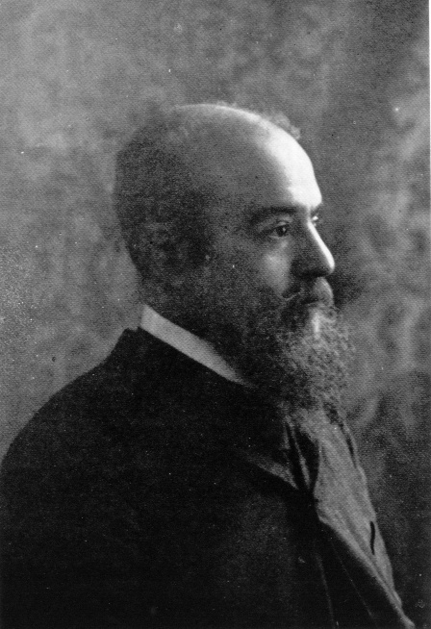
Multiple objective optimization
A set of decision variables that
forms a feasible solution to a
multiple objective optimization problem is Pareto dominant; if there exists no other such set
that could improve one decision variable without making at least one other decision variable
worse.
Vilfredo Pareto

Slide 19
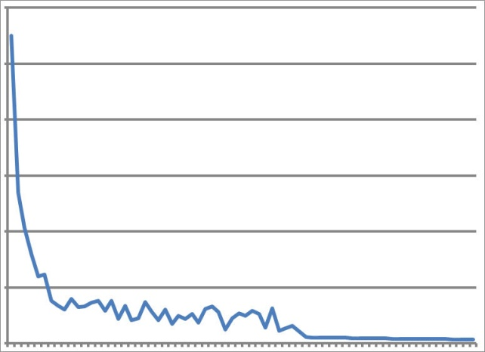
Convergence of pareto frontier
One dimensional objective space
It is relatively simple to determine an optimal solution for single objective methods (solution with the lowest error function)
However, for multiple objectives, we must evaluate solutions on a “Pareto frontier”
A solution lies on the Pareto frontier when any further changes to the parameters result in one or more objectives improving with the other objective(s) suffering as a result
Once a set of solutions have converged to the Pareto frontier, further testing is required in order to determine which candidate force field is optimal for the problems of interest
Be aware that searches with a limited number of parameters might “cram” a lot of important physics into a few parameters
Error function
Iteration
Two dimensional objective space
converged Pareto surface

Slide 20
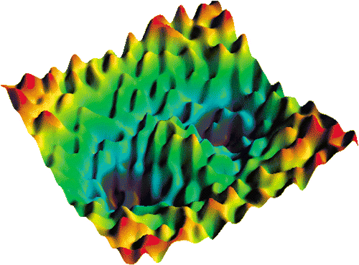

Model Calibration Optimization
Find parameters: λ₁,…,λ_{d}
That reproduce properties: p_{k} λ₁,…,λ_{d} ( )
Via some objective fxn:
g( λ₁,…,λ_{d} ) = Σw_{k} (p_{k} − p*_{k} )²
But not a downhill stroll:
- Many-dimensional
- Expensive function evaluation
- No analytical gradients
- Noisy properties

Slide 21
Metamodeling based optimization (MBO)
Define optimization
problem
Min f(x₁, x₂…x_{n})
s.t. g(x) ≤ 0
h(x) = 0
Evaluate f(x), g(x), h(x)
x₁
x₂
…
x_{n}
f
g
h
Refine design space
Add more data points
Metamodel
No
Identify most and least important variables
using GSA
Validation?
Perform optimiza-
tion
Yes
Stop
(not necessary but advisable)

Slide 22
Surrogate Modeling (Metamodels or Response Surface Methodology)
A method for constructing global approximations to system behavior based on results calculated at various design variable sets in the design space.
Linear
Elliptic
Quadratic
Surface fitting to calculate coefficients,

Slide 23
Procedure of Surrogate Design Optimization
Statistical process to obtain optimum design variable set to minimize (or maximize)
objective functions which satisfying constraints
Identify : Design variables (important controllable parameters to describe a system)
Objective functions (design goals or criteria) to be minimized or maximized
Constraints (design limitations or restrictions) that must be satisfied
Metamodeling
(Surrogate Modeling)
Interpolation Methods
Radial Basis Functions
Neural Networks
Regression Methods
Polynomial
Response Surface (PRS)
Support Vector
Regression (SVR)
Multivariate adaptive
regression splines (reg)
Gaussian Process (GP)
Hybrids
Kriging method (int+reg)
Ensemble (all methods)
Optimization
- Find an optimal design variable set
-Bayesian
-Optimization
algorithms (evolutionary-not gradient based)
- FDM, SUMT, LP,
GA
Multi-objective
function
formulations
- UFF, GCF, GTA
- Multi-level approach
Multi-start local
optimization
DOE methods
- Select design points that must be analyzed
Central composite
design
Factorial design
Plackett-Burman
Koshal design
Latin hypercube sampling
D-optimal design
Taguchi's
orthogonal array
Monte Carlo method
Analysis
- Analyze system using computational methods
ABAQUS FEA
LS-Dyna FEA
Pamcrash FEA
MegaMas DD
LAMMPS MD
VASP

Slide 24
Surrogate-Based
Optimization
(Metamodeling
or Response Surface
Methods)
DOE
Selected
Analysis
Benefit: quicker answers
Issue: less accuracy (maybe)
Metamodel Approximation
Objective – Develop metamodels as
low-cost surrogates for expensive
high-fidelity simulations
Optimizer

Slide 25
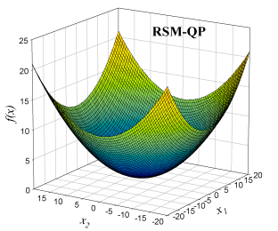
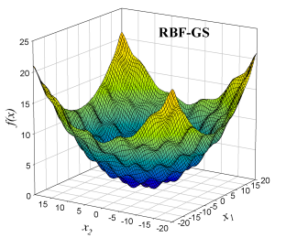
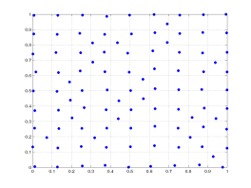
PRS
Metamodels (Surrogate Modeling)
Design of
Experiments
Metamodels
True Response:
Est. Response:
RBF
Polynomial Response Surface (PRS)
b₀, b_{i},b_{ij} are found by least squares
technique
Radial Basis Functions (RBF)
x₂
PRS
Thin-plate spline
training points
RBF
GP
Gaussian
λ’s are found from
Multiquadric
Inverse multiquadric
Gaussian Process (GP)
test points
x₁
Prediction at the N+1 point
C_{N}: covariance matrix with elements C_{ij}
smooths
noise
Interpolation mode:
Regression mode:

Slide 26
Design of Experiments Methods
Selection procedure for finding the design variable sets
that must be analyzed
Koshal Design, Plackett-Burman, Latin hypercube, D-Optimal Design
Central Composite Design, Factorial Design, Taguchi’s Orthogonal Array
Design points used in Central Composite Design
X₃
2^{n} factorial Design
X₂
Additional “face center”
X₁
Design Space (3 design variables)

Slide 27
Polynomial Response Surface (PRS)
y
Sampling data points
Assumption: Normally distributed uncorrelated noise
In presence of noise, response
surface may be more accurate
than observed data
Question to ask: Can the chosen order polynomial approximate the behavior?
Response surface
x
Acar & Rais-Rohani (2008)
27
Notes:
27

Slide 28
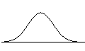
Kriging (KR)
Systematic departure
Trend model
Correlation function
y
Sampling data points
Assumption: Systematic
departures Z(x) are correlated, noise is small
Gaussian correlation function C(x, s,θ) is most popular
Computationally expensive for large problems (N>200)
Linear Trend Model
Systematic Departure
Kriging
x
Acar & Rais-Rohani (2008)
28
Notes:
28

Slide 29
Brief Overview of Other Metamodels
Radial Basis Functions (RBF)
True Response:
Est. Response:
Linear combination of selected basis functions.
Solution requires the calculation of interpolation coefficients.
Provides only an interpolation fit.
,
PRS
training points
RBF
GP
Gaussian Process (GP)
Assumes output responses are related and follow a Gaussian
joint probability distribution.
Prediction depends on the covariance matrix.
Solution requires the calculation of hyper parameters.
Accommodates both interpolation and regression fits.
test points
x
Support Vector Regression (SVR)
Makes use of selected Kernel functions.
Solution based on a constrained optimization problem.
Accommodates both linear and nonlinear regression fits.
Acar & Rais-Rohani (2008)
29

Slide 30
Maximizing the Benefit of Multiple Metamodels
An ensemble of M stand-alone metamodels: higher weight factor for better members
Simple averaging (Bishop 1995):
Error Correlation (Bishop 1995):
Prediction Variance (Zerpa 2005):
Parametric model based on generalized mean square error (GMSE) (Goel et al. 2007):
Acar & Rais-Rohani (2008)
30

Slide 31
Ensemble with Optimized Weight Factors
input variables & respective bounds
An ensemble of M stand-alone metamodels
DOE: Simulations at N training points
multiple (M) stand-alone metamodels
Find w_{i}, that would
min
s.t.
Ensemble of Metamodels
Find weight factors w_{i}, per:
EP (GMSE minimization)
EV_N_{v} (RMSE^{v} minimization)
An optimization problem, treating the
weight factors as the design variables and an error metric as the objective function.
        Error Estimation
GMSE at training
points
RMSE at test
points
mean GMSE of each model
mean RMSE of each model
Acar & Rais-Rohani (2008)
31

Slide 32
Choice of Error Metric
Candidate error metrics for objective function, ε_{e}:
EP: Generalized cross validation mean square error (GMSE), similar to PRESS statistic
EV_N_{v}: Root mean square error at a few validation points (RMSE^{v})
Proper value of N_{v} is problem dependent.
input variables & respective bounds
DOE: Simulations at N training points
multiple (M) stand-alone metamodels
Ensemble of Metamodels
Find weight factors w_{i}, per:
EP (GMSE minimization)
EV_N_{v} (RMSE^{v} minimization)
(ave. error at all training pts)
        Error Estimation
(ave. error at a few validation pts)
GMSE at training points
RMSE at test points
mean GMSE of each model
mean RMSE of each model
Acar & Rais-Rohani (2008)
32

Slide 33
Adequacy Checking of Response Surface
Error Analysis to determine the accuracy of a surface response
Residual sum of squares
Maximum residual
Prediction error
Prediction sum of squares residual

Slide 34
Choice of Training, Test, & Validation Points
Training Points:
  Random design points used to construct the metamodel.
  Sampling distribution depends on the DOE
  method used.
Test Points:
  Random design points used to test the
  accuracy of the metamodel.
  Typically fewer in number and different in
  location than the training points.
Validation Points:
  a few design points used for evaluating an
  error metric (RMSE) used as the objective
  function.
  Different from the training and test points.
(usually 20-40% of the number of training points)
input variables & respective bounds
DOE: Simulations at N training points
multiple (M) stand-alone metamodels
Ensemble of Metamodels
Find weight factors w_{i}, per:
EP (GMSE minimization at training points)
EV (RMSE minimization at validation points)
        Error Estimation
GMSE at training
points
RMSE at test
points
mean GMSE of each model
mean RMSE of each model
Acar & Rais-Rohani (2008)
34

Slide 35
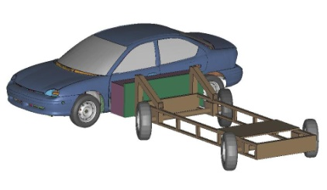
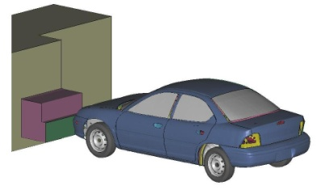
Ensemble of Two or More Metamodels (Car Crash Example)
Ensemble of Metamodels
Evaluation of Accuracy of the Ensemble
An ensemble of M stand-alone metamodels
Response | PRS | RBF | KR | GP | SVR | EP
R₁ (intrusion, OFI) | 1.43 | 1.02 | 1.11 | 1.24 | 1.0 | 0.92
R₂ (intrusion, SI) | 4.01 | 6.59 | 1.46 | 1.0 | 3.52 | 0.94
R₃ (energy, OFI) | 6.49 | 9.55 | 4.75 | 1.0 | 4.76 | 0.99
R₄ (energy, SI) | 6.07 | 2.54 | 1.48 | 1.22 | 1.0 | 0.93
Proposed approach: Find w_{i}, that would
min
s.t.
Candidate error metrics for objective function, ε_{e}:
EP:
EV:
Ensemble error (1 to 8%) less than the best individual metamodel
SI
OFI
Effect of Ensemble Expansion
(for R₁ in OFI)
Metamodels included in the ensemble | SVR | SVR, RBF | SVR, RBF, KR | SVR, RBF, KR, GP | SVR, RBF, KR, GP, PRS
Weight factors | 1 | 0.542, 0.458 | 0.613, 0.000, 0.387 | 0.596, 0.000, 0.379, 0.025 | 0.560, 0.000, 0.325, 0.036, 0.079
Error (GMSE) | 1 | 0.948 | 0.923 | 0.922 | 0.918
(error at training pts)
(error at validation pts)
  Acar, E., and Solanki, K., “Improving accuracy of vehicle crashworthiness response predictions using ensemble of metamodels,” submitted to International Journal of Crashworthiness, 2008.

Slide 36
Maximizing Benefit of Multiple Metamodels
Ensemble of Metamodelsª
input variables &
respective bounds
An ensemble (weighted average) of M stand-alone metamodels
DOE: Simulations at N training points
Proposed approach: Find w_{i}, that would
min
s.t.
Candidate error metrics for objective function, ε_{e}:
EP:
EV:
multiple (M) stand-alone
metamodels
Yes
build
ensemble?
No
        Error Estimation
GMSE at training points
RMSE at test points
(error at training pts)
mean GMSE of each model
mean RMSE of each model
Ensemble of Metamodels
Find weight factors w_{i}, per:
EA (simple averaging)
EG (Goel et al. 2007)
EP (GMSE minimization at training points)
EV (RMSE minimization at validation points)
(error at validation pts)
ªNot available in iSIGHT-FD or VisualDOC

Slide 37
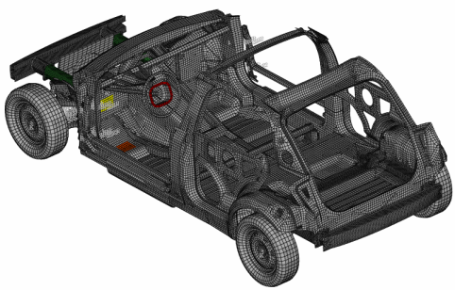
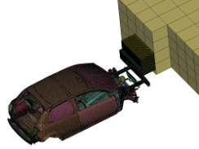
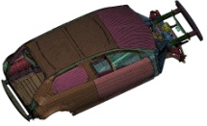
Comparison of Metamodels (Ensemble is a good idea)
Reliance on a single metamodel can be risky!
Example problem:
FE model of PNGV
Nonlinear transient
dynamic simulations
using LS-DYNA
Steering Wheel (SW)
In complex engineering problems, different responses can
have different characteristics (e.g., linear, nonlinear, noisy)
Response examples in automobile crash:
  structural mass
  intrusion distance at different sites in FFI and OFI
  acceleration at different sites in FFI and OFI
Metamodel suitability:
  PRS for mass
  RBF for intrusion distance at floor pan in FFI
  SVR for intrusion distance at floor pan in OFI
Better to use an ensemble of metamodels whenever possible!
Floor Pan (FP)
Crash Conditions:
Driver Seat (DS)
FFI
OFI
Exact
Response
$$$$$
GMSE Error for Acceleration at DS in FFI
Simulation
Input
Variables
most accurate
Metamodel
Approximate Response
$
Input examples: part geometry (shape, sizing), applied
loads, material properties, crash conditions, …
Response examples: max. stress, damage index, intrusion distance, acceleration, energy absorption, …

Slide 38

System Reliability Based Vehicle Design
Problem definition
System reliability calculation
System reliability based optimization (SRBO) of the
vehicles are essential since it allows investigating
- Reliability allocation between different components
- Reliability allocation between different failure modes
Four failure modes considered
(1,2) Excessive intrusion at OFI and SI
(3,4) Insufficient energy absorption at OFI and SI
The system reliability is calculated using Complementary
Intersection Method (Youn et al. 2006)
: probability of failure for different failure modes
Complementary
intersection event
OFI
SI
Design variables and random variables
Safer design via SRBO
SRBO can lead to safer vehicle design by leading to optimum reliability allocation between different failure modes.
ID | Component thicknesses
DV1 | Left and right front doors
DV2 | Left and right rear doors
DV3 | Inner hood
DV4 | Left and right outer B-pillars
DV5 | Left and right middle B-pillar
DV6 | Inner front bumper
DV7 | Front floor panel
DV8 | Left and right outer CBN
DV9 | Left and right front fenders
DV10 | Left and right inner front rails
DV11 | Left and right outer front rails
DV12 | Rear plate
DV13 | Suspension frame
ID | Description | Dist. type | COV
RV1 | Material parameter | Nor. | 0.1667
RV2 | Occupant mass | Nor. | 0.1667
RV3 | Impact speed | Nor. | 0.1667
 | Min Pf1 | Min Pf2 | Min PFS
Pf1 | 0.0031 | 0.0063 | 0.0068
Pf2 | 0.0001 | 0.0000 | 0.0000
Pf3 | 0.0064 | 0.0091 | 0.0058
Pf4 | 0.0066 | 0.0002 | 0.0009
PFS | 0.0162 | 0.0157 | 0.0135
Weight | 0.9785 | 0.9785 | 0.9785
14-17%
Reduction
in PFS
Notes:
38

Slide 39
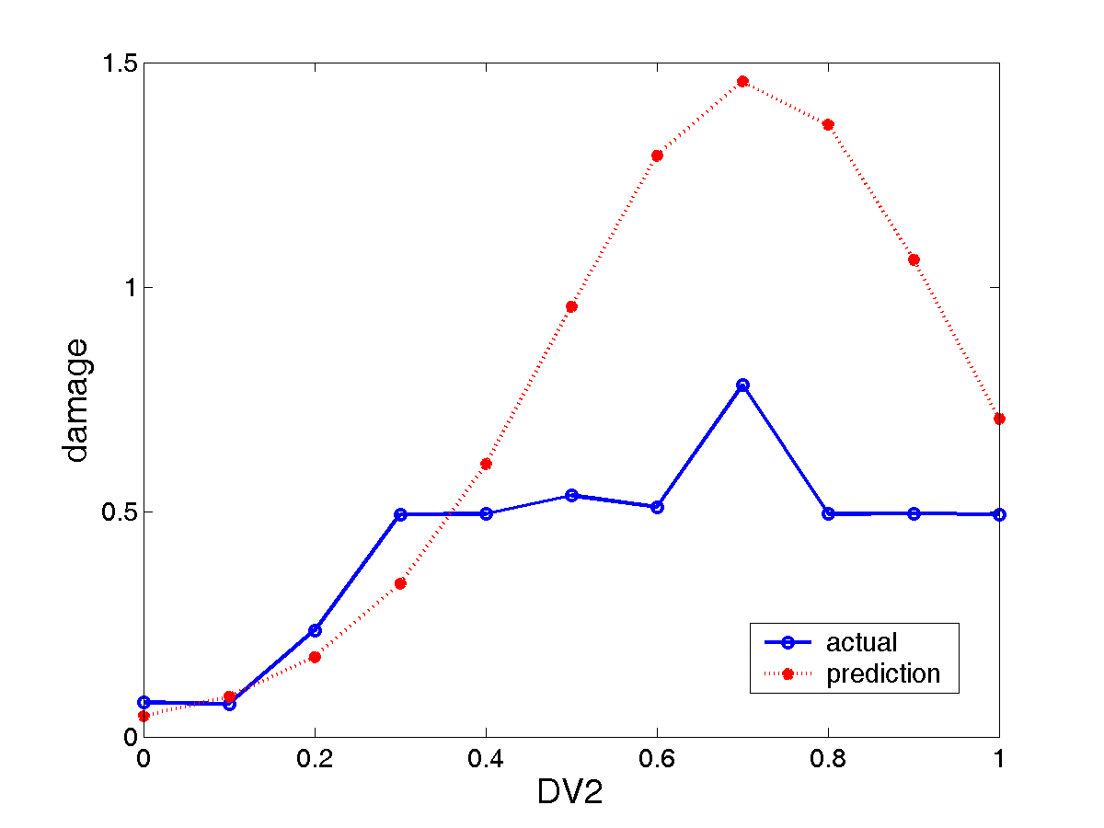
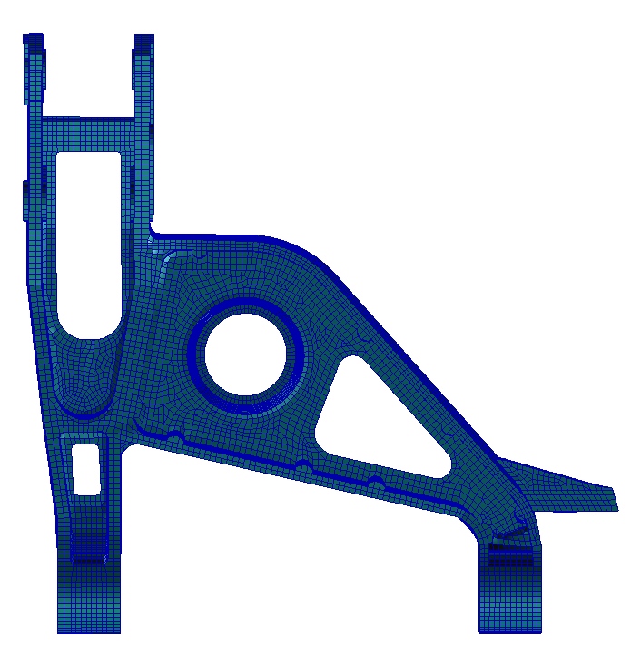
Comparison of Metamodels for Control Arm Example
Metamodels:
  Polynomial response surface (RS)
  Radial basis functions (RBF)
  Kriging (KR)
  Gaussian process (GP)
  Support vector regression (SVR)
Response Estimation Error Summary
Damage (deterministic case)
Metamodel | RS | RBF | GP | KR | SVR
% Error | 488 | 268 | 29 | 229 | 262
von Mises Stress (deterministic case)
No. of input variables = 13
No. of sampling points = 159
Metamodel | RS | RBF | GP | KR | SVR
% Error | 1.6 | 1.4 | 0.6 | 1.5 | 1.4
Damage (probabilistic case)
No. of input variables = 55
No. of sampling points = 421
Metamodel | RS | RBF | GP | KR | SVR
% Error | 44 | 44 | 44 | 139 | 77
Gaussian process (GP)
t₂
Damage
t₂

Slide 40
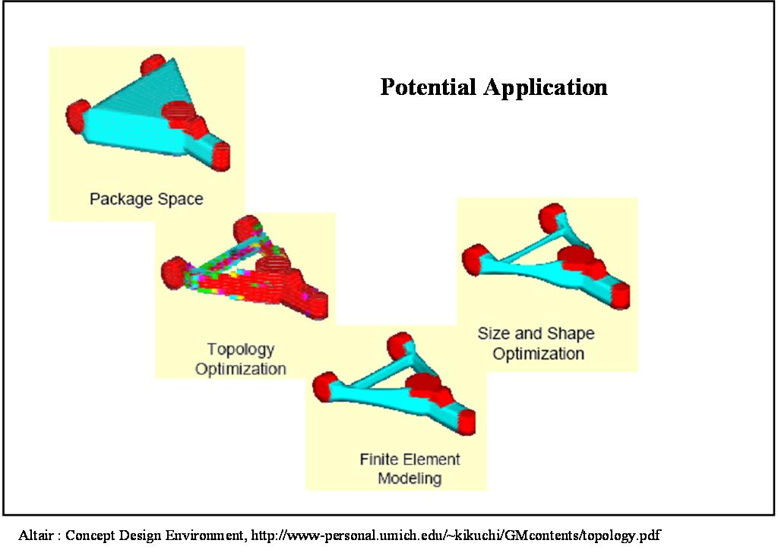
Structural optimization
Topology optimization
  Start with a black box
  Locate the holes
Shape optimization
  Draw the boundaries
  Element shapes change during optimization
Sizing optimization
  Determine thicknesses
  Finite element model is fixed
Topology, Shape, & Sizing Optimization
topology
design domain
FEM 1
Optimum
Shape & Size
Optimum
Topology
FEM 2

Slide 41
Multi-Objective Function Optimization
To find an optimal design variable set to achieve several objectives simultaneously with satisfying constraints
Notion of Pareto Front
Utility Function Formulation
Global Criterion Formulation
Game Theory Approach
Goal Programming Method
Goal Attainment Method
Bounded Objective Function Formulation
Lexicographic Method
Multiple Grade Approach
Multilevel Decomposition Approach

Slide 42
Software Codes
Gradient Approaches
 | Unconstrained | Constrained | Population Based | Metamodels
DOT (Design Opt Tools) | x | x
Mathematica | x | x
Excel | x | x
Matlab | x | x | x | x
Fortran | x | x
GENESIS (DOT) | x | x
NASTRAN (DOT) | x | x
GENOA (DOT predecessor) |  | x
ISIGHT
HEEDS | x | x | x
LS-Opt | x | x | x

Slide 43
Summary
Conventional Design Method
Unconstrained Design Optimization
Constrained Design Optimization
Global-Local Design Optimization
Multi-Objective Design Optimization
Surrogate (Metalmodeling and
Response Surface Methods) Design Optimization using Metamodels

