Slide 1
Verification and Validation (V&V)
of Simulations
(Uncertainty Analysis)
Validation: “doing the right thing”
Verification: “doing things right”

Slide 2
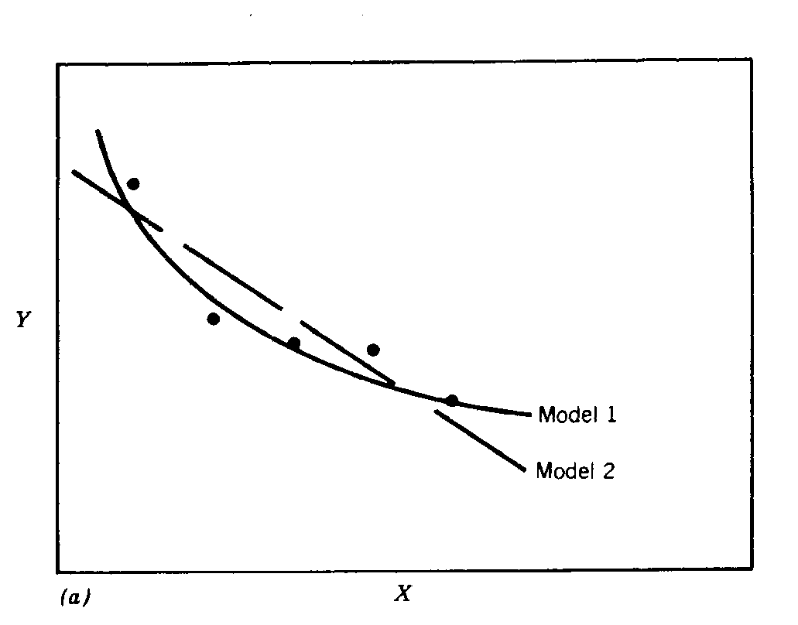
Consider the comparison between a simulation result and experimental data….
Suppose we have a simulation result. How good is it? The Verification and Validation (V&V) Process
can provide a quantitative answer to that question.

Slide 3
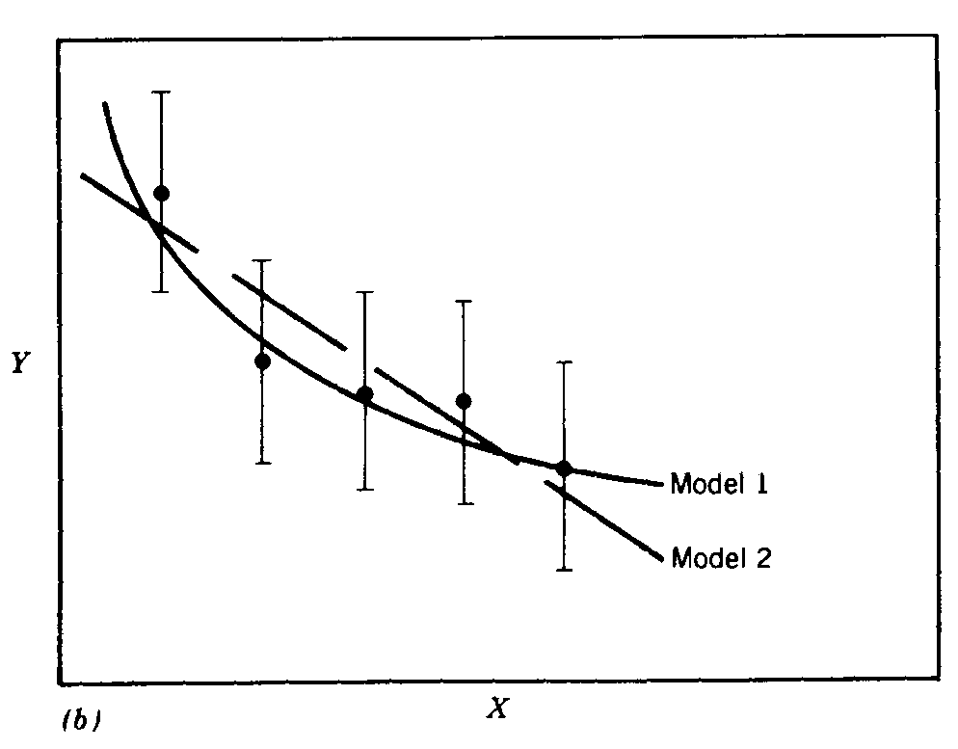
The perspective changes when one begins to consider the uncertainties involved…
The uncertainties determine
  the scale at which meaningful comparisons can be made
  the lowest level of validation which is possible; i.e., the “noise level”
Thus, the uncertainties in the data and the uncertainties in the simulation must be considered if meaningful conclusions are to be drawn.

Slide 4
Definitions for Validation
“Doing the right thing”
S → value from the simulation
D → data value from experiment
E → comparison error
E = D - S = δ_{D} - δ_{S}

Slide 5
Validation Comparison of Simulation
Results with Experimental Results

Slide 6
Uncertainty (Error) Definitions
The error δ_{S} in the simulation is composed of
  errors δ_{SN} due to the simulation’s numerical solution of the equations
  errors δ_{SPD} due to the use of simulation of previous experimental data (properties, etc.)
  errors δ_{SMA} due to simulation modeling assumptions
  δ_{S} = δ_{SN} + δ_{SPD} + δ_{SMA}
Therefore, the comparison error E can be written as
E = D - S = δ_{D} - δ_{S}
or
E = δ_{D} - δ_{SN} - δ_{SPD} - δ_{SMA}
(A primary objective of a validation effort is to assess the simulation modeling error δ_{SMA}.)

Slide 7
Consider the error equation
E = δ_{D} - δ_{SN} - δ_{SPD} - δ_{SMA}
When we don’t know the value of an error δ_{i}, we estimate an uncertainty interval ±U_{i} that bounds δ_{i} and then work with uncertainties rather than with errors.
The uncertainty interval ±U_{E} which bounds the comparison error E = D-S is given by (assuming no correlations among the errors)
or
(U_{E})² = (U_{D})² + (U_{SN})² + (U_{SPD})² + (U_{SMA})²

Slide 8
(U_{E})² = (U_{D})² + (U_{SN})² + (U_{SPD})² + (U_{SMA})²
U_{D} can be estimated using well-accepted experimental uncertainty analysis techniques
The estimation of U_{SN} is the objective of verification, typically involves grid convergence studies, etc, and is currently an active research area.
To estimate U_{SPD} for a case in which the simulation uses previous (input) data d_{i} for m variables
where the U_{di} are the uncertainties associated with the input data.
However, we know of no a priori approach for estimating U_{SMA} -- in fact, a primary objective of a validation effort is to assess U_{SMA} (or δ_{SMA}) through comparison of the simulation prediction and benchmark experimental data.

Slide 9
(U_{E})² = (U_{D})² + (U_{SN})² + (U_{SPD})² + (U_{SMA})²
So, we define a validation uncertainty U_{VAL} given by
(U_{VAL})² = (U_{E})² - (U_{SMA})² = (U_{D})² + (U_{SN})² + (U_{SPD})²
U_{VAL} is the key metric in this validation approach
  it is the “noise level” imposed by the experimental and numerical solution uncertainties;
  If δ_{SMA} = 0, then ±U_{VAL} would contain the resultant of all of the other errors (E) 95 times out of 100
  thus, U_{VAL} is the tightest (lowest, best) level of validation possible (i.e., it is “the best that can be done” considering the existing uncertainties)

Slide 10
If |E | < U_{VAL}, then the level of validation is equal to U_{VAL} .
If |E | > U_{VAL} , the level of validation is equal to |E |
If |E | » U_{VAL} , the level of validation is equal to |E | and one can argue that probably δ_{SMA} ≈ E since the interval ±U_{VAL} should contain the resultant of all errors except δ_{SMA} (that is, δ_{D} - δ_{SN} - δ_{SPD} ).
The other important metric is the required level of validation, U_{reqd}, which is set by program objectives.

Slide 11
Schematic of Verification and
Validation of a Simulation

Slide 12
Types of Uncertainty Analysis
Monte Carlo (MC)
First Order Taylor Series (FOTS)
Univariate Dimension Reduction (UDR or DR) (an additive decomposition technique that evaluates the multidimensional integral of a random function by solving a series of one-dimensional integrals)
Extended Generalized Lambda Distribution (EGLD) (probability distribution function)
Random Field Uncertainty Propagation
Karhunen-Loeve Expansion of Random Field

Slide 13
To develop and quantify uncertainty related to material heterogeneities
K.N. Solanki , M.F. Horstemeyer, W.G. Steele, Y. Hammi, J.B. Jordon, Calibration, validation, and verification including uncertainty of a physically motivated internal state variable plasticity and damage model,” International Journal of Solids and Structures, Vol. 47, 186–203, 2010.

Slide 14
Uncertainty Methodology
Uncertainty in engineering systems
Extrinsic
Intrinsic
Experimental setup
Sensor errors
Surroundings
Modeling
Parametric
Constitutive relations
Underlying physics
Surroundings
Boundary conditions
Process parameters
Experiments
Modeling/Simulations

Slide 15
Experimental Uncertainty
Uncertainty in experimentally measure quantities (force and strain) is give by
where , is random uncertainty
, is systematic uncertainty
Coleman and Steele, 1999

Slide 16
Experimental Uncertainty
Random uncertainty in experimentally measure quantities , (force and strain) for M different tests is give by
Systematic uncertainty in experimentally measure quantities , (force and strain) for M different tests is give by
Coleman and Steele, 1999

Slide 17
Experimental Uncertainty
Measured Quantities
  Force and Strain
  Specimen Size (width and Thickness)

Slide 18
Experimental Uncertainty
Uncertainty in true stress and true strain is given by
where F, is measured force
w, is width of specimen
t, is thickness of specimen
ε, is engineering strain

Slide 19
Model Calibration Example Under Uncertainty
±9.75%
±8.1%
±7.0%

Slide 20
Model Validation Example Under Uncertainty
tension followed by compression
compression followed by tension

Slide 21
SUMMARY: The V&V Process
Preparation
  Specification of validation variables, validation set points, validation levels required, etc. (This specification determines the resource commitment that is necessary.)
  It is critical for modelers and experimentalists to work together in this phase.
Verification
  Are the equations solved correctly? (Grid convergence studies, etc, to estimate U_{SN}.)
Validation
  Are the correct equations being solved? (Compare with experimental data and attempt to assess δ_{SMA} )

Slide 22
Uncertainty Quantification
and Propagation
Objective – Forward propagation of uncertainties from basic sources to system response, R
Experimental Uncertainty Analysis: [Coleman & Steele 1999]
X = {X₁, X₂, …, X_{N}}^{T} = Vector of random variables; R = R{X} = Random response
expanded
uncertainty
random standard uncertainty
due to correlated error in X_{k} and X_{l}
variance of X_{k}
systematic standard uncertainty
due to elemental sources of uncertainty affecting X_{k}
No prior probability distribution is required in this approach.
Probabilistic Approach: [Sundararajan 1995]
Given the probability density function (PDF) of random variables (X_{k}, k=1,N)
f_{X 3}
= uncertainty in R
f_{X 2}
(for independent random variables)
Based on first-order Taylor series approximation of R
x₁
Notes:
In bk calculation, the uncertainty sources associated with each random variable is also considered.
For example, what instrument am I using to measure wall thickness? What is the uncertainty associated with that tool. That information goes into the calculation of bk.
If I am using the same tool to measure two different properties, wall thickness in member 1 and that in member 2, then bkl will be important as the two wall thickness random variables would be correlated as they are influenced by the same source of error or uncertainty.
There are some similarities and some differences in the formulation as well as the calculation of uncertainty in the two approaches.

Slide 23
Uncertainty Quantification
and Propagation (cont)
Given the probability density function (PDF) of each random variable, find uncertainty (st. deviation) in response R as [Sundararajan 1995]
Dimension Reduction + Distribution Fitting (DR+EGLD):
X = {X₁, X₂, …, X_{N}}^{T} = Vector of random variables; R = R{X} = random response
Step 1: Use the Univariate Dimension Reduction approach [Rahman & Xu 2004] to estimate the l^{th} statistical moment, m_{l} of response R based on m_{l} of individual random variables
Step 2: Match the approximate statistical moments of R with those of the extended generalized Lambda distribution to find the fitting parameters
=> more complete description of random uncertainty in R
f_{X 3}
PDF of X_{k}, k=1,N
( for independent random variables)
f_{X 2}
x₁
Acar, E., Rais-Rohani, M., and Eamon, C., “Structural Reliability Analysis using Dimension Reduction and Extended Generalized Lambda Distribution,” International Journal of Reliability and Safety, Vol. 4, Nos. 2/3, 2010, pp. 166-187.
Notes:
In bk calculation, the uncertainty sources associated with each random variable is also considered.
For example, what instrument am I using to measure wall thickness? What is the uncertainty associated with that tool. That information goes into the calculation of bk.
If I am using the same tool to measure two different properties, wall thickness in member 1 and that in member 2, then bkl will be important as the two wall thickness random variables would be correlated as they are influenced by the same source of error or uncertainty.
There are some similarities and some differences in the formulation as well as the calculation of uncertainty in the two approaches.

Slide 24
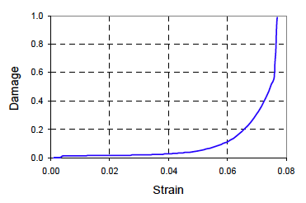

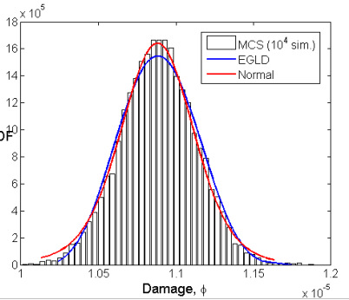
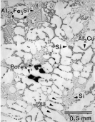

Uncertainty Quantification and
Propagation (Example)
Objective – Forward propagation of uncertainties from basic sources to system response, R
Dimension Reduction + Distribution Fitting: [Acar, Rais-Rohani & Eamon 2008]
Step 1: Using the Dimension Reduction Approach [Rahman & Xu 2004], estimate the l^{th} statistical moment, m_{l} (e.g., mean, variance, etc.) of response R based on m_{l} of individual random variables
=> Exact multidimensional integral approximated by multiple one-dimensional (simple) integrals
Step 2: Match the approximate statistical moments of R with those of an appropriate distribution function (e.g., EGLD - Extended Generalized Lambda Distribution) to find the fitting parameters.
=> More complete description (i.e., PDF) of stochastic uncertainty in R
Normalized damage sensitivities
Example: Determine the stochastic uncertainty in the damage response
Uncertainty in damage-strain data
ε = 0.001
Initial radius
A356 Tensile Specimen
Uncertainty in damage
Uncertainty in microstructure
Uncertainty in model constants
= 0.001/s
Nucleation coeff.
ISV-Damage Constitutive Model
Damage
ε = 0.05
Fracture toughness
Strain
Initial temp
Coalescence coeff.
ε = 0.001
Collaborative effort between Tasks 1 and 4: [Acar, Solanki, Rais-Rohani & Horstemeyer 2008]

Slide 25
Uncertainty and Sensitivity
Analysis of Damage
Use DR+EGLD to estimate the uncertainty in damage based on uncertainties in microstructure features (e.g., void size, particle size, etc.) found in AA356-T6 cast.
@ ε = 0.005
@ ε = 0.05
Initial temperature
Coalescence coefficient
@ ε = 0.005
Fracture toughness
ISV based plasticity-damage => model
Initial temperature
Coalescence coefficient
@ ε = 0.05
Strain, ε
Acar, E., Solanki, K., Rais-Rohani, M., and Horstemeyer, M., “Stochastic Uncertainty Analysis of Damage Evolution Computed Through Microstructure-Property Relations,” Journal of Probabilistic Mechanics, Vol. 25, No. 2, 2010, pp. 198-205.
Notes:
In bk calculation, the uncertainty sources associated with each random variable is also considered.
For example, what instrument am I using to measure wall thickness? What is the uncertainty associated with that tool. That information goes into the calculation of bk.
If I am using the same tool to measure two different properties, wall thickness in member 1 and that in member 2, then bkl will be important as the two wall thickness random variables would be correlated as they are influenced by the same source of error or uncertainty.
There are some similarities and some differences in the formulation as well as the calculation of uncertainty in the two approaches.

Slide 26
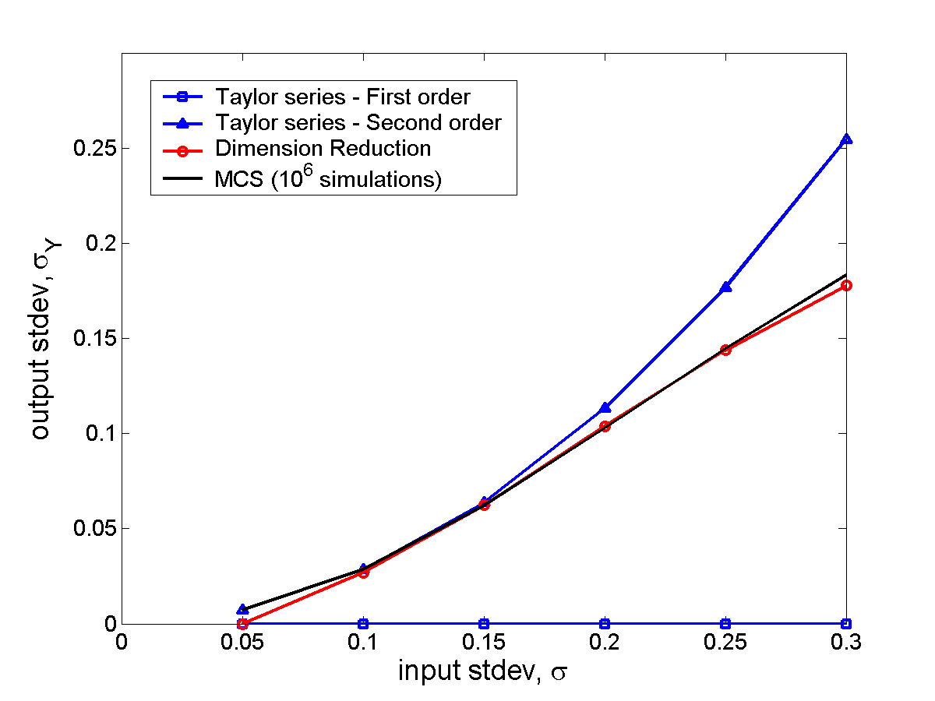
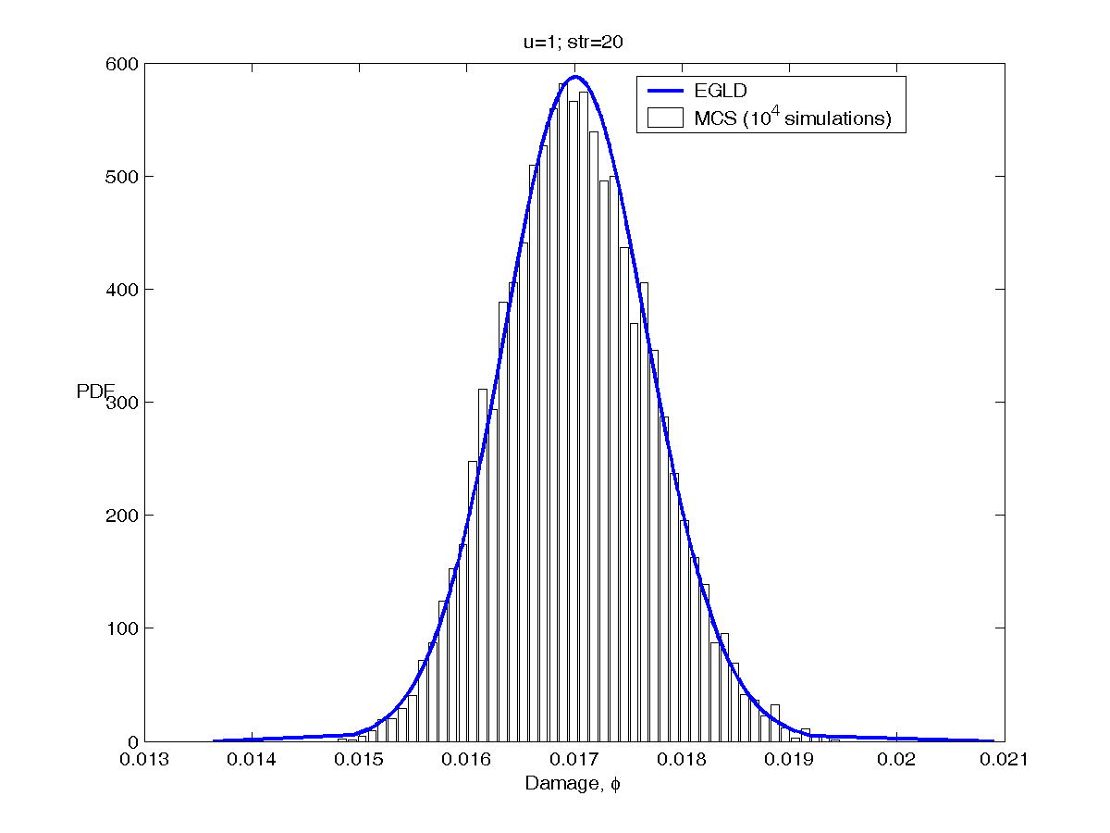
Uncertainty Analysis Example:
Damage using DR+EGLD
Uncertainty Estimation
Comparison of Uncertainty Analysis Results
A356 aluminum tensile specimen, strain rate controlled test
First order Taylor-series (FOTS) expansion
Needs derivatives of response, Y
Feasible for simple problems
(numerical derivatives for
complex problems)
May fail for mildly nonlinear probs.
 | Standard deviation of damage
Strain level | 0.001 | 0.02 | 0.05
FOTS | 2.4×10⁻⁷ | 7.3×10⁻⁴ | 3.1×10⁻³
DR | 2.4×10⁻⁷ | 6.9×10⁻⁴ | 3.0×10⁻³
MCS with 10⁴ sample | 2.4×10⁻⁷ | 6.9×10⁻⁴ | 3.0×10⁻³
An analytical example: Find standard
deviation in Y(X) based on that of X.
DR more accurate than FOTS
DR much less costly than MCS
Dimension Reduction Techniques
Damage Probability Distribution using EGLD
A356 aluminum tensile specimen, strain rate controlled test
Based on reducing multi-dimensional integrals to a series of one-dimensional integrals (Rahman & Xu 2004)
@ Strain = 0.02
Var_{Y} = m₂ - m₁²
Damage
Using binomial formula
PDF
Strain
to be calculated recursively
Damage
Notes:
26

Slide 27
Rationale for Probabilistic
(Reliability-Based) Design
More meaningful to say “Structural design has a P_{f} = 10⁻⁴ under the extreme loading condition,” than to say it has a factor of safety of 2 [Wirsching 1992].
Explicit inclusion of statistical data into the design algorithm.
Quantify the effect of each stochastic uncertainty on the final design.
For a limit state expressed in terms of strength (resistance) R and load L
Limit state function:
PDF
β = Reliability index
Failure probability:
L
Exact solution by integration not practical
Estimate P_{f} or β using
  Simulation Techniques (e.g., Monte Carlo)
  Excellent accuracy, Inefficient
f_{g}(r,l)
Failure Probability
0
x
r,l
For P_{f} = 0.001 with 20% error at 95% confidence, N_{s} = 100,000!
  Analytical Techniques ---> Mixed accuracy, Efficient
  Advanced Techniques ---> Good accuracy, Mixed efficiency

Slide 28
Hybrid Uncertainty Approach
Related to Structural Reliability
Structural Reliability Methods:
  Simulation (MCS, LH, IS, AIS)
  Analytical (FORM, SORM, AMV+)
  Hybrid methods under development:
    Dimension Reduction + EGLD (Acar et al. 2008)
    Full Failure Sampling (Eamon & Charumas 2008)
  Acar, E., Rais-Rohani, M., and Eamon, C., “Reliability Estimation using Dimension Reduction and Extended Generalized Lambda Distribution,” submitted to International Journal of Reliability and Safety, 2008.
Limit state:
PDF
Reliability index: β
L
Failure Probability
f_{g}(R,L)
0
x
Most Probable Point, MPP

Slide 29
SUMMARY: The V&V Process
Preparation
  Specification of validation variables, validation set points, validation levels required, etc. (This specification determines the resource commitment that is necessary.)
  It is critical for modelers and experimentalists to work together in this phase.
Verification
  Are the equations solved correctly? (Grid convergence studies, etc, to estimate U_{SN}.)
Validation
  Are the correct equations being solved? (Compare with experimental data and attempt to assess δ_{SMA} )

Slide 30
Some Selected References
Coleman, H.W. and Stern, F., "Uncertainties in CFD Code Validation," ASME J. Fluids Eng., Vol. 119, pp. 795-803, Dec. 1997. (See also Roache, P. J, “Discussion” and Coleman and Stern, “Authors’ Closure,” ASME J. Fluids Eng., Vol. 120, pp. 635-636, Sept. 1998.)
Roache, P. J., Verification and Validation in Computational Science and Engineering, Hermosa, 1998. (www.hermosa-pub.com)
Guide for the Verification and Validation of Computational Fluid Dynamics Solutions, AIAA Guide G-077-1998, 1998. (www.aiaa.org)
Stern, F., Wilson, R. V., Coleman, H.W., and Paterson, E. G., “Comprehensive Approach to Verification and Validation of CFD Simulations—Part 1: Methodology and Procedures,” ASME J. Fluids Eng., Vol. 123, pp. 793-802, Dec. 2001.
K.N. Solanki , M.F. Horstemeyer, W.G. Steele, Y. Hammi, J.B. Jordon, Calibration, validation, and verification including uncertainty of a physically motivated internal state variable plasticity and damage model,” International Journal of Solids and Structures, Vol. 47, 186–203, 2010.

