Slide 1




Physical Motivations for Modeling Pore/Void Coalescence in Ductile Materials:
A Multiscale Approach
Dr. Mark F. Horstemeyer
CAVS Chair Professor
Mississippi State University

Slide 2
Outline of Presentation
Introduction to Multiscale Modeling
Physical Observations of Ductile Fracture and the Role
  of Pore/Void Coalescence
Materials Processing Influence on Ductile Fracture
Pore Coalescence Definitions
Pore Coalescence Bridging to the Macroscale
Summary

Slide 3
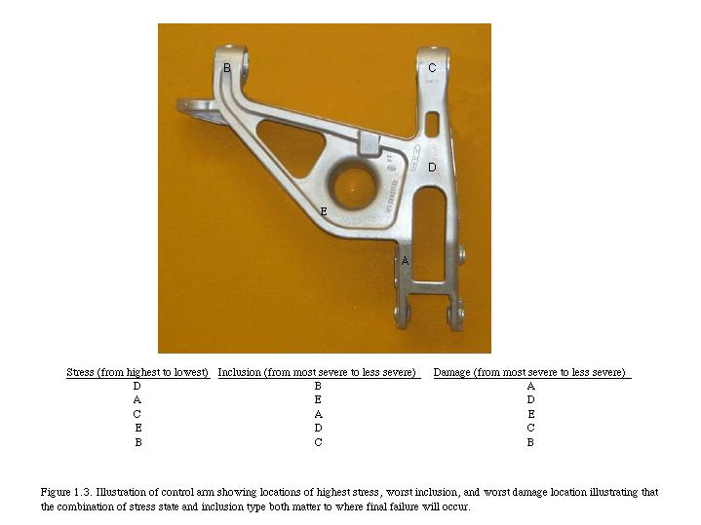

Slide 4

Bridge 11 = FEA
ISV
ISV
ISV
Bridge 10 = material model
Macroscale ISV Continuum
Macroscale ISV Continuum
Bridge 9 =
pore\ pore
interactions
Bridge 8 =
Pore \ Crack Growth
Crystal
Plasticity
(ISV + FEA)
100-500µm
Bridge 7=
Pore \ Crack Nucleation
Bridge 4 = Particle-Pore Interactions
10-100 µm
Crystal Plasticity
(ISV + FEA)
Bridge 6 =
High Rate Mechanisms
Bridge 3 = Particle Interactions
100’s Nm
µm
Crystal Plasticity
(ISV + FEA)
Bridge 5 =
Elastic Moduli
Bridge 2 = LEFM should work
Nm
Atomistics
(EAM,MEAM,MD,MS,
Bridge 1 = Interfacial Energy, Elasticity
Å
Electronics
Principles (DFT)

Slide 5
Structural Analysis
Steering Knuckle
Upper Control Arm
Experiments
FEM
Macromechanics
Atomistics
Continuum Model
Cyclic Plasticity
Damage
Experiment
Uniaxial Monotonic
Torsional Monotonic
Notch Tensile
Fatigue Crack Growth
Cyclic Plasticity
Model
Cohesive Energy
Critical Stress
Analysis
Fracture
Interface Debonding
FEM Analysis
Torsion
Compression
Tension
Monotonic/Cyclic Loads
Micromechanics
ISV Model
Void Nucleation
Mesomechanics
IVS Model
Void Growth
Void/Void Coalescence
Void/Particle Coalescence
Experiment
Fracture
Interface Debonding
ISV Model
Void Growth
Void/Crack Nucleation
Experiment
Fracture of Silicon
Growth of Holes
FEM Analysis
Idealized Geometry
Realistic Geometry
Fem Analysis
Idealized Geometry
Realistic RVE Geometry
Monotonic/Cyclic Loads
Crystal Plasticity

Slide 6
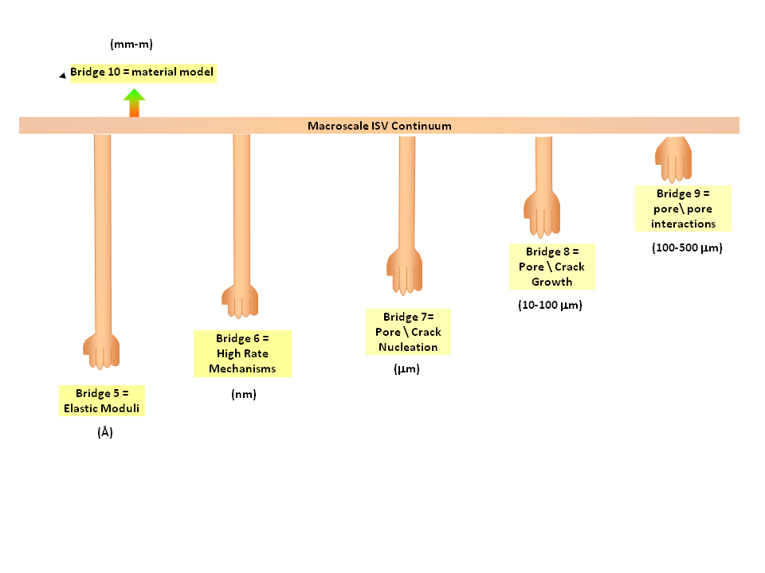

Slide 8
Evolution of Damage

Slide 9
Types of Damage

Slide 10
void impingement
void sheet mechanism
increasing
deformation

Slide 11
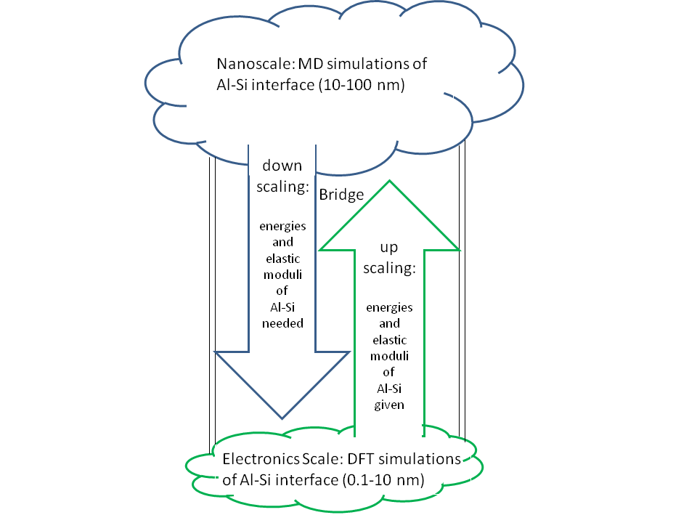

Slide 12
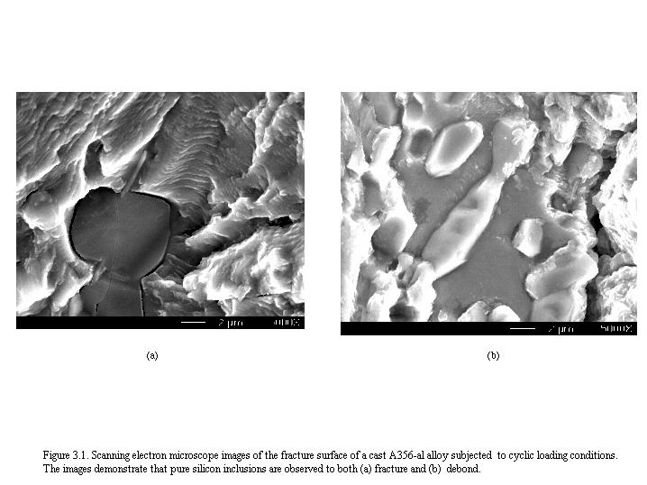

Slide 13
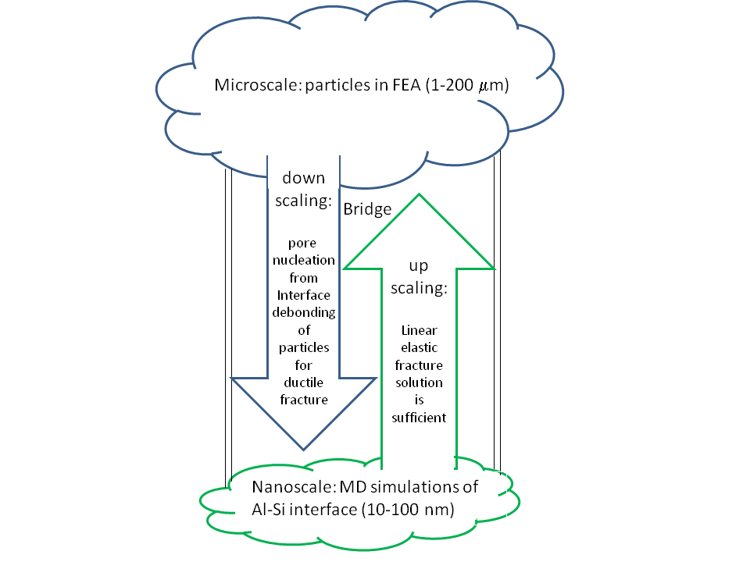

Slide 15
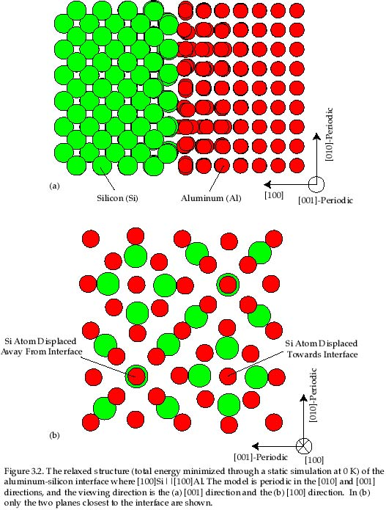

Slide 16
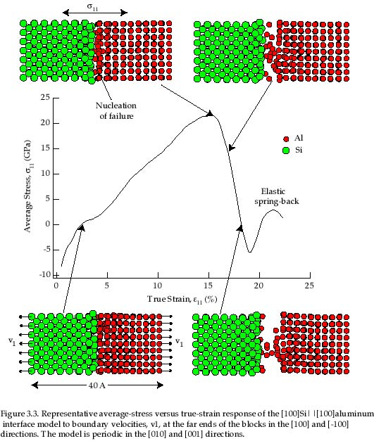

Slide 17
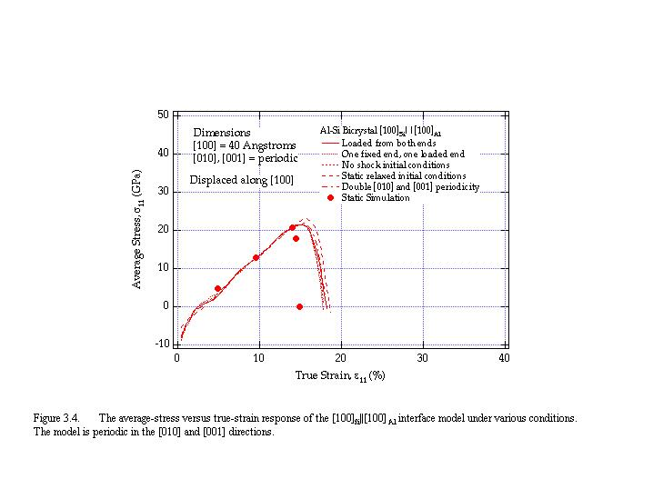

Slide 18
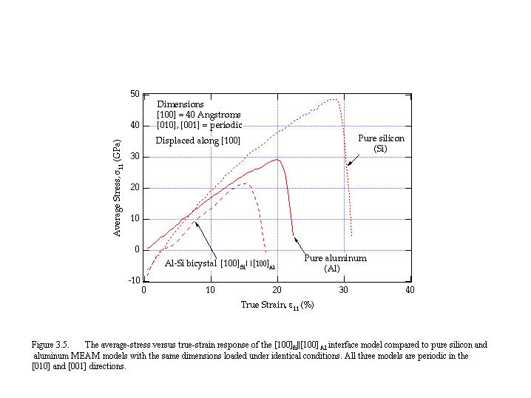

Slide 19
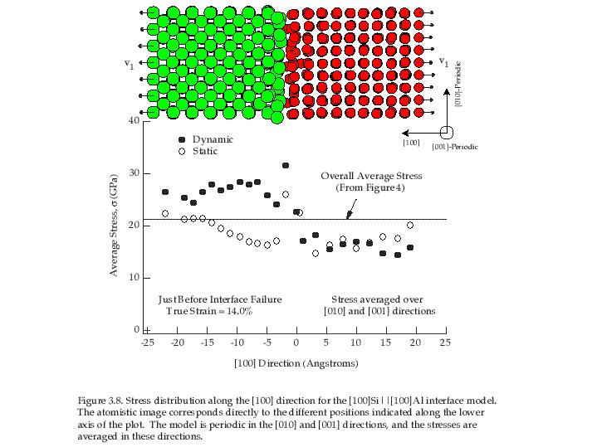

Slide 20
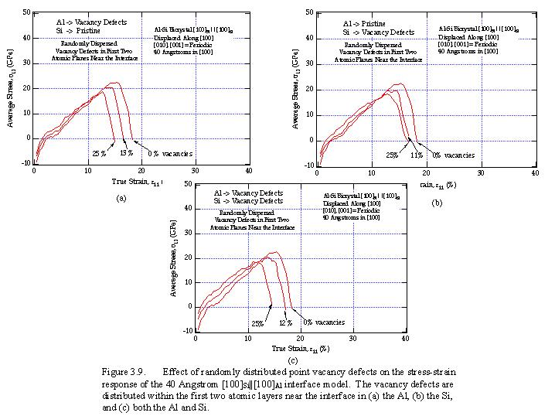

Slide 21
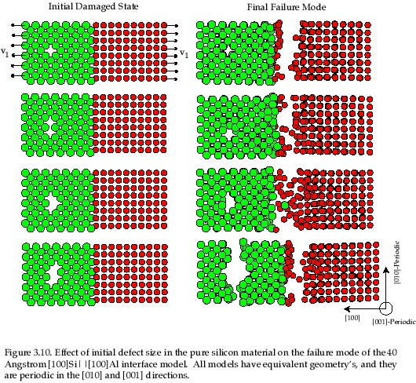

Slide 22
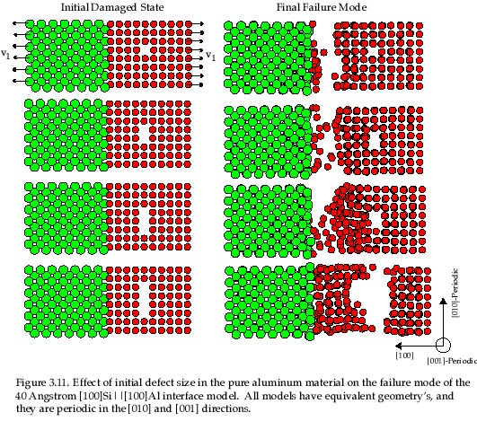

Slide 23
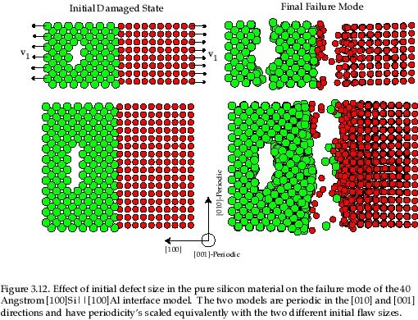

Slide 24
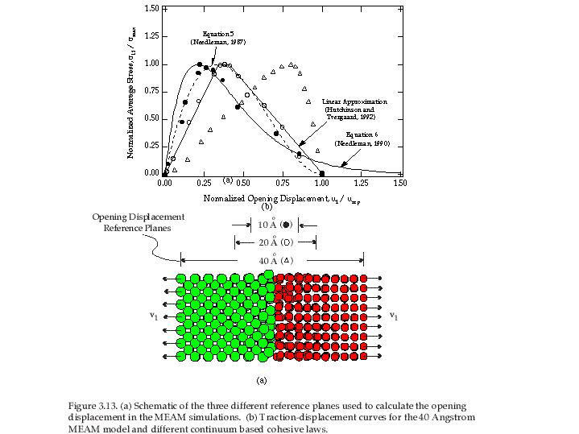

Slide 37
Macroscale Constraints:
Thermodynamics (cf, Solanki &
Bammann, 2010)
Kinematics (cf. Horstemeyer 2000)
Kinetics (from upscaling)
Macroscale:
Continuum Point (mm)
down
scaling:
pore-pore
coalescence
kinetics
for
ductile
fracture
Bridge
up
scaling:
coalescence
parametric
effects
Mesoscale Activities:
Physical admissibilities (cf, Garrison & Moody
1987; Jones & Horstemeyer, 2007)
Parameters (cf. Horstemeyer & Ramaswamy
2000)
Results (Horstemeyer et al., 2000 IJP)
Mesoscale: ANOVA FEA with multiple pores (100-500 μm)

Slide 48
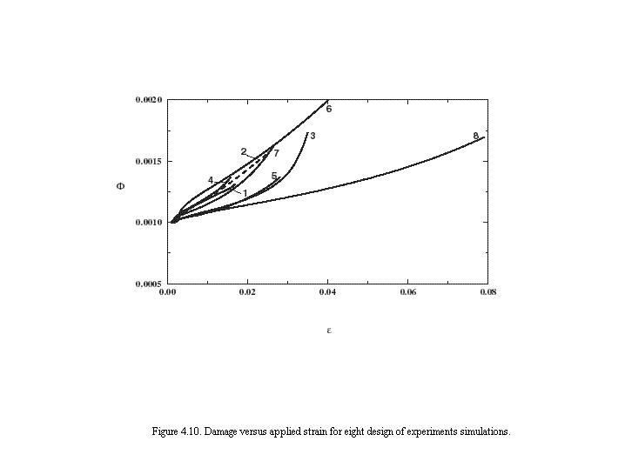

Slide 49
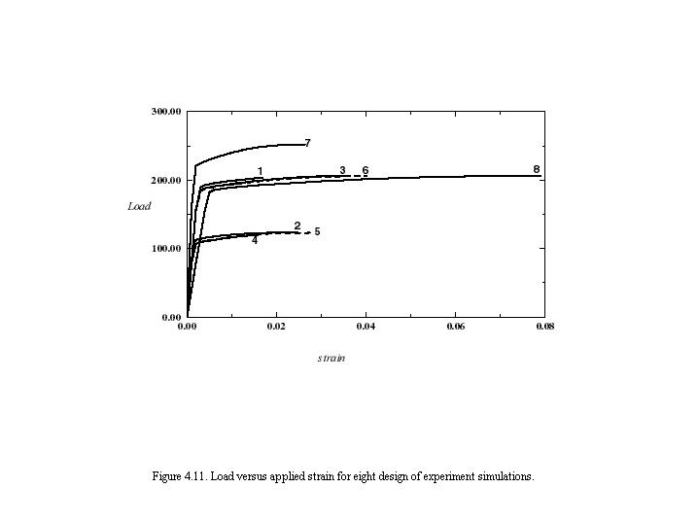

Slide 54

Void Coalescence Model (Macroscale)
Bridge mesoscale finite element simulations with macroscale microstructure-property model
Mesoscale:
Local , , &
Macroscale:
Effective , , &
Discrete Entities
Continuum
The question is: what goes into this bridge?

Slide 55
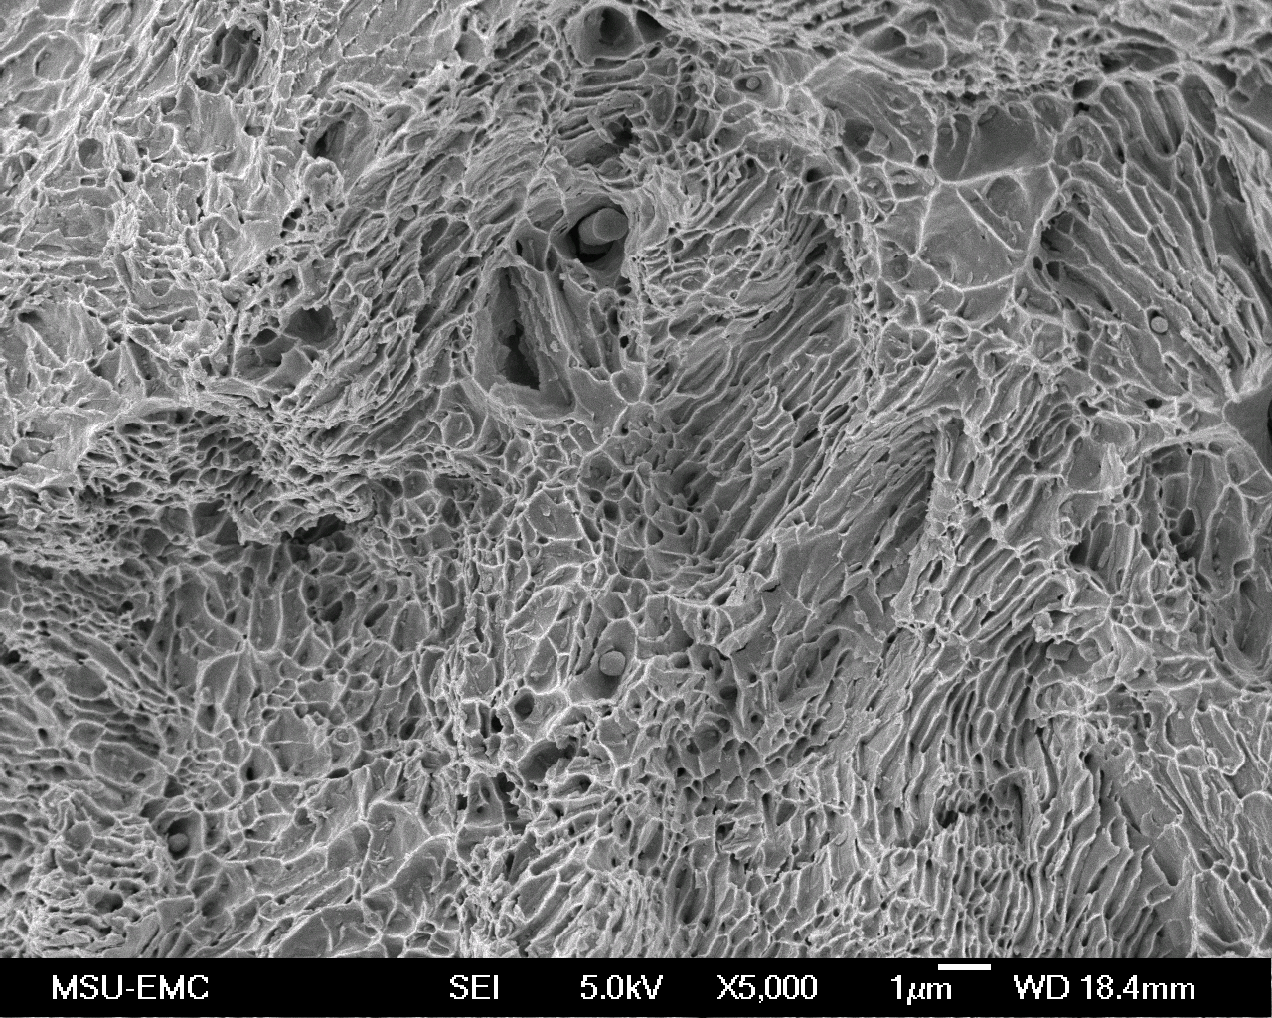
Fracture surfaces of wrought materials reveal pores have nucleated from particles, then grew and coalesced together
[Garrison and Moody, 1987 (Review Paper)]
NOTE:
particles
inside of
pores for
extruded
4140 steel
alloy

Slide 56
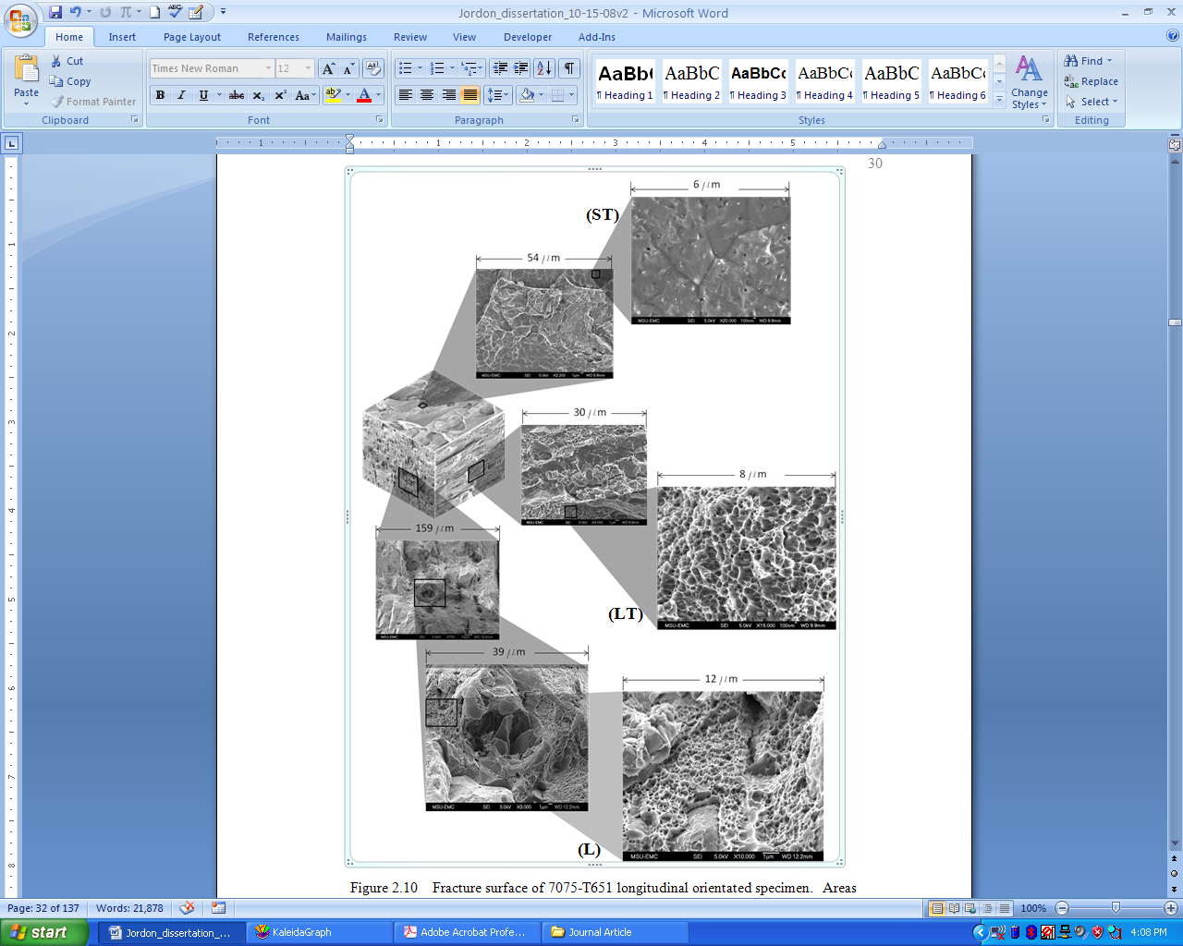
Fracture surfaces of rolled 7075 al alloy reveal pores have nucleated from particles, then grew and coalesced together in anisotropic manner
Short Transverse
direction
Longitudinal
(rolling )
direction
Long
Transverse
direction
Note: two levels
of particles

Slide 58
Fracture surface of a cast A356 Al alloy reveals that pores arising from the casting process and pores from particles in eutectic region grow and coalesce together
[Gall et al., 2000]

Slide 59
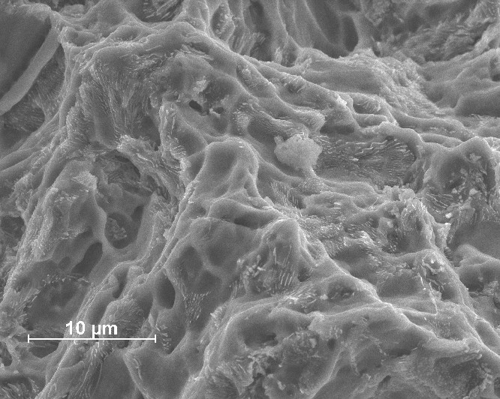
Fracture surface of a cast AE44 Mg alloy reveals that pores arising from the casting process grow and coalesce together
[unpublished data]

Slide 60
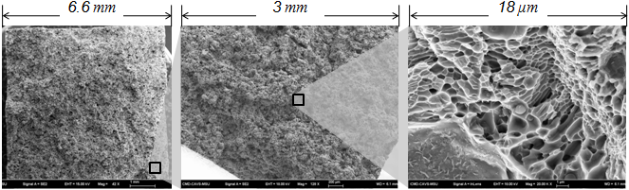
Fracture surfaces of powder metals reveal that pores arising from the compaction process grow and coalesce together
[Allison, 2010 (PhD thesis)]
FC0205 Steel Alloy

Slide 61
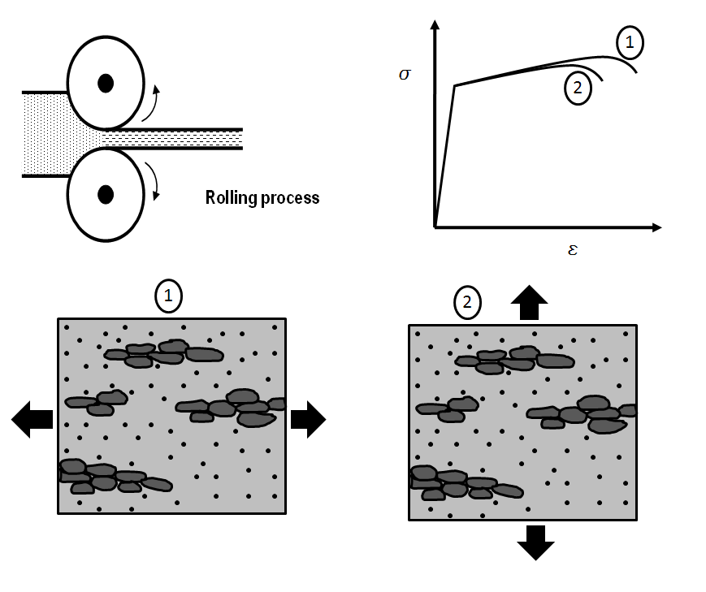
Definitions of the Coalescence Initiation
Classical Mechanics Definition: coalescence
occurs at the end of the ductility regime
Classical Materials Science Definition: coalescence
occurs when the voids touch each other (impinge)
Horstemeyer Definition: when a void is close enough to another void to affect its stress or strain fields so as to modify the single void growth solution
coalescence
starts
(Gurson, Needleman, Chaboche, etc.)
(Embury, Garrison, Moody, etc.)
voids
which can lead to
coalescence
starts
stress/strain
fields

Slide 62
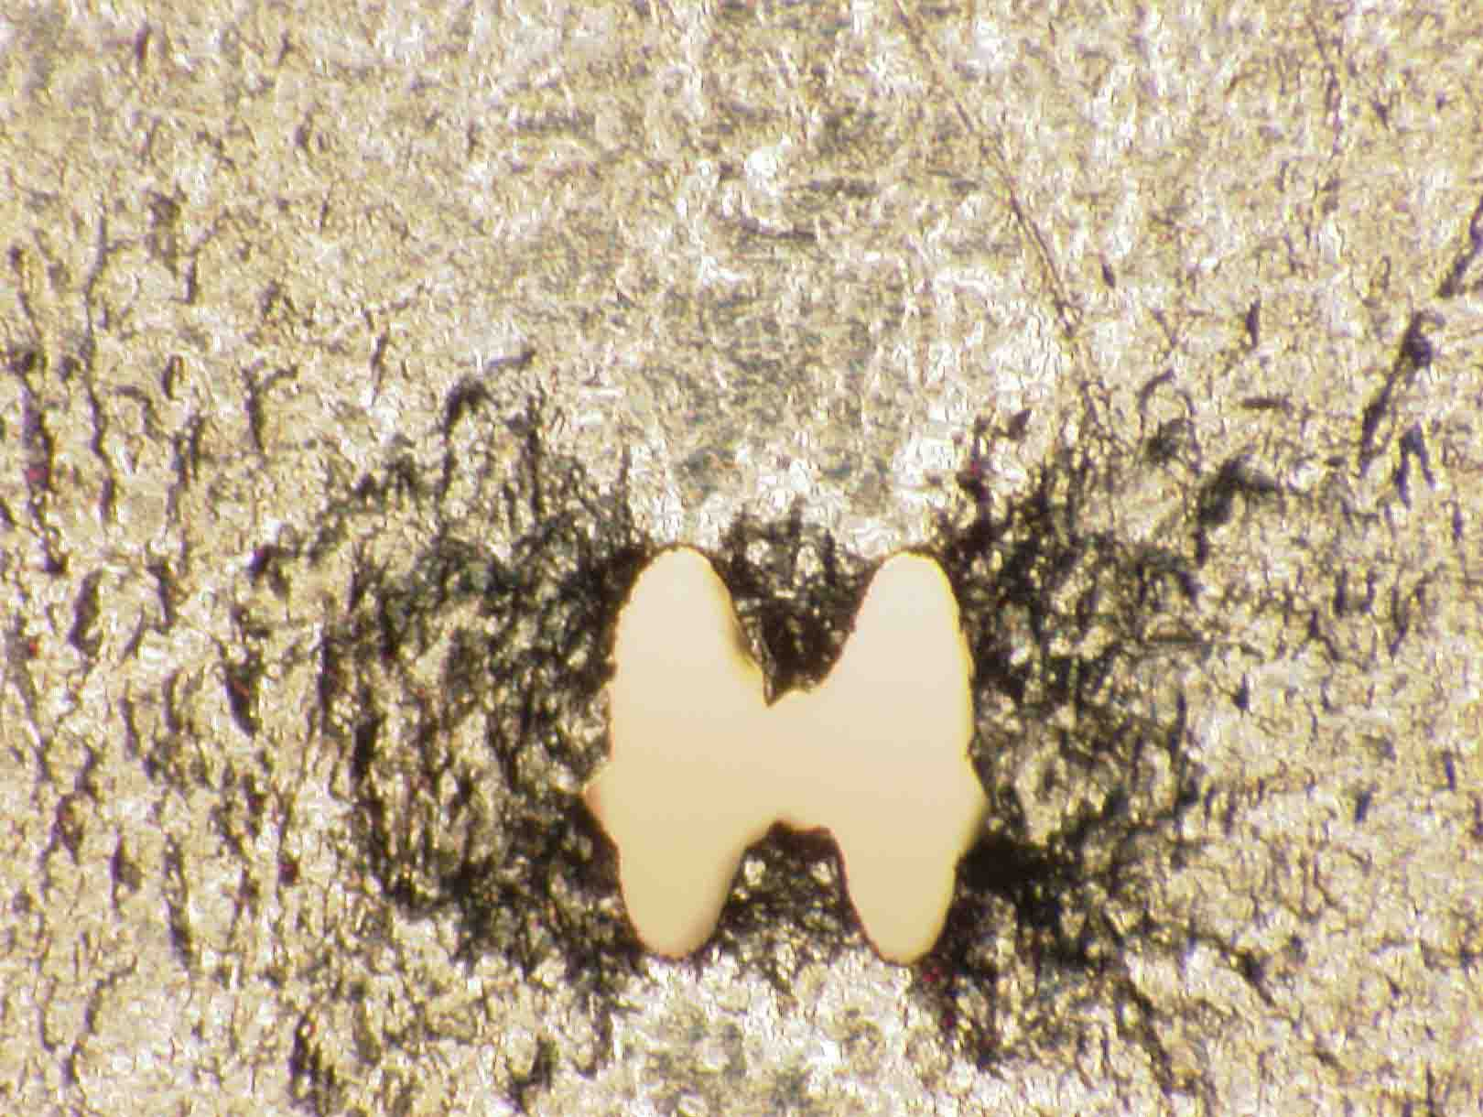
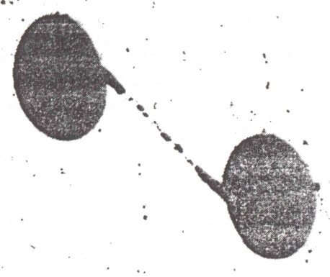
Description of Void Coalescence
Coalescence Mechanisms
Two voids within a critical distance experience an increase in stress and plastic deformation in the ligament between the voids, increasing the growth of both voids.
Coalescence is considered to be a process beginning when there is a deviation in growth from that of a single isolated void, and completing when the voids have physically joined.
Increasing
Deformation
Void Impingement
Void Sheeting

Slide 63
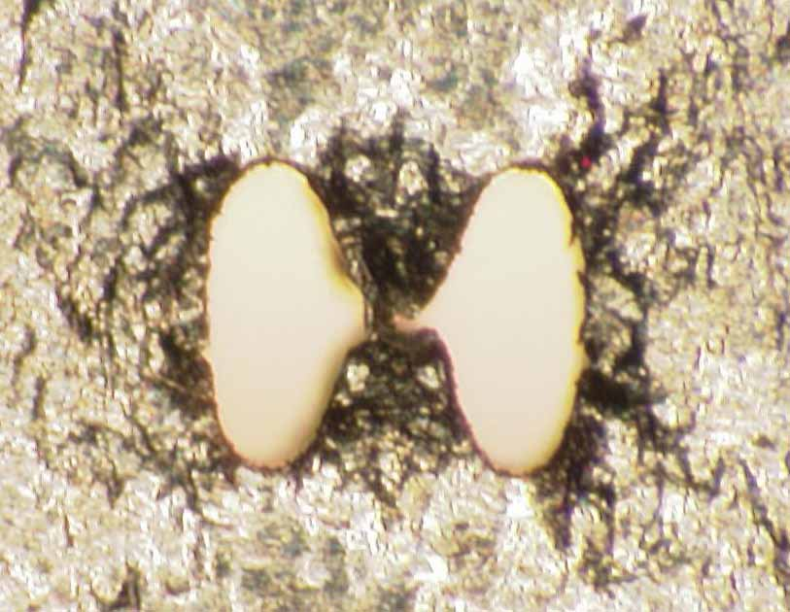
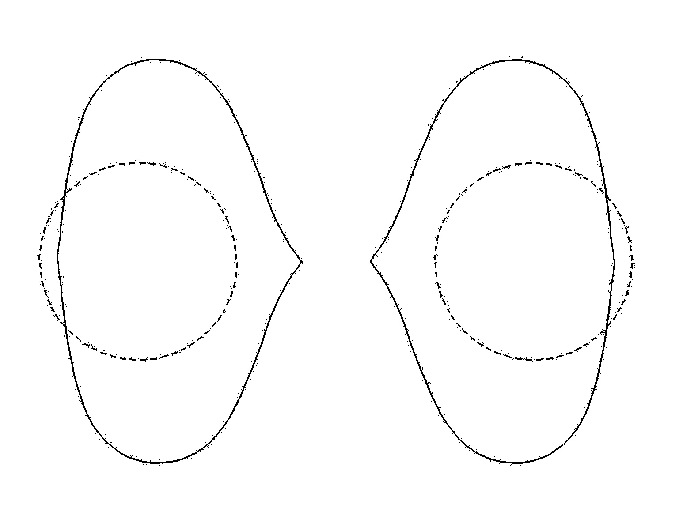
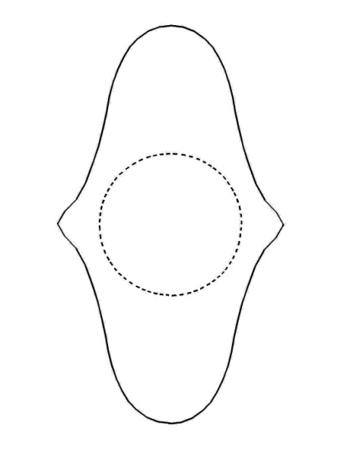
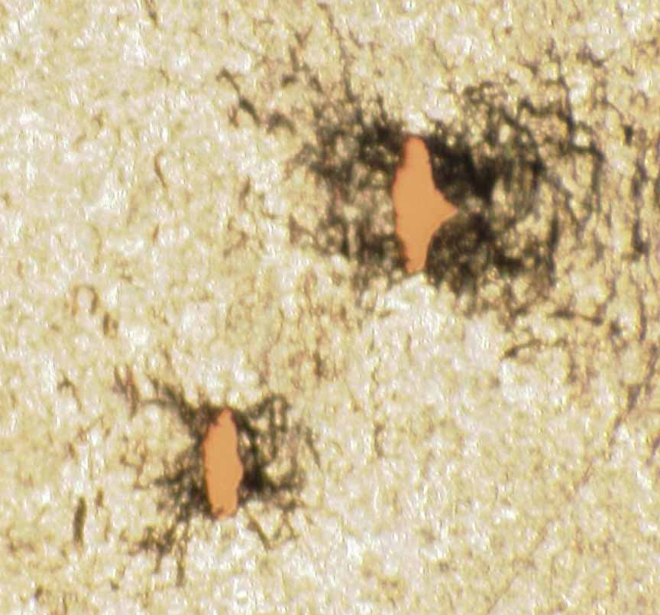
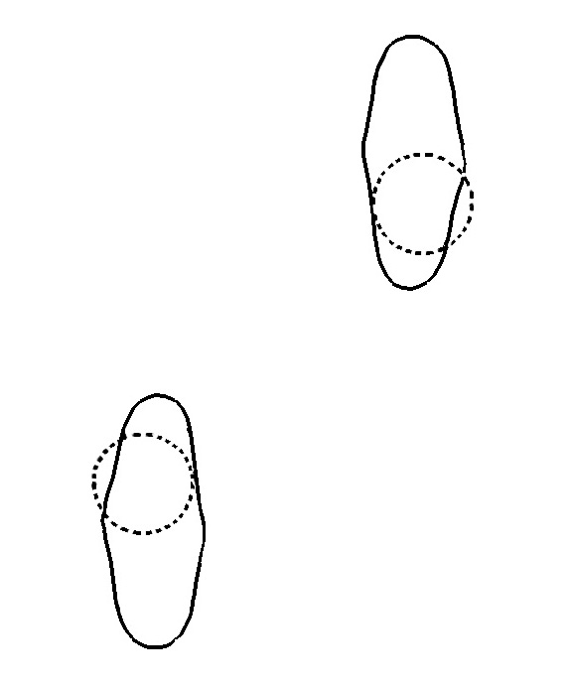
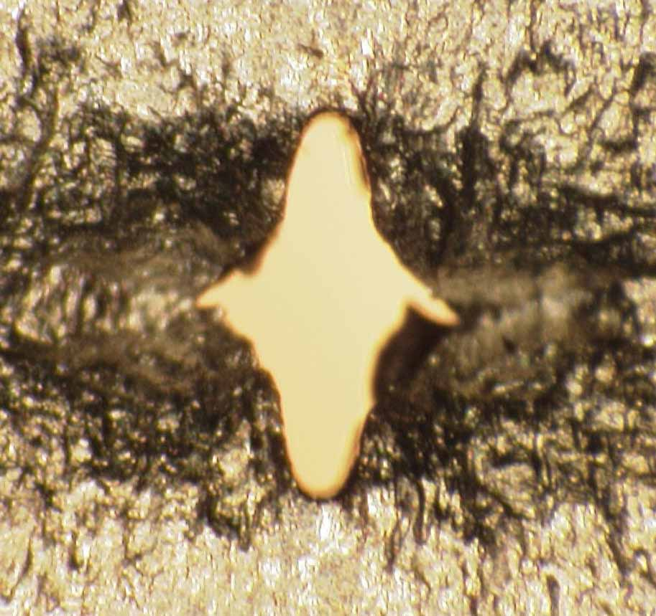
Nickel Cylindrical Void Results

Slide 64
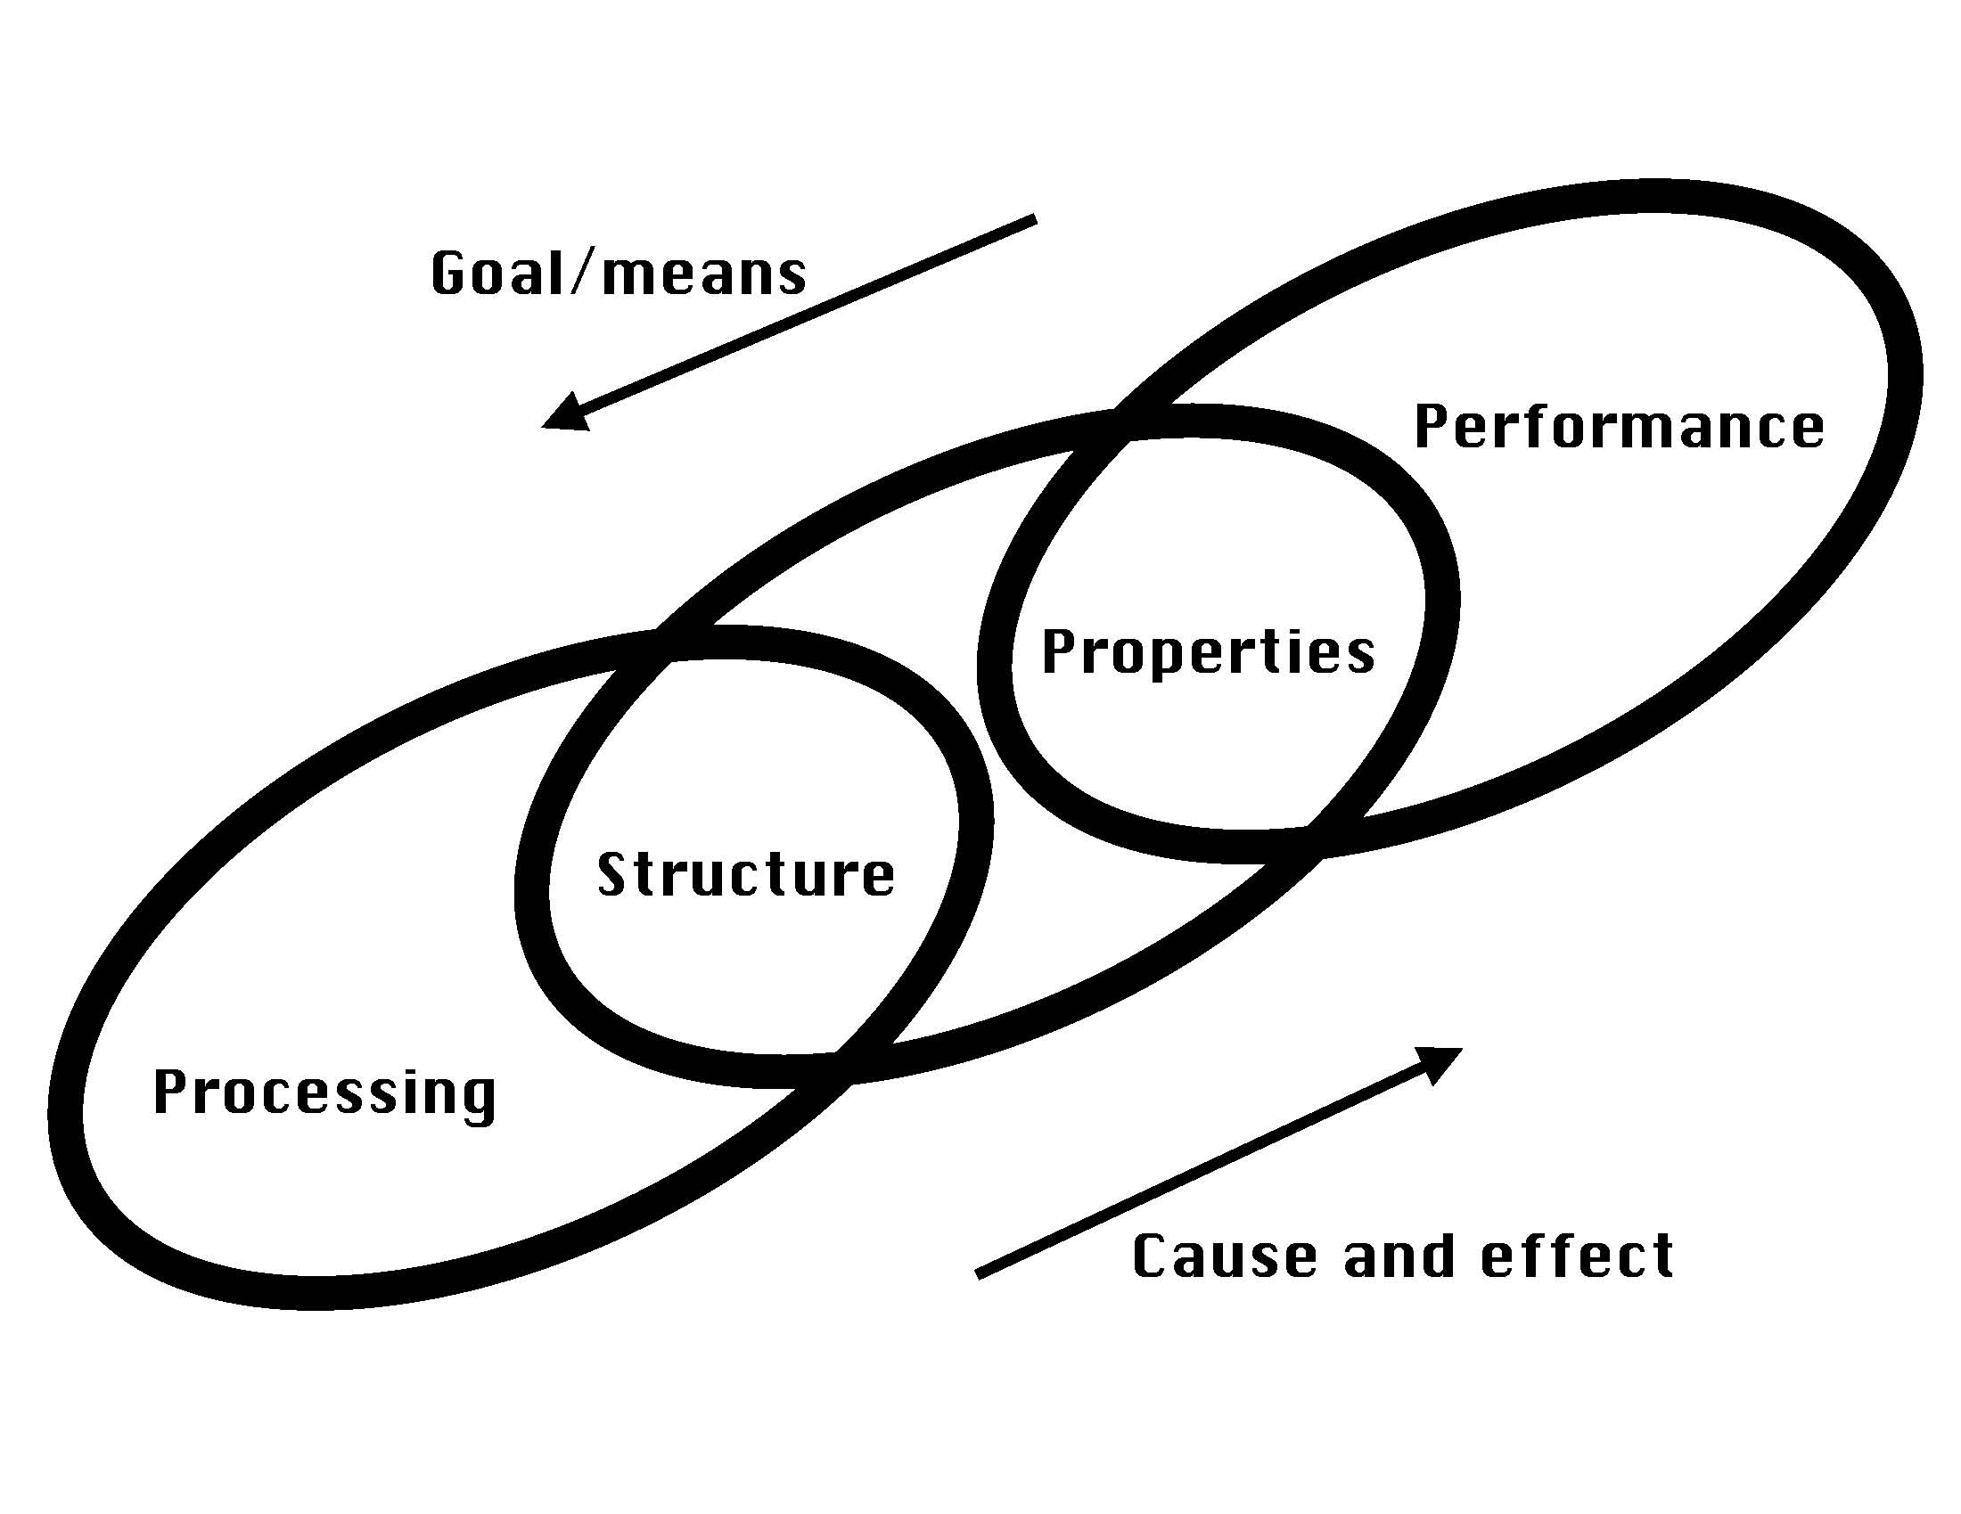
[Olson, 2000]

Slide 65
Relationship of Manufacturing Process, Defect, and Ductile Fracture Mechanisms
Rolling/Extrusion/Forging/Stamping
Particles
Pore
nucleation
Manufacturing process
Defect type
Dominant damage mechanism
under monotonic loads
Casting
Particles Porosity
Pore Pore growth
nucleation +coalescence
+growth
Powder metal compaction/sintering
Porosity
Pore
coalescence
Defect size (m)
10⁻⁷
10⁻⁶
10⁻⁵
10⁻⁴
10⁻³
Ductile
fracture
Defect volume
fraction
10⁻⁵
10⁻⁴
10⁻³
10⁻²
10⁻¹
10⁻⁰

Slide 66
What appears to be information that should be passed on a bridge between length scales may not be important!

Slide 67
Recall that A356 al alloy exhibited both second phase
particle fracture and particle debonding
Second phase particle fracture
Second phase particle debonding

Slide 68
Mesomechanical finite element simulations employed real
microstructural mappings for the mesh
Void number densities were
measured to quantify the
void nucleation rate

Slide 69
Mesomechanical finite element simulations show that coalescence can be quantified and the damage level for fracture (and as a function of temperature)
Known
Unknown
φ=ηvc
(porosity, void volume
fraction, or damage) is
determined from the
simulations
c is coalescence that
needs to be determined
from these simulations
(void nucleation) is
known from experiments
v is a single void
growth model
Damage, φ, at fracture

Slide 70
The damage level is essentially the same in the continuum
RVE although the local processes of void nucleation and
hence amount of void growth and coalescence are different
damage

Slide 71
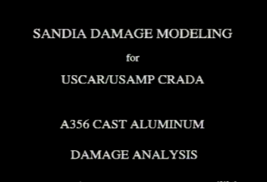

Slide 72
The damage level is essentially the same in the continuum
RVE although the local processes of void nucleation and
hence amount of void growth and coalescence are different
damage

Slide 73
Mesomechanical Simulations Show a Damage Level Increase at Fracture for Increasing Temperatures
Indicates a temperature dependence for macroscale coalescence and percolation limit!

Slide 74
Stress state also affects the void coalescence and percolation limit
 | % porosity at failure | % strain at failure
Uniaxial (χ=0.33, T=294K) | 7.8 | 14.0
Biaxial (χ=0.66, T=294K) | 59.0 | 13.5
Uniaxial (χ=0.33, T=400K) | 12.1 | 22.1
Biaxial (χ=0.66, T=400K) | 58.9 | 15.0
χ=stress triaxiality= σ_{H}/σ_{vm}
Indicates a triaxiality
dependence for
macroscale coalescence
and percolation limit!
uniaxial loading
biaxial loading

Slide 77
Sometimes the information that should be passed on a bridge between length scales may be a surprise!

Slide 78
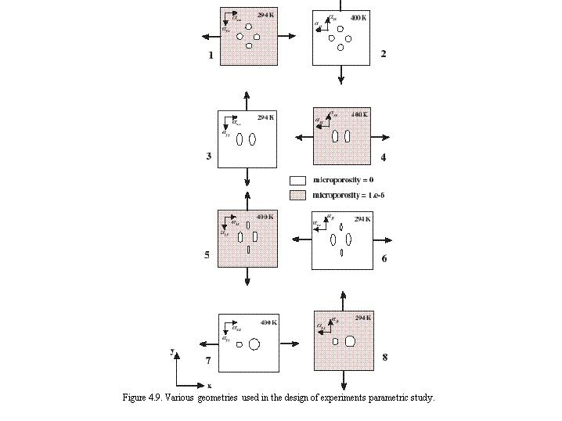
Various Geometries and Conditions to Study Void-Void Coalescence (Horstemeyer and Ramaswamy, 2000)
Parameters
Void size
Intervoid ligament (IVL) distance
Void shape
Prestrain history (residual stresses)
Temperature
Loading direction
Microporosity included at smaller length scale

Slide 79
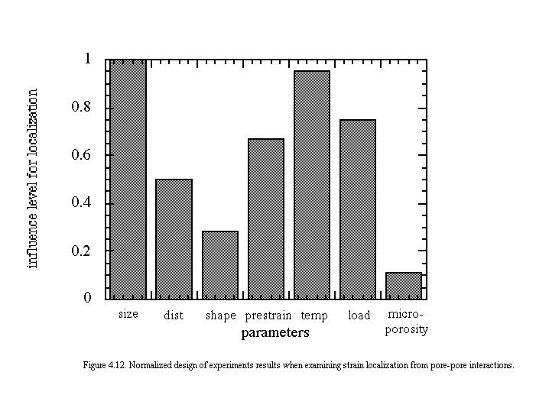
Design of Experiments (DOE) results for strain localization related to void sheet mechanism
[Horstemeyer and Ramaswamy, 2000]
Note importance of void size and temperature as the first order parameters

Slide 80
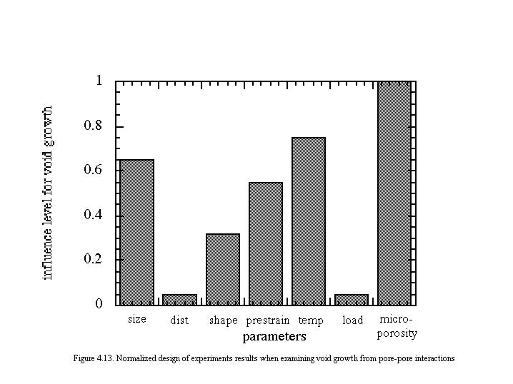
Design of Experiments (DOE) results for
void impingement coalescence
[Horstemeyer and Ramaswamy, 2000]
Note the first order response of microporosity meaning two levels of porosity influenced the void coalescence the greatest; temperature was near first order as well.

Slide 81
Single void
Two voids
Two voids

Slide 83
Void volume fraction normalized by the initial void volume fraction versus strain illustrating the two void material will experience greater void growth than the one void case given the same initial void volume fractions.
Horstemeyer et al., 2000 (IJP)

Slide 85
Temperature Dependence on Coalescence
One void growing, v,
shows minimal temp
dependence
As voids are near each
other and the temp
increases, damage
increases because c
increases
Horstemeyer et al., 2000 (IJP)

Slide 88
Effective plastic strain contours at the same snapshot in time illustrate the increase in plastic deformation
as the temperature increases. This increase in plastic deformation enhances void growth.
294K
600K

Slide 89
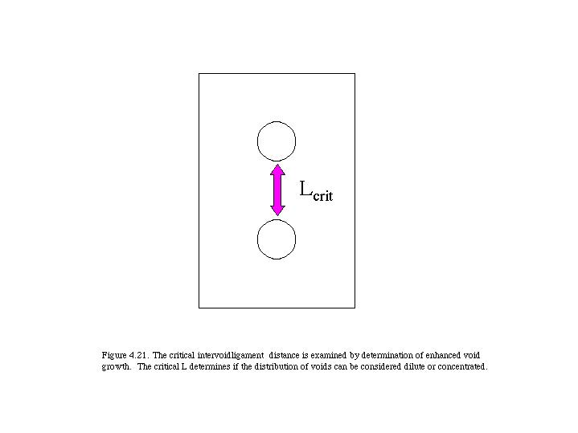

Slide 94
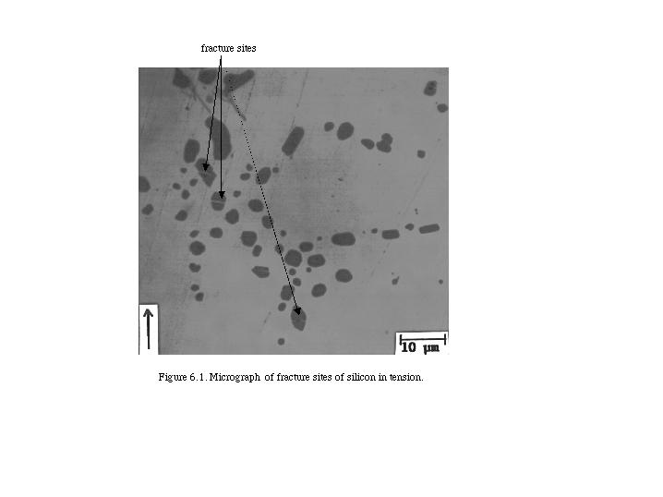

Slide 95
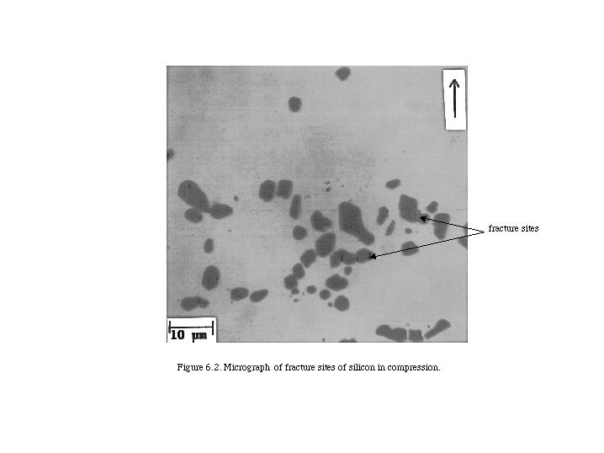

Slide 96
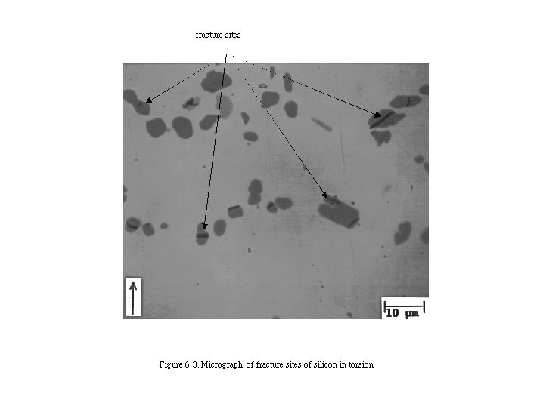

Slide 97
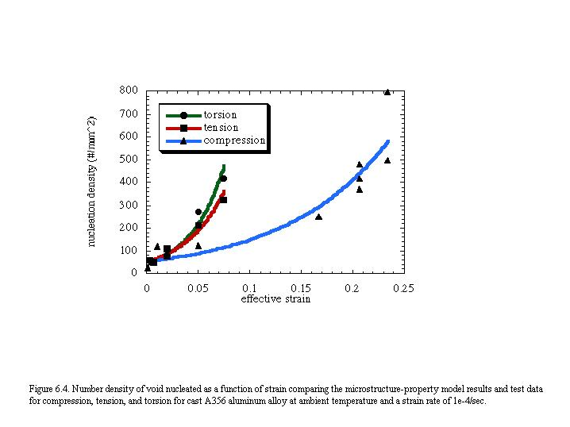

Slide 105
initially homogeneous porosity
distribution φ=0.0001
initially homogeneous porosity
distribution φ=0.001
initially random porosity
distribution φ=0.0001
initially random porosity
distribution φ=0.001

Slide 106
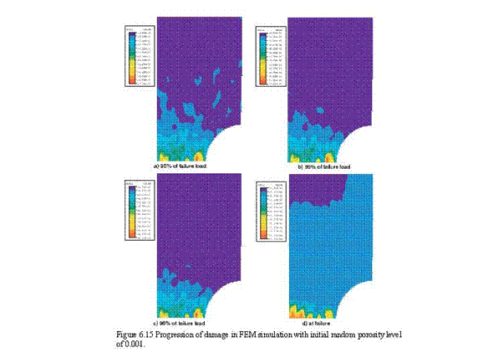
a) 50% of failure load
b) 90% of failure load
c) 96% of failure load
d) at failure

Slide 107
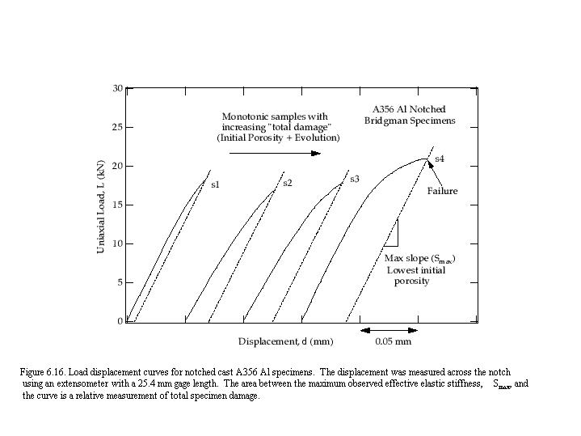

Slide 108
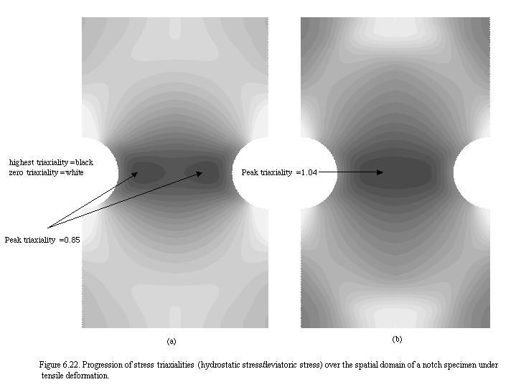

Slide 109
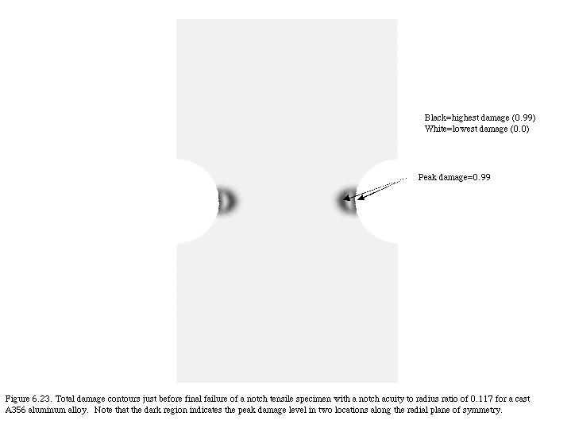

Slide 110
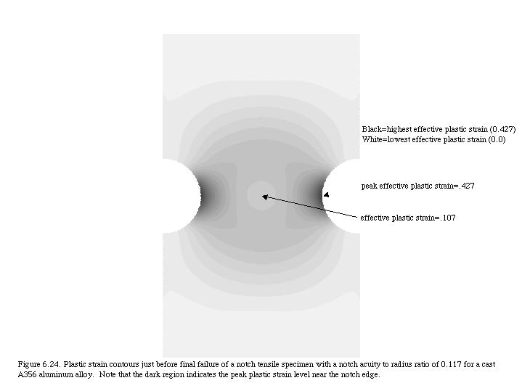

Slide 111
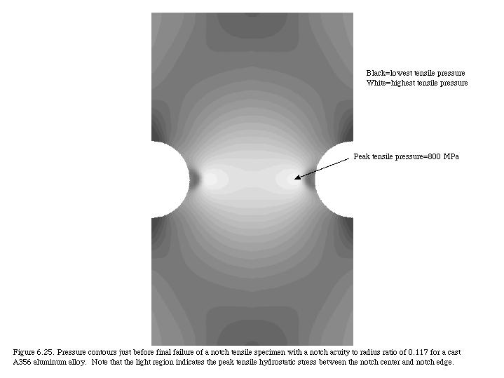

Slide 112
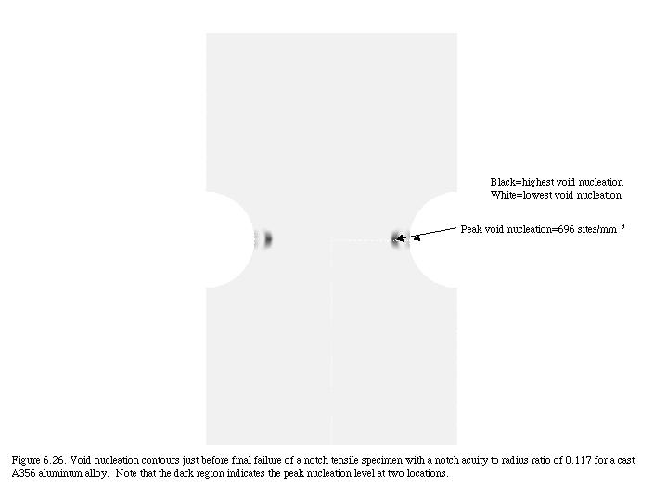

Slide 113
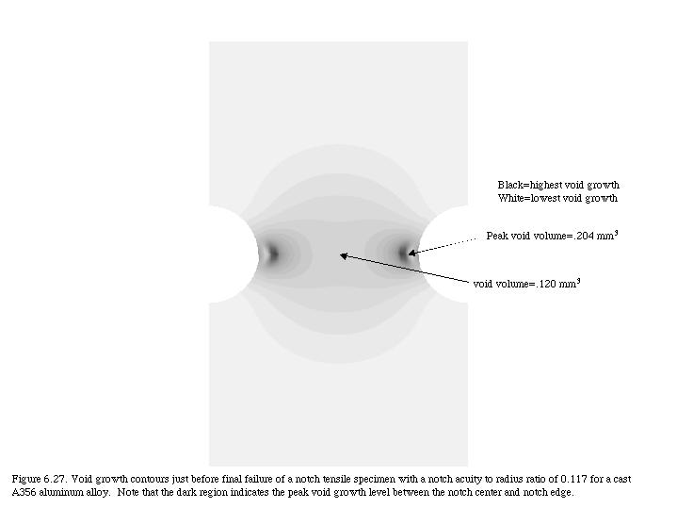

Slide 115
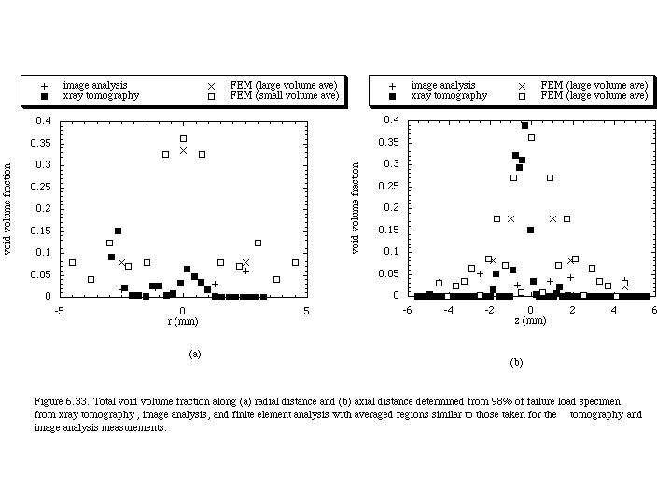

Slide 118
Void Coalescence Model (Macroscale Local Form)
Bridge mesoscale finite element simulations with macroscale microstructure-property model
Coalescence and damage equations in microstructure-property model
  Damage Eqn:
  Coalescence Eqn 1:
  Coalescence Eqn 2:
Mesoscale:
Local , , &
Macroscale:
Effective , , &
Discrete Entities
Continuum
NND
[Horstemeyer et al., 2000]
[Allison &
Horstemeyer, 2010]

Slide 119
Void Coalescence Model (Macroscale Nonlocal Form)
Coalescence and damage equations in microstructure-property model
  Damage Eqn:
  Coalescence Eqn 3:
where
.
.
d
IVL
where
IVL=NND-d
d=(6v/π)^{1/3}
NND
Comments:
(1) note time rate of change of IVL’s
(2) they can be measured by experiments
(3) they are length scale parameters

Slide 120
Macroscale ISV Constitutive Equations
Bridge 8 =
Pore \ Crack Growth & Coalescence
Mesoscale Crystal Plasticity
(FEA)
Bridge 4 = Particle-Pore Interactions
10-100 µm
Mesoscale FEA Simulations
Bridge 3 = Particle Interactions
Microscale Crystal Plasticity
(ISV + FEA)

Slide 121
Macroscale ISV Constitutive Equations
Bridge 9 = pore\ pore
Coalescence Interactions
Crystal Plasticity
(FEA)
100-500 µm
Bridge 4 = Particle-Pore Coalescence Interactions
Mesoscale FEA
Simulations

Slide 122
failure sites
(a)
first damage initiation site
(b)
Comparison of (a) experiment and (b) microstructure-property model failure prediction (damage=SDV14)
for weapons carrier analysis.

Slide 126
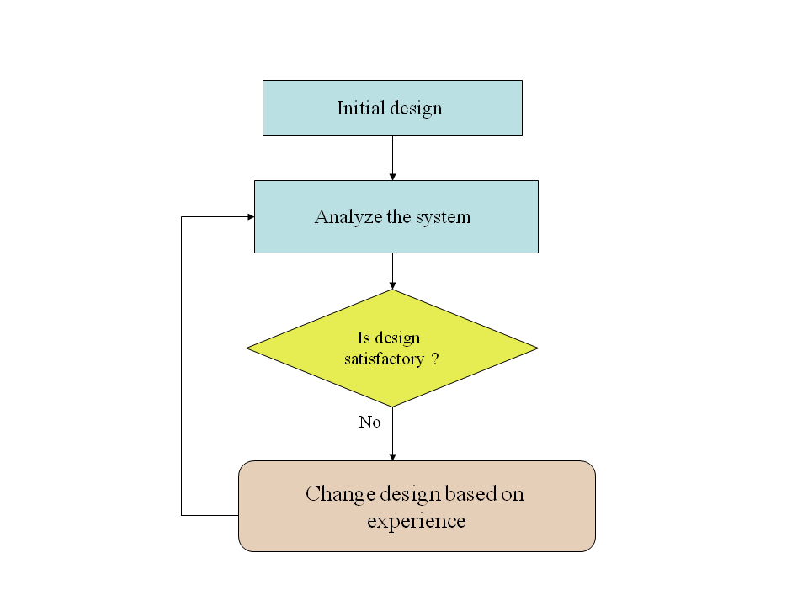

Slide 127


Slide 130

(a)
initial failure site
(b)
Comparison of microstructure-property model failure prediction (damage=SDV14) with experiment for
Control Arm 2. The worst case microstructure/inclusion content was assumed in the calculation.

Slide 131


Slide 132


Slide 134


Y₈
Y₈
Y₁₃
Y₄
Y₁₂
Y₁₁
Y₁
Y₃
Y₄
Y₉
Y₅
Y₆
Y₂
Y₇
Y₁₀

Slide 135
Establish initial set of DOE points
Start: Define design variables
Finish: Evaluate results
Morph FE mesh using GENESIS
Perform FE simulations using ABAQUS
Solve the deterministic optimization problem
Yes
Metamodels
accurate?
No
Extract responses of interest (e.g., damage, weight)
Keep reasonable designs & transform responses
Generate a Metamodel for each response
Add more DOE points

Slide 136


Slide 137
Under USCAR/USAMP Lightweight Metals CRADA,
Control Arm was optimized
Sandia model was used to optimize a redesign:
25% weight saved
50% increase in load-bearing capacity
100% increase in fatigue life
$2 less per part.

Slide 138


GM CADILLAC CONTROL
ARM LIGHTWEIGHT DESIGN
Objective: To employ multiscale material modeling
to reduce the weight of components
B
C
D
E
A
Stress
(from highest
to lowest)
D
A
C
E
B
Inclusion
(from most severe
to less severe)
B
E
A
D
C
Damage
(from most severe
to less severe)
A
D
E
C
B
model
Region 1
Region 3
(a)
initial failure site
Result: To optimize a redesign such that
25% weight saved
50% increase in load-bearing capacity
100% increase in fatigue life
$2 less per part
(b)
experiment

Slide 140
Relationship of Manufacturing Process, Defect, and Ductile Fracture Mechanisms
Rolling/Extrusion/Forging/Stamping
Particles
Pore
nucleation
Manufacturing process
Defect type
Dominant damage mechanism
under monotonic loads
Casting
Particles Porosity
Pore Pore growth
nucleation +coalescence
+growth
Powder metal compaction/sintering
Porosity
Pore
coalescence
Defect size (m)
10⁻⁷
10⁻⁶
10⁻⁵
10⁻⁴
10⁻³
Ductile
fracture
Defect volume
fraction
10⁻⁵
10⁻⁴
10⁻³
10⁻²
10⁻¹
10⁻⁰

Slide 141
Void Coalescence Summary
Void coalescence as defined by Horstemeyer (difference when two or more voids are interacting as opposed to a single void) is physically motivated and can be quantified by experiments.
Void coalescence effects are dependent upon the materials processing because of the microstructural state.
The multiscale modeling approach has revealed the important and non-important features of the bridge to the macroscale model
Higher order mathematical forms of coalescence have yet to be realized although the physical arguments have been rationalized

Slide 143
Y₈
Y₈
Y₁₃
Y₄
Y₁₂
Y₁₁
Y₁
Y₃
Y₄
Y₉
Y₅
Y₆
Y₂
Y₇
Y₁₀
Figure 7.94. Description of shape design variables.

Slide 144
Establish initial set of DOE points
Start: Define design variables
Finish: Evaluate results
Morph FE mesh using GENESIS
Perform FE simulations using ABAQUS
Solve the deterministic optimization problem
Yes
Metamodels
accurate?
No
Extract responses of interest (e.g., damage, weight)
Keep reasonable designs & transform responses
Generate a Metamodel for each response
Add more DOE points
Figure 7.95. Flowchart for deterministic optimization.

Slide 145



(a)
(b)
(c)
Figure 7.98. Comparison of (a) baseline and optimal designs using (b) multiscale and (c) plasticity models.

Slide 146
ISV Microstructure-Property Model Equations (2000 version)
Damage
Dislocation-plasticity internal state variables
Dimensionless grain size
Damage internal state variables
Grain size
Particle size
Damage rate
Particle Volume fraction
Nearest neighbor distance
Dimensionless grain size

