Slide 1
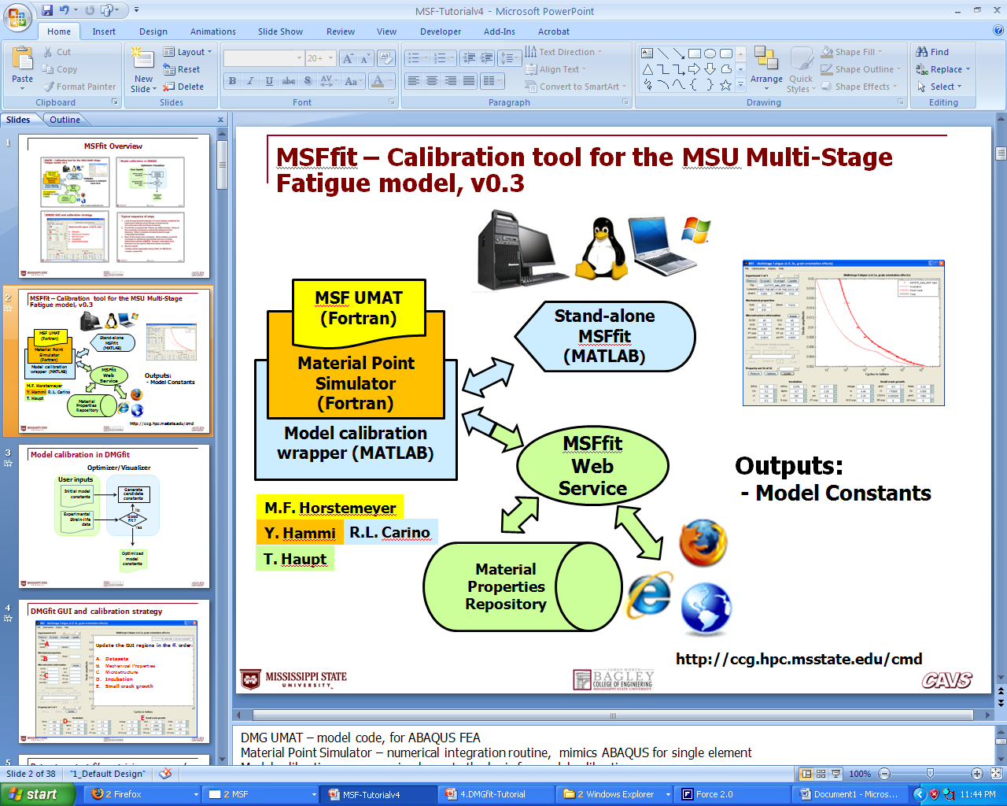
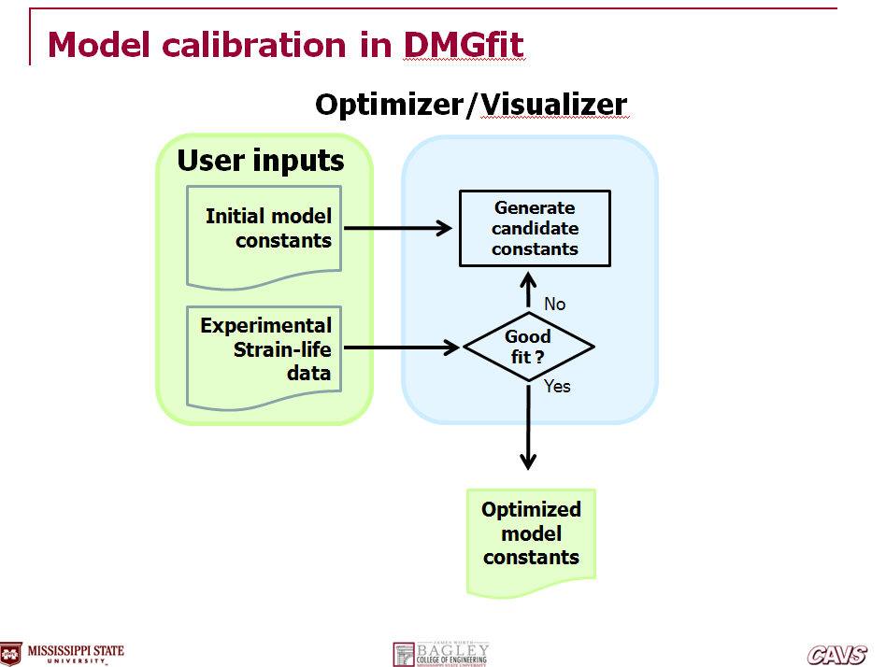
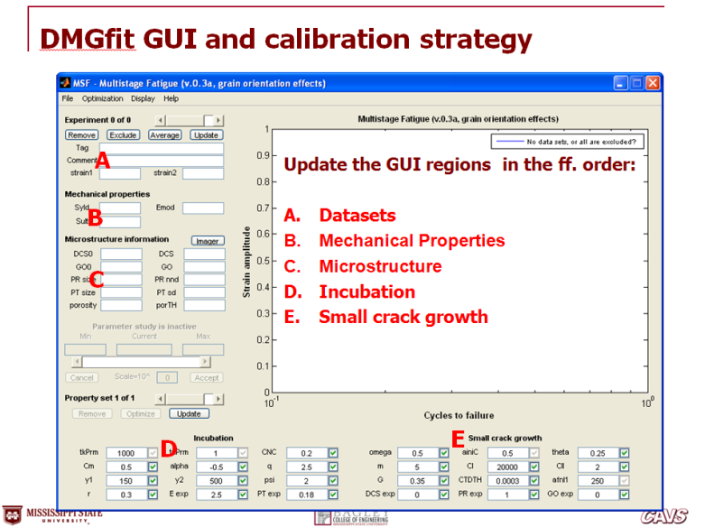
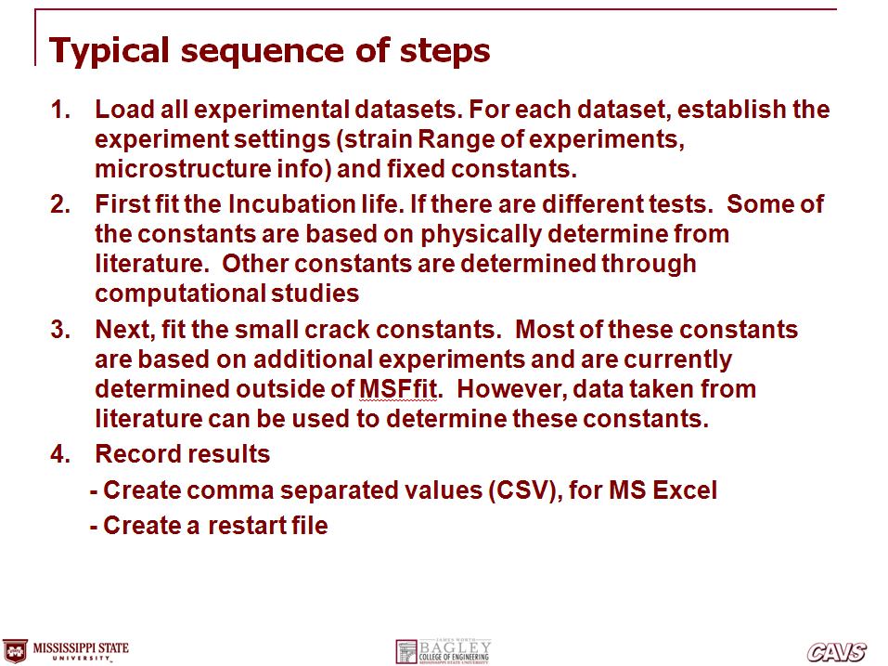
MSFfit Overview
Notes:
In this presentation:
The relationship between the plasticity-damage model (DMG), and the model calibration tool (DMGfit)
Implementations of DMGfit: for users on stand-alone PCs, or for Web-based users
The overall model calibration strategy
The calibration process specific to the DMG
The mapping of the calibration process to the DMGfit GUI
Labor saving features in the GUI, requested by MSU researchers
DMGfit demo

Slide 2




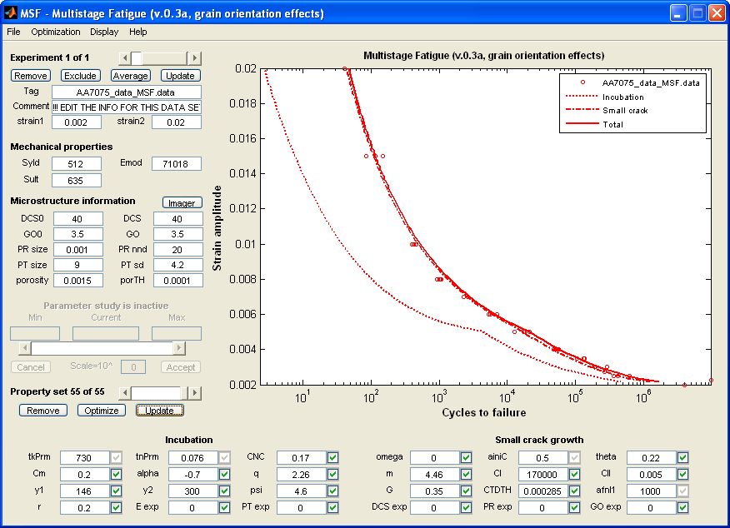



MSFfit – Calibration tool for the MSU Multi-Stage Fatigue model, v0.3
MSF UMAT
(Fortran)
Material Point
Simulator (Fortran)
Stand-alone
MSFfit (MATLAB)
Model calibration wrapper (MATLAB)
MSFfit Web
Service
Outputs:
- Model Constants
M.F. Horstemeyer
Y. Hammi
R.L. Carino
T. Haupt
Material Properties Repository
http://ccg.hpc.msstate.edu/cmd
Notes:
DMG UMAT – model code, for ABAQUS FEA
Material Point Simulator – numerical integration routine, mimics ABAQUS for single element
Model calibration wrapper – implements the logic for model calibration
Stand-alone DMGfit – for users on Windows/Linux desktops/laptops that may not have a network connection
DMGfit web service – for users on the WWW
Material Properties Repository – a component of the CAVS-CMD CyberInfrastructure which stores experimental data, models, and model calibration tools

Slide 3
Model calibration in MSFfit
Optimizer/Visualizer
User inputs
Initial model constants
Generate candidate constants
No
Experimental
Strain-life data
Good
fit ?
Yes
Optimized
model constants

Slide 4
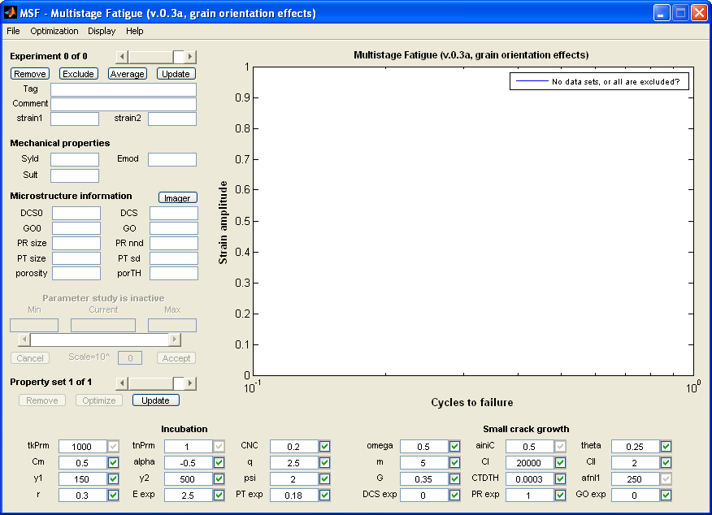
MSFfit GUI and calibration strategy
A
Update the GUI regions in the ff. order:
Datasets
Mechanical Properties
Microstructure
Incubation
Small crack growth
B
C
D
E

Slide 5
Dataset – a text file containing name= value
fname= AA7075_data_MSF.data
excluded= 0
material= AA7075
comment= !!! EDIT THE INFO FOR THIS DATA SET !!!
strain1= 0.002
strain2= 0.02
Syld= 512
Emod= 71018
Sult= 635
DCS0= 40
DCS= 40
GO0= 3.5
GO= 3.5
poresize= 0.001
porennd= 20
partsize= 9
partdev= 4.2
porosity= 0.0015
porTH= 0.0001
(continuation)
# Experimental data
strain_amp, Nf=
0.002 4e+006
0.00225 9.70617e+006
0.0025 369280
0.0025 418700
0.0025 425100
0.0025 627594
0.00275 267145
0.003 192665
0.003 196144
0.003 289229
0.0035 105964
0.0035 132830
0.0035 136256
0.004 47500
0.004 47700
0.004 51094
0.004 52699
0.004 55600
0.004 56627
0.004 56627
(continuation)
0.005 12675
0.005 17659
0.005 17664
0.005 17931
0.005 21444
0.006 5380
0.006 5631
0.006 7169
0.007 2311
0.007 2607
0.007 2634
0.008 923
0.008 1014
0.008 1043
0.008 1084
0.01 399
0.01 429
0.01 466
0.015 84
0.015 116
0.015 150
0.02 41

Slide 6
Typical sequence of steps
Load all experimental datasets. For each dataset, establish the experiment settings (strain Range of experiments, microstructure info) and fixed constants.
First fit the Incubation life. Some of the constants are based on physically determine constant from literature. Other constants are determined through computational studies.
Next, fit the small crack constants. Again, some of these constants are based on additional experiments and are currently determined outside of MSFfit. However, data taken from literature can be used to determine these constants.
Record results
  - Create comma separated values
  - Create a restart file

Slide 7
Step 1
Load all experimental datasets. For each dataset, establish the experiment settings (strain range of experiments, microstructure info) and fixed constants.

Slide 8
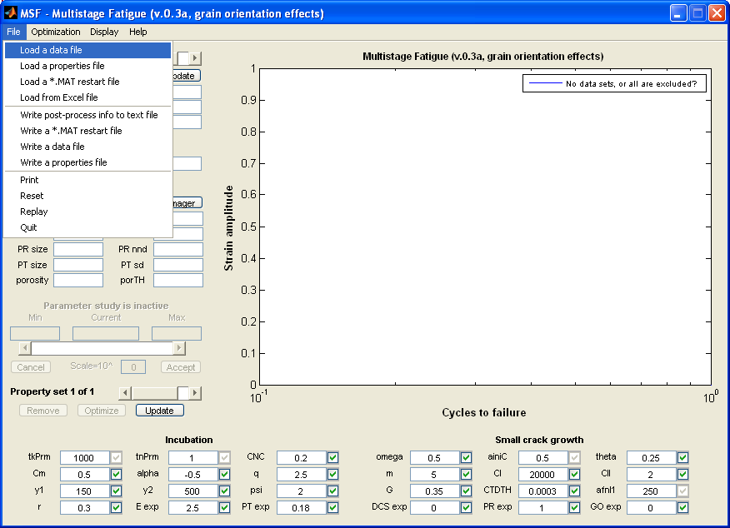
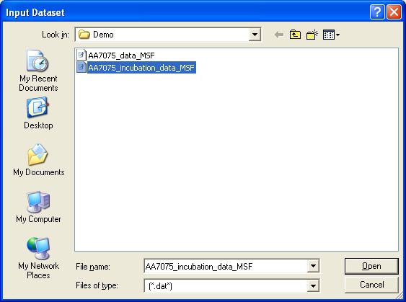
Load datasets
File | Load | A data file …
Select dataset

Slide 9
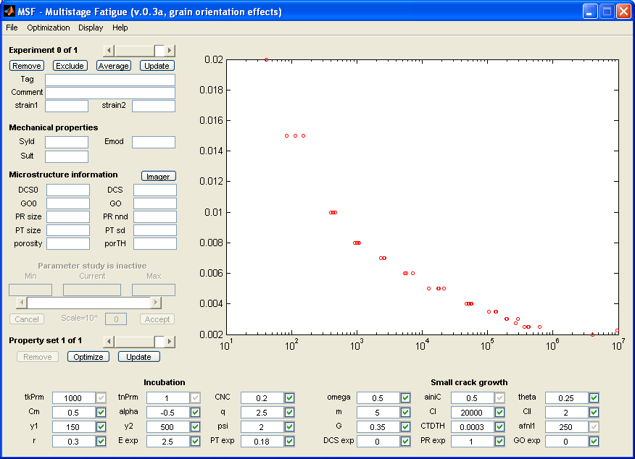
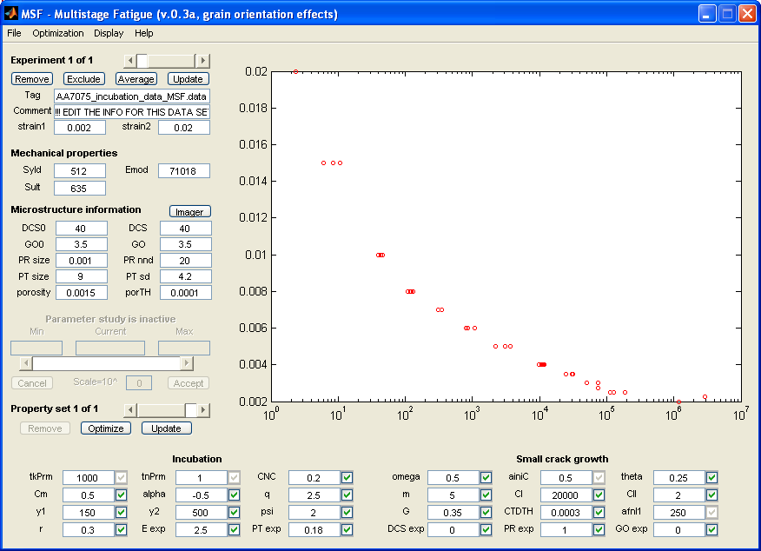
Load datasets
Default on experiment 0 of 1…
Select Incubation data set to focus on…

Slide 10
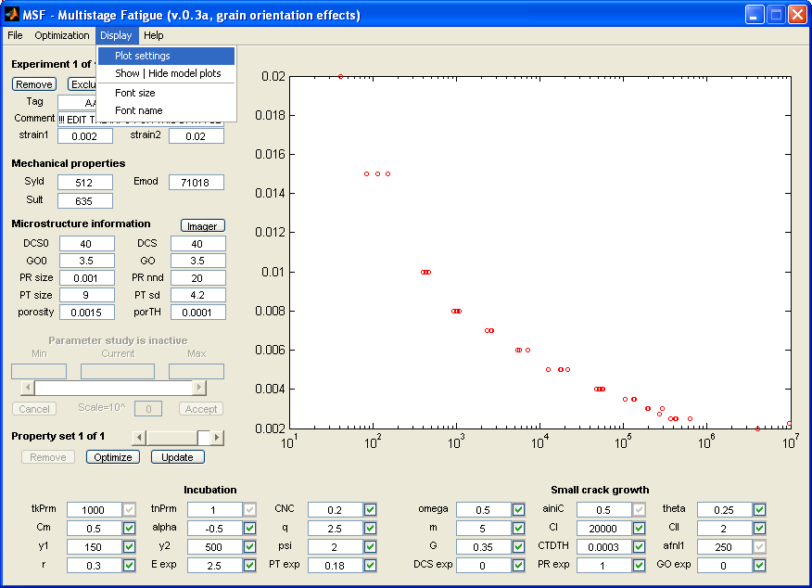
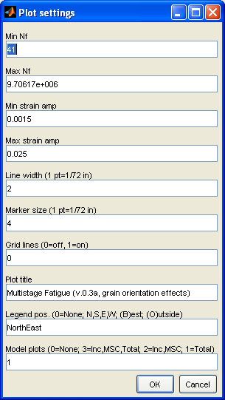
Edit plot settings
Min strain Amp .0015
Min strain Amp .025
Legend: NE
(northeast)

Slide 11

Material constants
Strain range (data)
Mechanical Props
Microstructure Props

Slide 12
Mechanical Properties
Yeld stress (MPa)
Elastic modulus (MPa)
Ultimate strength (MPa)

Slide 13
Microstructure Information
Grain size/Dentrite Cell size (mm)
Texture/grain orientation
Pore size and nearest Neighbor distance (mm)
Particle size and standard deviation (mm)
Porosity and porosity threshold

Slide 14
Step 2
First fit the Incubation stage….

Slide 15
Incubation constants- values are default
MSFfit Default values

Slide 16
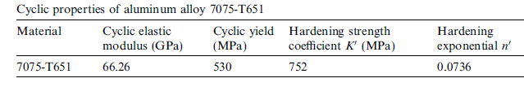
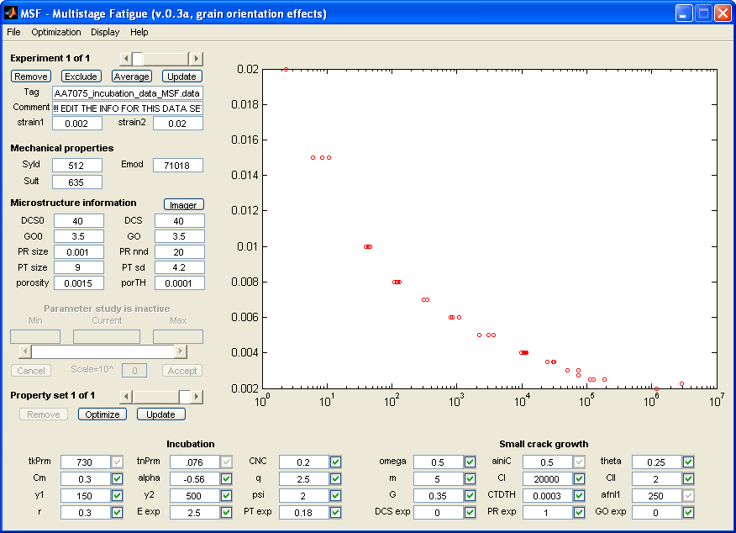
The first dataset
Constants taken from experiments/ literature

Slide 17
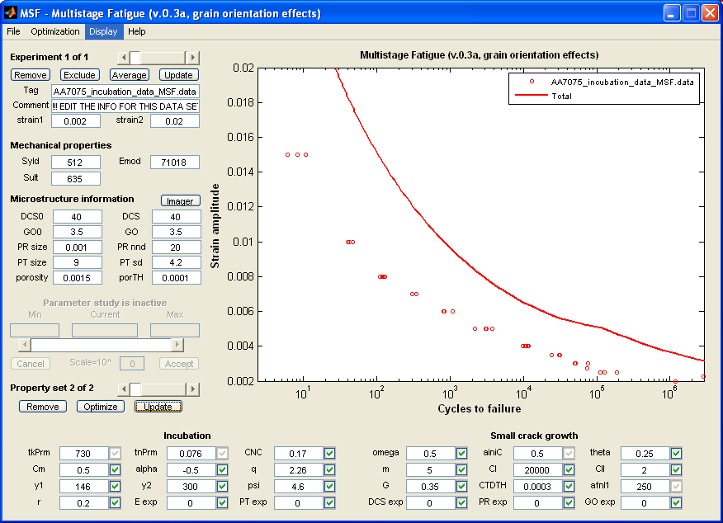
Constants from micromechanical simulations of local stress relating to incubation
Verify that these exponents are set to zero
Constants taken from simulations
Material Constant

Slide 18
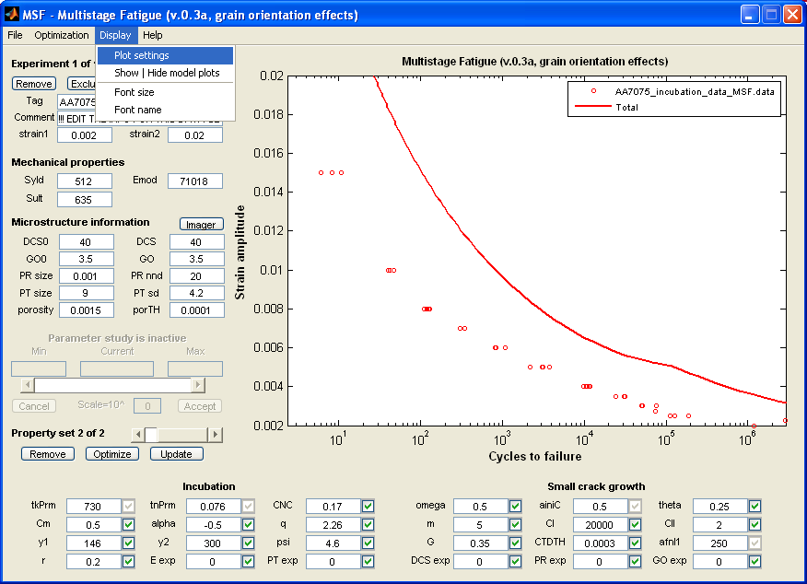
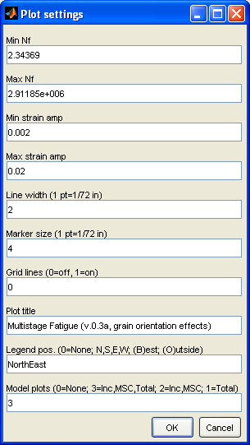
Change plot settings

Slide 19
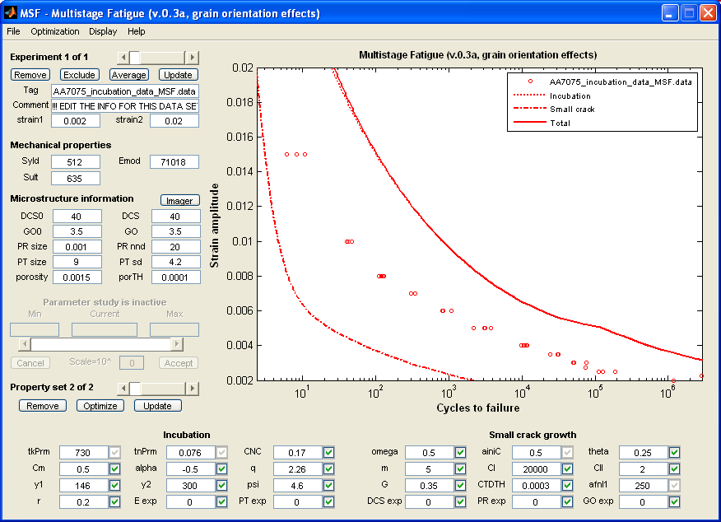
MSF model now shows curves for incubation, small crack and total life.

Slide 20
Adjust CM and Alpha constants until incubation curve is optimized with the incubation data.

Slide 21
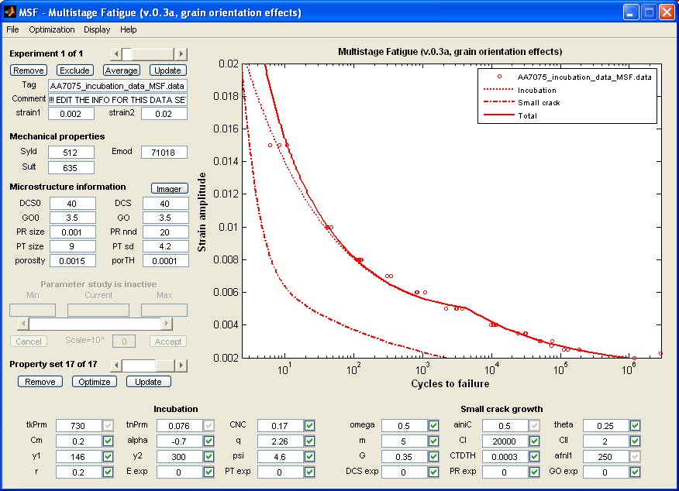
CM= 0.2 and Alpha=-0.7 give a good correlation to the incubation experimental data.
Incubation model (dotted line) shows good agreement with experimental results

Slide 22
Step 2
Next, fit the small crack stage….

Slide 23

Fixed small crack growth constants
Material constant for crack tip irreversibility (0.35 for aluminum alloys)
Notes:
Remember to click “Apply changes” after modifying one or more edit boxes or check boxes.

Slide 24
Fixed small crack growth constants
DCTD threshold for pure aluminum [1]
Notes:
Remember to click “Apply changes” after modifying one or more edit boxes or check boxes.

Slide 25
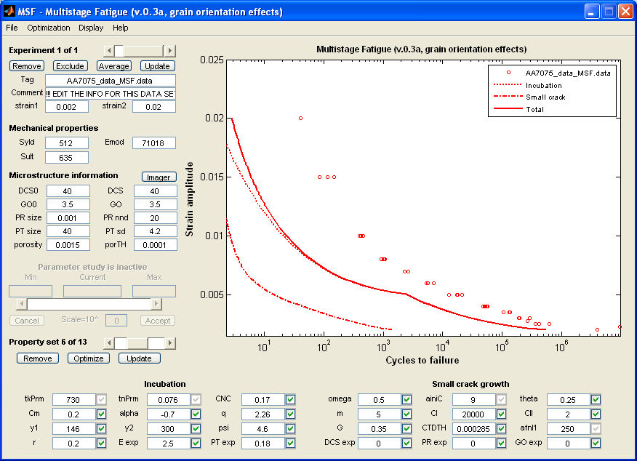
Initial and final crack size: ainiC=9mm, afnl1=1000mm
Initial crack size
Final crack size
Notes:
Remember to click “Apply changes” after modifying one or more edit boxes or check boxes.

Slide 26

Multi-axial loading
Multi-axial parameter determined from experiments
Notes:
Remember to click “Apply changes” after modifying one or more edit boxes or check boxes.

Slide 27
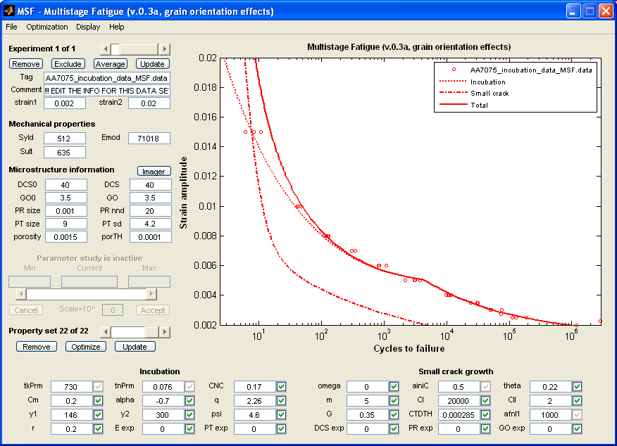
Microstructure effects
Constants and exponents that account for grain size, porosity, texture effects

Slide 28
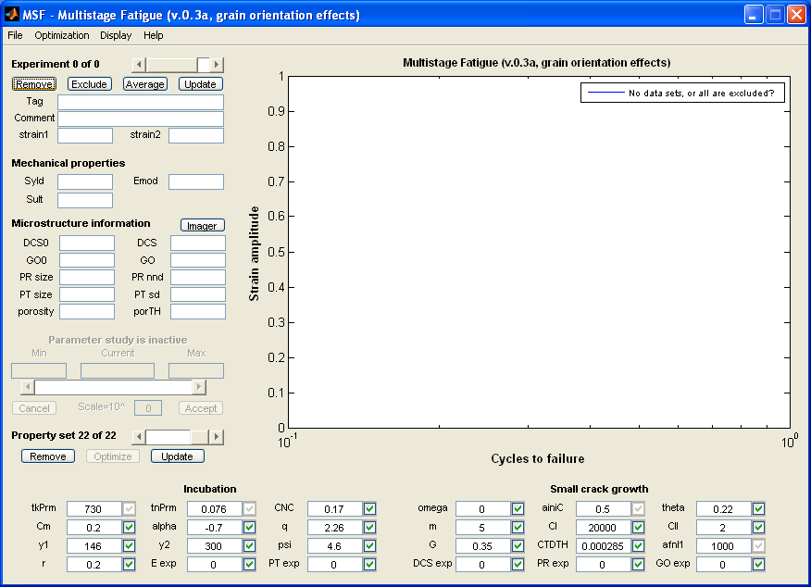
Remove incubation life data

Slide 29
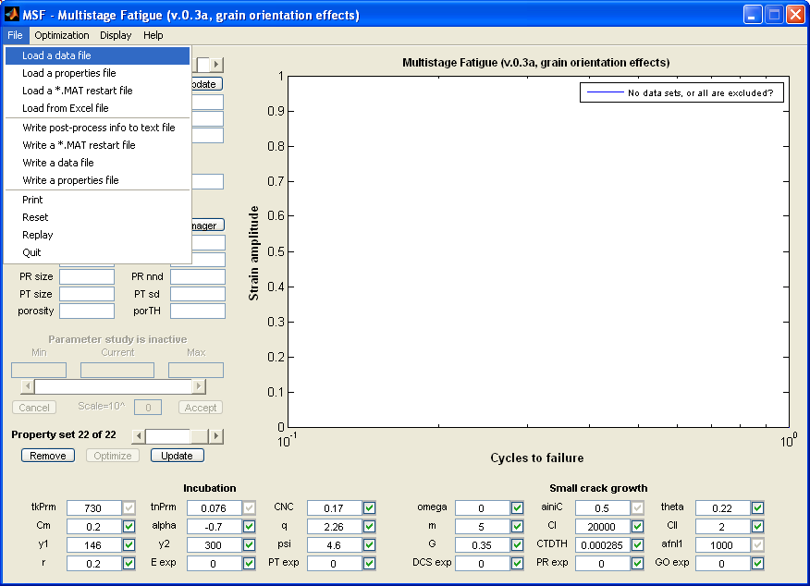
Load total fatigue life data

Slide 30
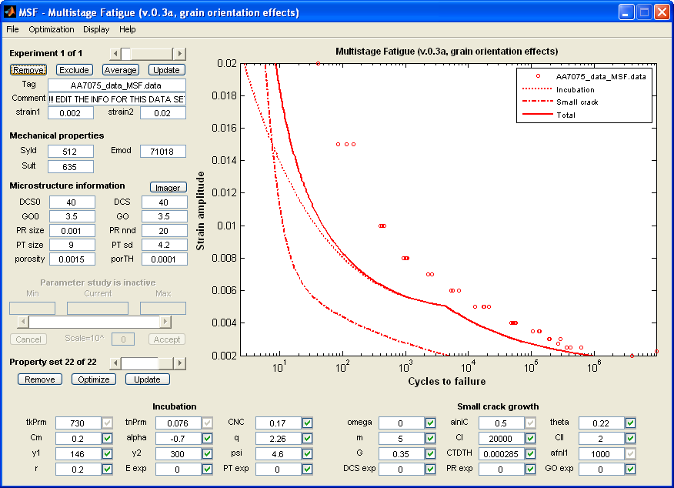
Now fit the small fatigue crack
Constants to adjust for for small fatigue crack growth

Slide 31
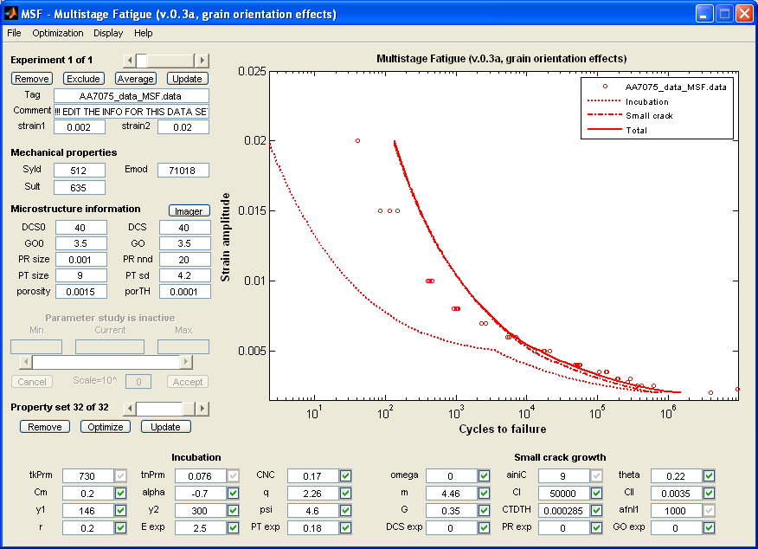
Decrease CII (HCF) until the “small crack” is in good agreement. (CII=0.0035)
LCF Range
Set m=4.46
Based on experiments
Decrease CII to 0.0035

Slide 32
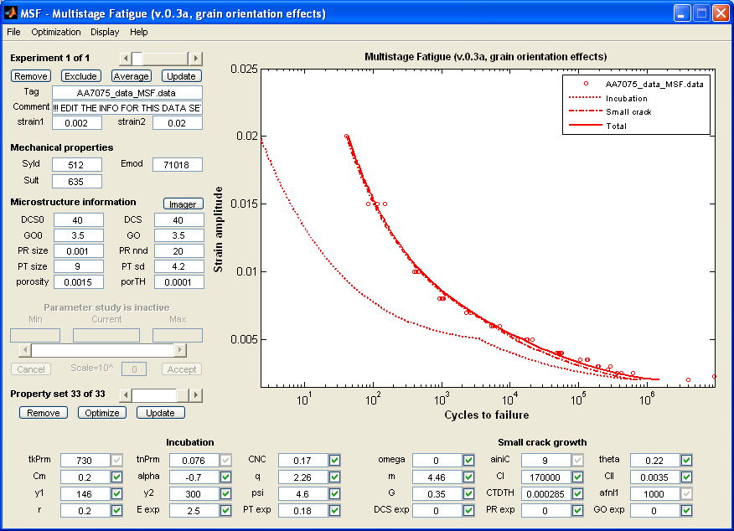
Increase CI (LCF) until the “small crack” curve is in good agreement. (CI=170000)
LCF Range
Increase CI to 170000

Slide 33
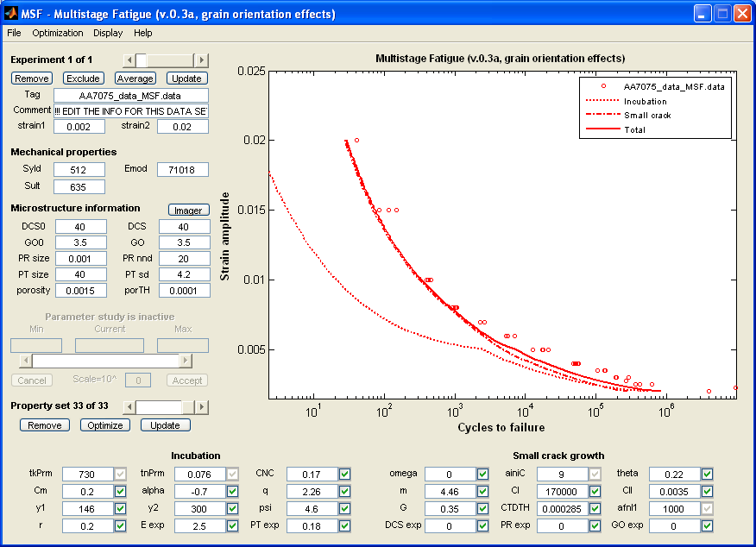
7075-T651 particle size range: 40-2mm. Enter large particle size to predict the lower bound (PT size= 40mm).
Curve shifts left

Slide 34
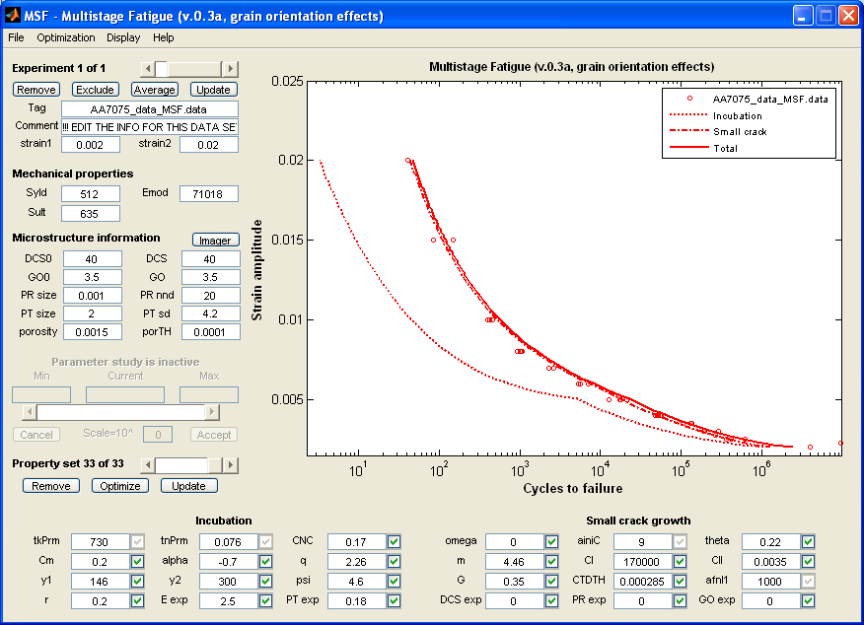
7075-T651 particle size range: 40-2mm. Enter Smaller particle size predict the upper bound (PT size= 2mm).
Curve shifts right

Slide 35
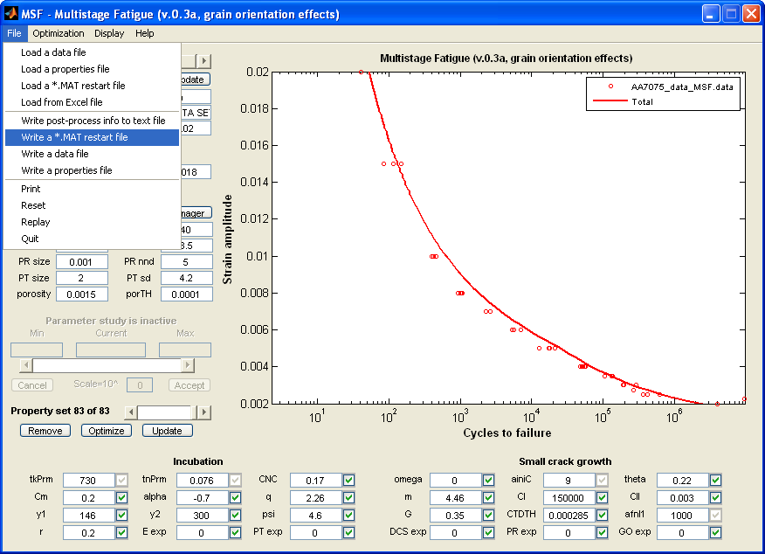
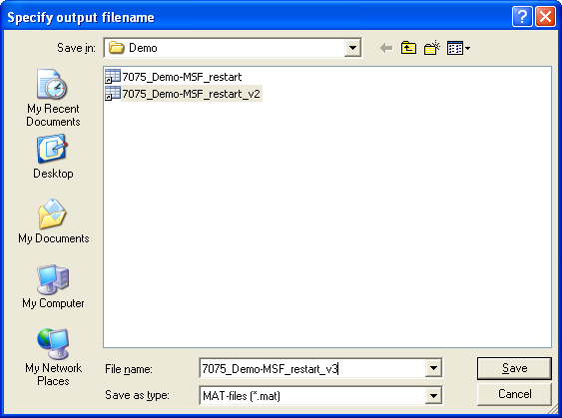
Write a restart file

Slide 36
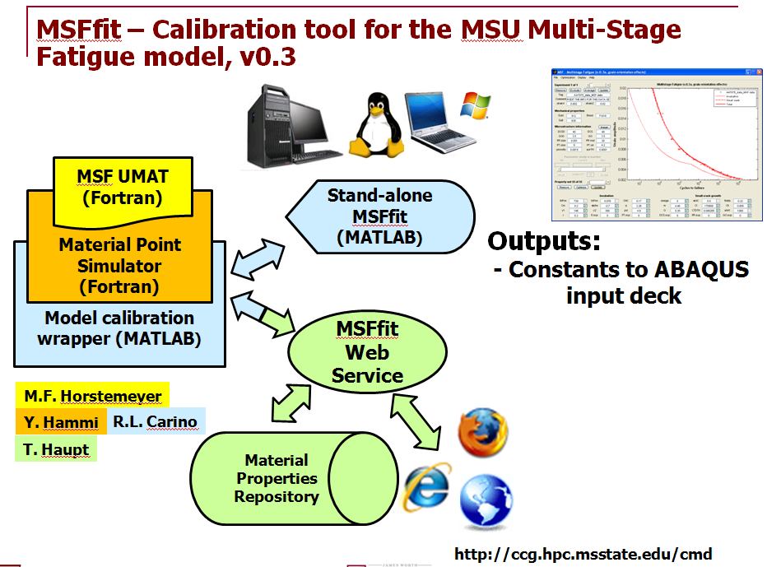
MSFfit Overview
Notes:
In this presentation:
The relationship between the plasticity-damage model (DMG), and the model calibration tool (DMGfit)
Implementations of DMGfit: for users on stand-alone PCs, or for Web-based users
The overall model calibration strategy
The calibration process specific to the DMG
The mapping of the calibration process to the DMGfit GUI
Labor saving features in the GUI, requested by MSU researchers
DMGfit demo

