Slide 1
Crystal Structure Basics
Downscaling/Upscaling from Atomic Level to Electrons Level

Slide 2
Crystal Structure: BCC
Primitive Vectors (non-orthogonal):
A1 = - ½ a X + ½ a Y + ½ a Z A2 = + ½ a X - ½ a Y + ½ a Z A3 = + ½ a X + ½ a Y - ½ a Z
Basis Vector:
B1 = 0 (W) (2a)
However in orthogonal unitcell:
A1 = a X A2 = a Y A3 = a Z
And the Basis vectors:
B1 = 0.0 0.0 0.0 B2 = 0.5 0.5 0.5

Slide 3
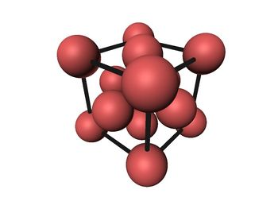
FCC Structure
Primitive Vectors:
A1 = ½ a Y + ½ a Z A2 = ½ a X + ½ a Z A3 = ½ a X + ½ a Y
Basis Vector:
B1 = 0 (Al) (4a)
However in orthogonal unitcell:
A1 = a X A2 = a Y A3 = a Z
And the Basis vectors:
B1 = 0.0 0.0 0.0 B2 = 0.5 0.5 0.0 B2 = 0.0 0.5 0.5 B2 = 0.5 0.0 0.5

Slide 4
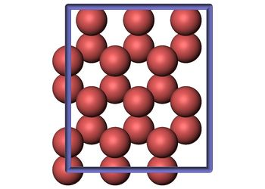
HCP Structure
Primitive Vectors:
A1 = ½ a X - ½ 31/2 a Y A2 = ½ a X + ½ 31/2 a Y A3 = c Z
Basis Vector:
B1 = 1/3 A1 + 2/3 A2 + ¼ A3 (Mg) (2c) B2 = 2/3 A1 + 1/3 A2 + ¾ A3 (Mg) (2c)
However in orthogonal unitcell:
A1 = a X A2 = b Y A3 = c Z
where b = Sqrt(3)a
And the Basis vectors:
B1 = 1/4 a 1/3 b 1/4 c B2 = 3/4 a 5/6 b 1/4 c B2 = 1/4 a 0 b 3/4 c B2 = 3/4 a 1/2 b 3/4 c

Slide 5
Requirements Defined by Downscaling from Atomic Level
First Order Requirements for EAM/MEAM Potentials
Lattice parameter: a₀
Elastic Moduli: C₁₁, C₂₂ (C₁₁-C₂₂/2: tetragonal shear modulus),
C₁₂, C₁₃, C₂₂, C₃₃, and C₄₄ (trigonal shear modulus)
Cohesive Energy: E_{C}
Volume: V₀
Exponential Decay Factor for MEAM potential: α
Objectives for Optimization of Parameters for EAM/MEAM Potentials
Surface Formation Energies
Generalized Stacking Fault Curve
Vacancy Formation Energy
Atomic Forces
Lattice ratio: HCP c/a ratio
Crystal energy differences: E_{fcc}-E_{hcp}
Crystal energy differences: E_{bcc}-E_{hcp}

Slide 6
First Order Requirements
Draw energy potential and relate the elastic moduli, lattice parameter, cohesive energy, etc

Slide 7
Surface Formation Energies
= surface formation energy per unit surface area, the energy
that is required to do ???
E_{tot} = the total energy of the system
N = the number of atoms in the system
ε = total energy per atom in the bulk
A = surface area
(show picture if you can get one)

Slide 8
Generalized Stacking Fault Energy Curves
E_{sf} = the energy per surface area to form a stacking fault
E_{tot} = the total energy of the system with a stacking fault
N = the number of atoms in the system
ε = total energy per atom in the bulk
A = unit cell surface area that is perpendicular to the stacking fault
(show picture of GSFE curve)

Slide 9
Vacancy Formation Energy
E_{vac} = the energy per surface area to form a vacancy
E_{tot} = the total energy of the system with a vacancy
N = the number of atoms in the system
ε = total energy per atom in the bulk
(show picture of GSFE curve)

Slide 10
Atomic Forces
(show picture of GSFE curve)

Slide 11
C/A Ratio for HCP crystals
(show picture of GSFE curve)

Slide 12
Crystal Energy Differences: fcc vs hcp
(show picture of GSFE curve)

Slide 13
Crystal Energy Differences: bcc vs hcp
(show picture of GSFE curve)

Slide 14
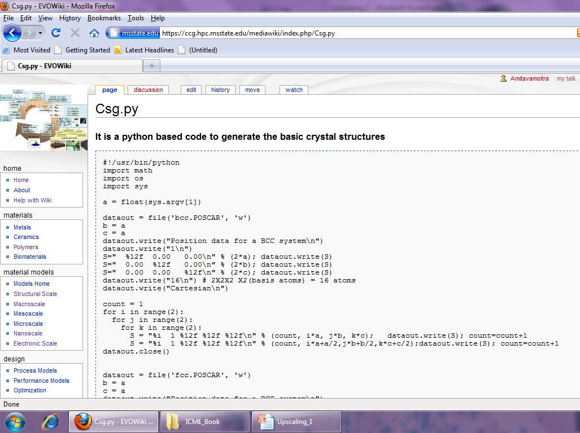

Slide 15
HANDS ON TUTORIAL ON DFT CALCULATIONS

