Slide 1
Atomistic modeling of fatigue crack growth in nickel and magnesium single crystals
Mark F. Horstemeyer, Tian Tang, Gabriel Potirniche

Slide 2
FCC Crystal orientations

Slide 3
Fatigue crack growth in
Middle Tension (MT) Specimens

Slide 4
Orientation A – [111]
Cycle 1- loading – 0 strain
Cycle 2- loading – 4.35 strain
Cycle 2- loading – 4.6 strain
Cycle 3- loading – 4.45 strain
Cycle 3- loading – 5.5 strain
Cycle 3- loading – 6.9 strain

Slide 5
Orientation B – [100]
Cycle 2- unloading – 4.35% strain
Cycle 3- loading – 5.95% strain
Cycle 3- loading – 6.5% strain
Cycle 3- loading – 7.14% strain
Cycle 3- loading – 8.16% strain
Cycle 3- loading – 7% strain

Slide 6
Orientation C – [110]
Cycle 2- loading – 4.35% strain
Cycle 2- loading – 4.84% strain
Cycle 2- unloading – 4.84% strain
Cycle 3- loading – 4.75% strain
Cycle 3- loading – 5.25% strain
Cycle 3- loading – 5.75% strain

Slide 7
Orientation D – [101]
Cycle 1- loading – 2.85% strain
Cycle 2- loading – 3.85% strain
Cycle 2- loading – 4.84% strain
Cycle 3- loading – 5.25% strain
Cycle 3- loading – 6.75% strain
Cycle 3- loading – 7.65% strain

Slide 8
Conclusions
Fatigue crack growth in single crystals is highly dependent on the crystal orientation
Plastic slip at the crack tip causes the crack advance or retardation, and crack deviation into a mixed mode of propagation
Fatigue crack may advance by void coalescence ahead of the crack tip in some orientations([111]), while in others no void nucleation is noticed ([110])
Crack tip blunting is dependent on the crystal orientation

Slide 9
Magnesium Outline
Introduction
Objective
Simulation method
  Embedded Atom Method (EAM)
  Centrosymmetry and Akron parameter
Crack orientation dependence for fatigue crack growth
Temperature dependence of fatigue crack growth
Conclusions

Slide 10
Introduction
Fatigue behavior at nanoscale is much less understand.
Several researchers performed the molecular dynamics simulation of fatigue crack growth in FCC metals at nanoscale.
Almost no research on atomistic modeling of fatigue crack growth in Mg crystals (HCP metal) can be found in open literatures.

Slide 11
Objectives
Investigate the fatigue crack growth mechanisms in magnesium single crystals (at nanoscale) under the application of cyclic loading.
  The effects of crystallographic orientation of the initial crack.
  The effects of temperature.

Slide 12




Simulation method
The interatomic potential employed in this investigation is Embedded Atom Method (EAM) developed by Daw and Baskes [1, 2].
Centro-symmetry parameter [3], P and Ackland parameter [4], , was used to visualize the defects including dislocations, twin, and crack.
Energy:
dipole force tensor:
stress:
[1] M. Daw, M. Baskes, Mater. Sci. 50 (1983) 1285.
[2] M. Daw, S. Foiles, M. Baskes, Mater. Sci. Rep. 9 (1993) 251.
[3] C. Kelchner, S. Plimpton, J. Hamilton, Phys. Rev. B 58 (1998) 11085.
[4] Ackland, Jones, Phys Rev B, 73, 054104 (2006).

Slide 13
Atomistic Model
Thickness t
y
Thickness t
a₀
y
H
H
a₀
x (periodic)
x
z (periodic)
z (periodic)
w
w
Center crack
Edge crack
W=20 nm
H=20 nm
a0/w=1/10
W=50 nm
H=18 nm
a0/w=1/5

Slide 14


Crack orientation dependence for fatigue crack growth in magnesium crystals

Slide 15
Crystal Orientation of Initial Crack
* Cyclic loading was applied along the direction perpendicular to the crack plane.
Orientation A
Orientation B
Orientation C
Orientation D
Orientation E
Crack plane: (1 10)
Crack plane: (10 0)
Crack plane: (10 0)
Crack plane: (1 10)
Crack plane: (0001)
Crack direction: [10 0]
Crack direction: [1 10]
Crack direction: [0001]
Crack direction: [0001]
Crack direction: [10 0]
Orientation F
Orientation G
Orientation H
Orientation I
Orientation J
Crack plane: (0001)
Crack plane: (10 1)
Crack plane: (10 2)
Crack plane: (10 1)
Crack direction: [1 10]
Crack direction: [ ]
Crack direction: [10 ]
Crack plane: (10 2)
Crack direction: [10 ]
Crack direction: [1 10]

Slide 16
Cyclic loading
Monotonic tension test was performed using center crack model to determine the critical value of maximum strain at which the initial crack start growing.
Apply cyclic loading
  Maximum strain: 90% of critical value
  Strain ratio, R=0.8
  Temperature: 100K
  Strain rate: 1.5E9 1/s
orientation | A | B | C | D | E | F | G | H | I | J
Critical value | 0.05 | N/A | 0.046 | 0.046 | N/A | 0.04 | 0.066 | 0.445 | 0.05 | 0.055

Slide 17
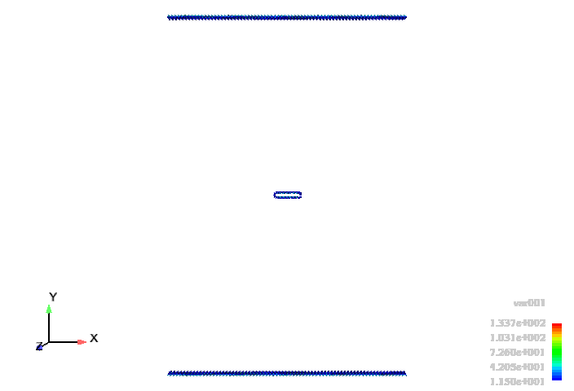
Orientation A
Crack: (1 10) [10 0]
Loading: εmax=0.045, R=0.8

Slide 18
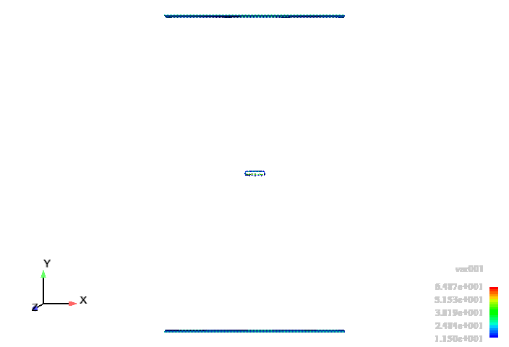
Orientation B
Crack: (10 0) [1 10]
Loading: εmax=0.045, R=0.8

Slide 19
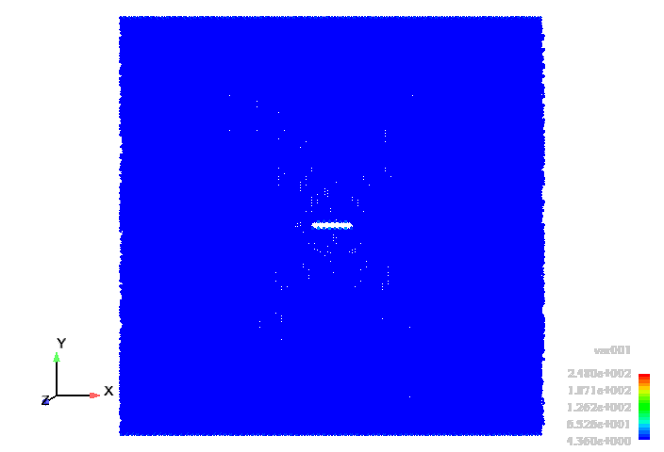
Orientation C
Crack: (10 0) [0001]
Centro-symmetry contour
Loading: εmax=0.0418, R=0.8

Slide 20
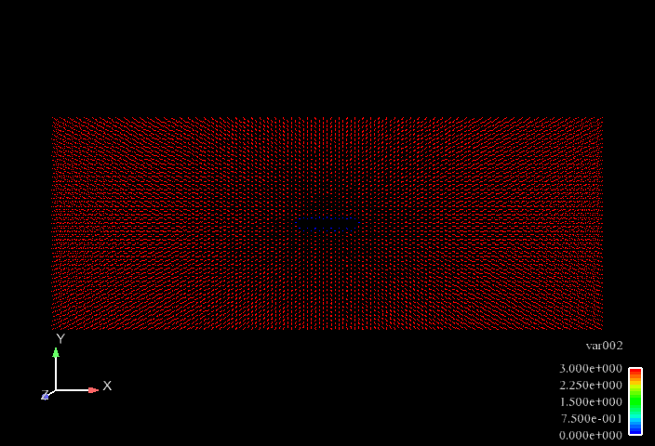
Orientation C
Crack: (10 0) [0001]
Ackland contour
Loading: εmax=0.0418, R=0.8

Slide 21
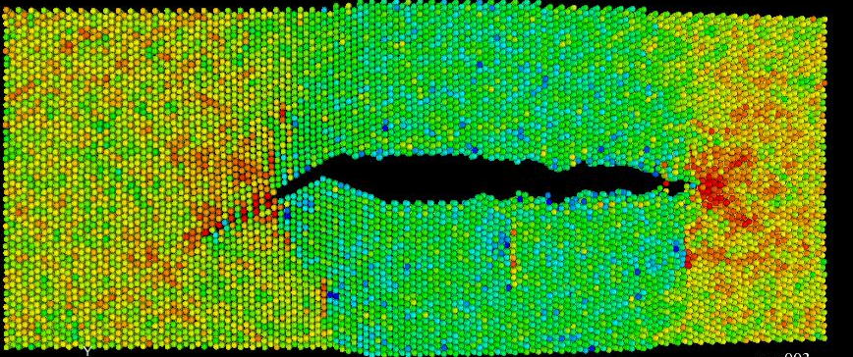
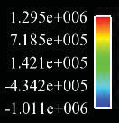
Orientation C (cont.)
Stress σy contour
Crack: (10 0) [0001]

Slide 22
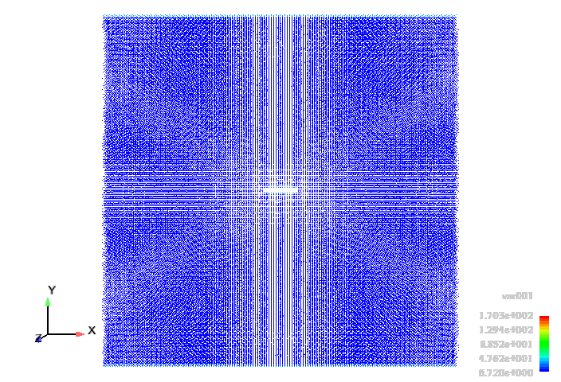
Orientation D
Crack: (1 10) [0001]
Centro-symmetry contour
Loading: εmax=0.0418, R=0.8

Slide 23
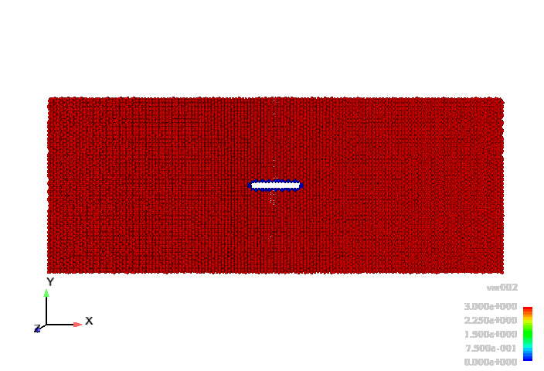
Orientation D
Crack: (1 10) [0001]
Ackland contour
Loading: εmax=0.0418, R=0.8

Slide 24
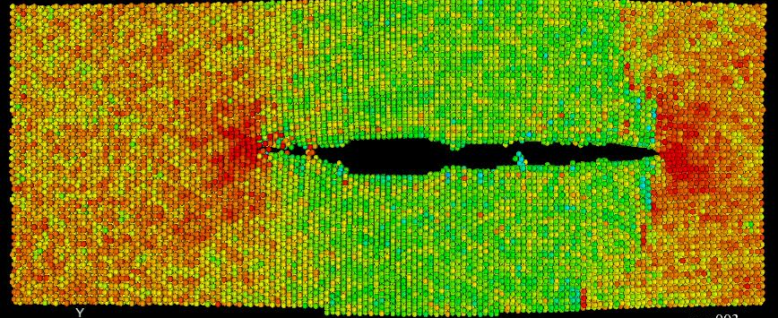
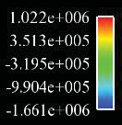
Orientation D
Stress σy contour
Crack: (1 10) [0001]

Slide 25
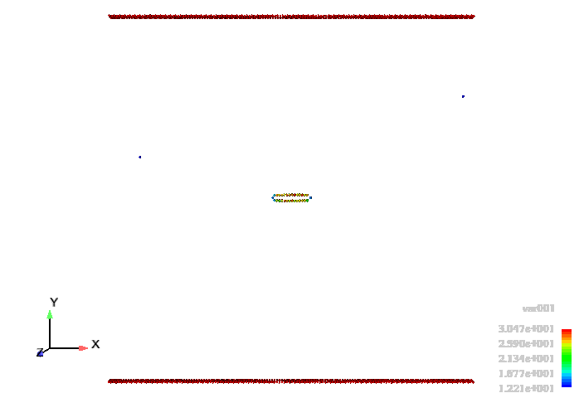
Orientation E
Crack: (0001) [10 0]
Loading: εmax=0.0425, R=0.8

Slide 26
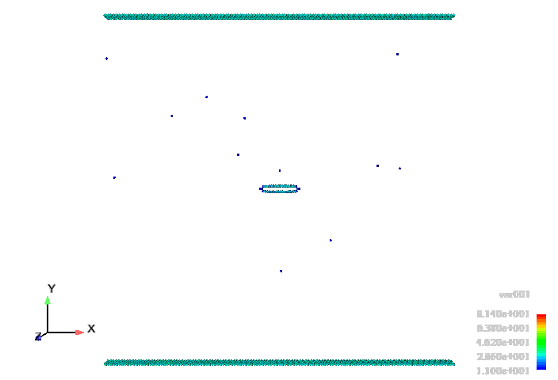
Orientation F
Crack: (0001) [1 10]

Slide 27
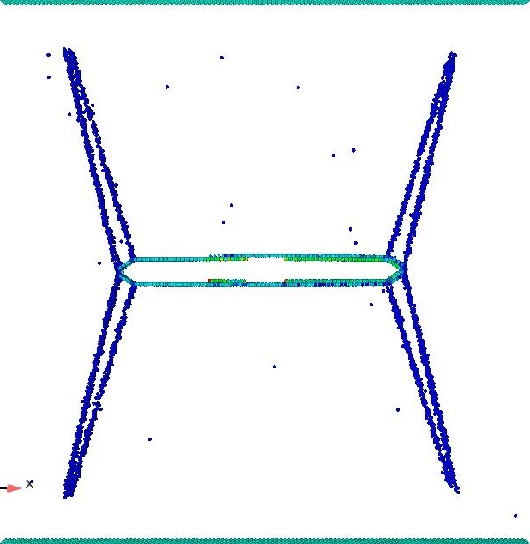
Orientation F (cont.)
Centro-symmetry
Twin: (11 1) [ 26]
cycle 4
Loading: εmax=0.038, R=0.8

Slide 28
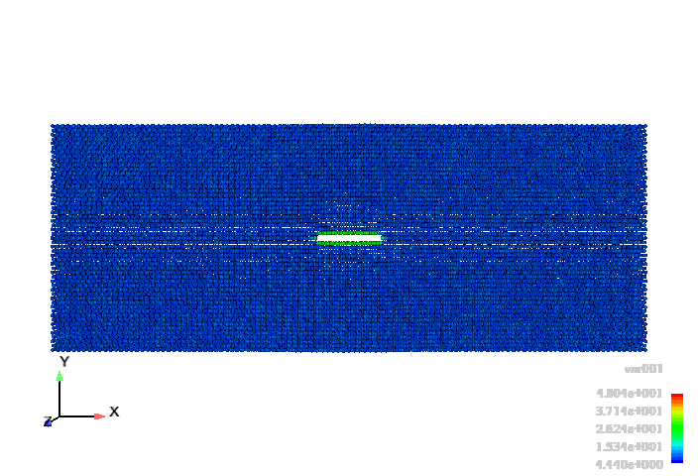
Orientation F (cont.)

Slide 29
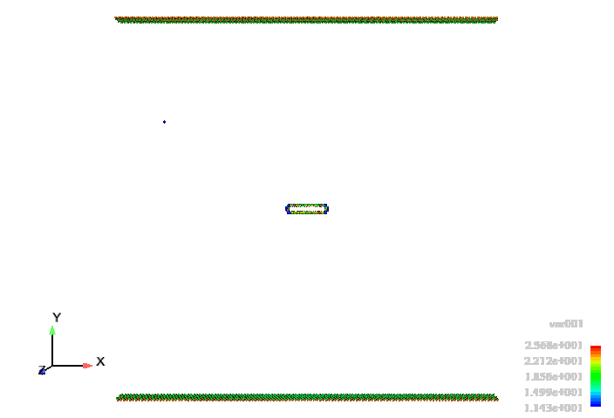
Orientation G
Crack: (10 1)[ ]
Loading: εmax=0.06, R=0.8

Slide 30
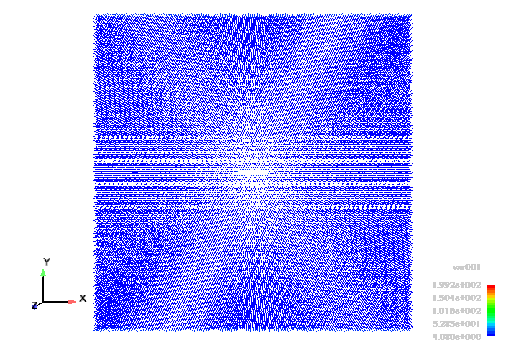
Orientation H
Crack: (10 2) [10 ]
Loading: εmax=0.0425, R=0.8

Slide 31
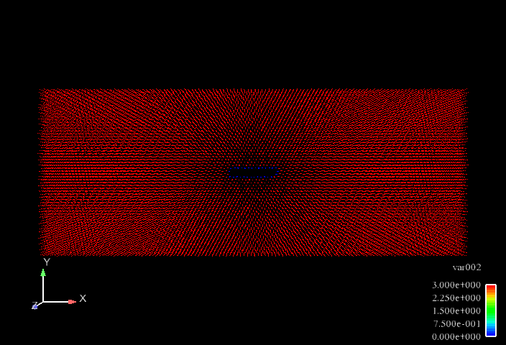
Orientation H
Ackland contour
Loading: εmax=0.0425, R=0.8

Slide 32
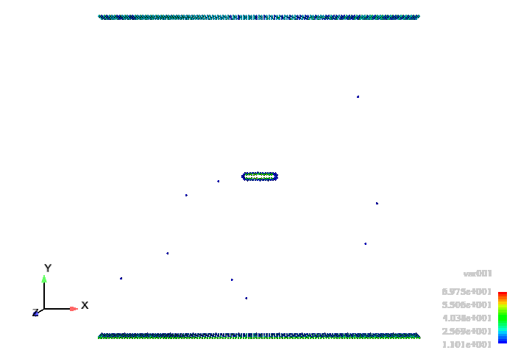
Orientation I
Crack: (10 2) [10 1]
Loading: εmax=0.046, R=0.8

Slide 33
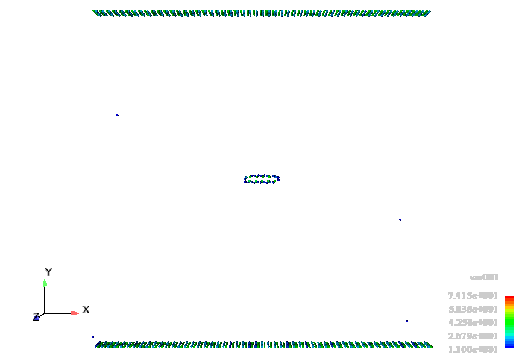
Orientation J
Crack: (10 2) [1 10]
Loading: εmax=0.0475, R=0.8

Slide 34
Fatigue Crack Growth Rate
* Compare the variation of crack length with the number of cycles using edge crack model.
Loading: εmax=0.045, R=0.8,T=10K

Slide 35
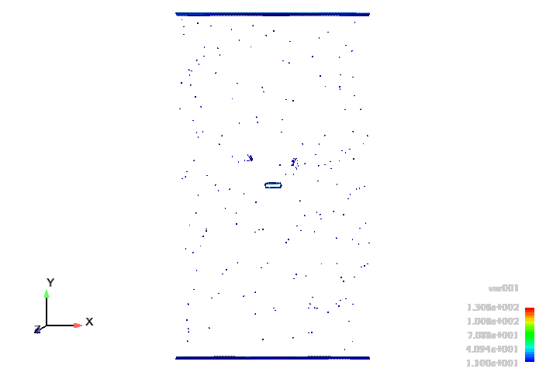
Fatigue damage under increased maximum strain
Orientation B
ε_{max}
ε_{min}=0.33ε_{max}

Slide 36
Fatigue damage under increased maximum strain (cont.)
Orientation E

Slide 37
The effects of strain rate
Orientation D
Orientation F

Slide 38
Temperature dependence for fatigue crack growth in magnesium crystals

Slide 39
Lattice constants
Variation of lattice constants with temperature
c
a

Slide 40
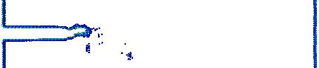
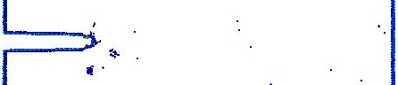
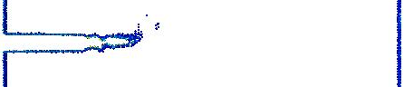
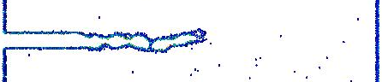
Effects of Temperature
Orientation A at cycle 15
10 K
100 K
300 K
500 K

Slide 41
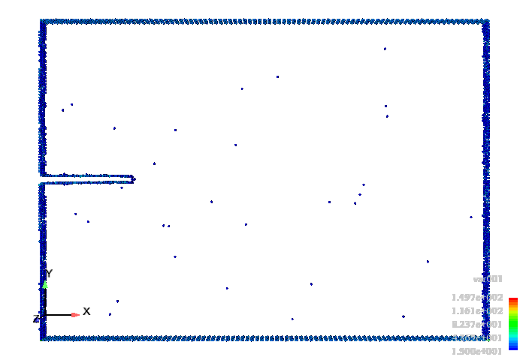
Effects of Temperature (cont.)
Orientation A at 500K
The void nucleated ahead crack tip link back to the main crack.

Slide 42
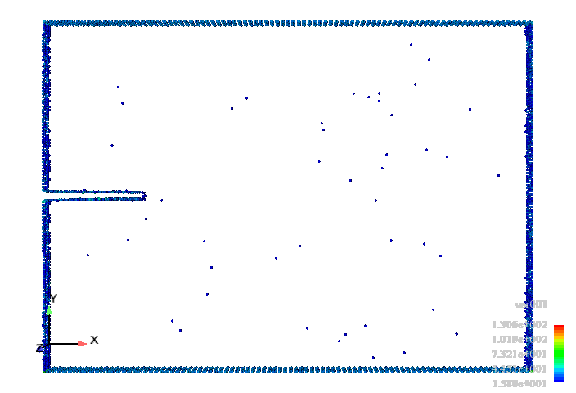
Effects of Temperature (cont.)
Orientation A at 600K
The void nucleated ahead crack tip link back to the main crack.

Slide 43
Effects of Temperature (cont.)
Orientation C
Orientation D

Slide 44
Effects of Temperature (cont.)
Orientation F
Orientation G

Slide 45
Effects of Temperature (cont.)
Orientation H
The crack does not grow at 500K.

Slide 46
Conclusions
The mechanisms of fatigue crack growth are strongly dependent on the crystal orientation of the initial crack.
The resistance of fatigue crack growth of orientation B is the highest.
The growth rate of fatigue crack growth decreased with increasing strain rate.
The growth rate decreases with increasing temperature.

Slide 47
Acknowledgement
The present research is supported by:
Center for Advanced Vehicular Systems at Mississippi State University.
Department of Energy.
Thank you!

