Slide 1
Nanomechanical Damage
Void growth
Void nucleation and hydrogen effects
Fatigue

Slide 2
Work Completed
Stress, σ, is a function
of size.
Work yet to do
Damage φ
is a function of stress
and has three components:
1. Nucleation η=η(σ,Τ,ε,size)
2. Growth v=v(σ,Τ,ε,size)
3. Coalescence c =c(σ,Τ,ε,size)
domain of SMM
and LIGA
components
Damage model
φ=ηvc
Finite element model

Slide 3
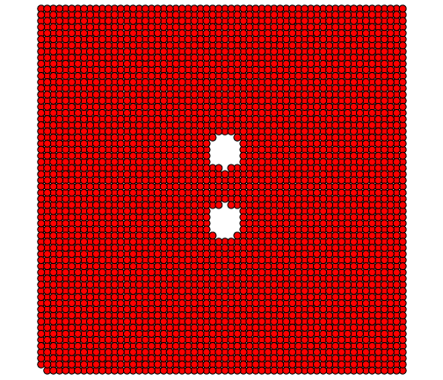
Atomistic Simulations: Consideration of
Boundary Conditions
Case 1: Periodic x,y,z
Δx=Δy=specified
Case 2: Periodic z,
Δx= specified, Δy=linear on x-face
Δy= specified, Δx=linear on y-face
Case 3: Periodic z,
Δx= specified, Δy=free on x-face
Δy= specified, Δx=free on y-face
Case 4: Periodic z,
Δx= specified, Δy=linear on x-face
Δy= specified, Δx=linear on y-face

Slide 4
Boundary Conditions for one void case do not
matter much for void growth analysis

Slide 5
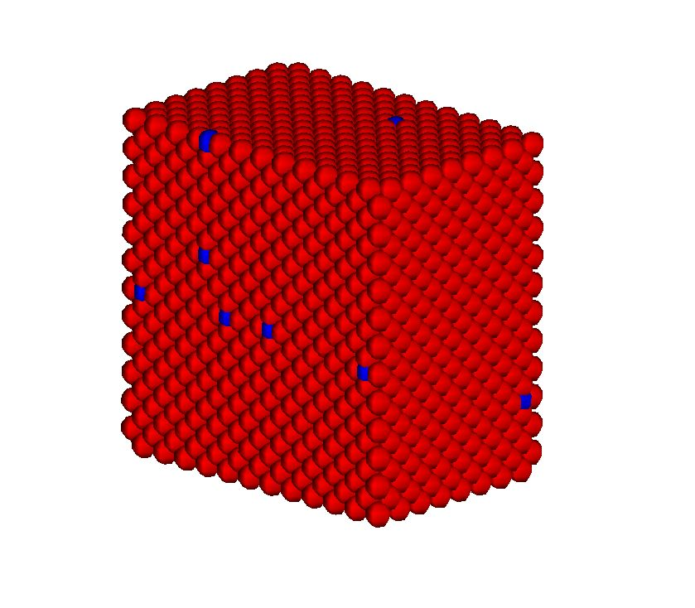
Nanoscale Single Crystals
Model Setup and Parameters
Y
(0 1 0)
(1 0 0)
X
(0 0 1)
Z

Slide 6
Nanoscale Single Crystals
Model Setup and Parameters for Hydrogen in Ni and Al
Y
(0 1 0)
(1 0 0)
X
(0 0 1)
Z

Slide 7
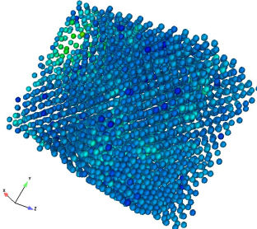
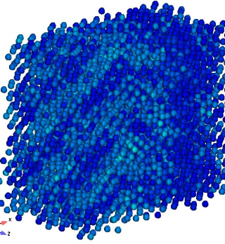
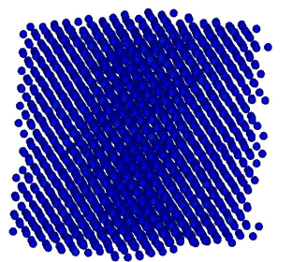
Stress-Strain Response of Nickel Lattices
with Hydrogen Atoms
(Same loads are applied in the simulations)

Slide 8
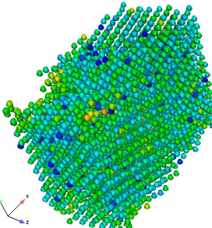
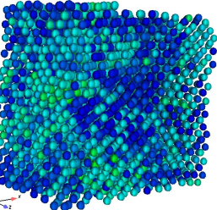
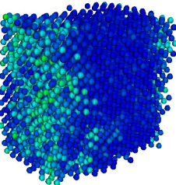
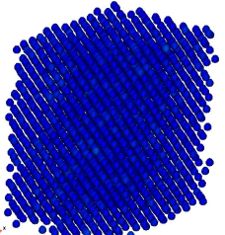
Stress-Strain Response of Aluminum Lattices with Hydrogen Atoms
(Same loads are applied in the simulations)

Slide 9
Size Scale Effects of Stress-Strain Response

Slide 10
Fracture Strain and Stress vs Hydrogen
Atomic Concentration
The effect of hydrogen on crack growth susceptibility in a number of alloy systems
exhibit limiting values at high concentrations. (Moody, 1990)

Slide 11
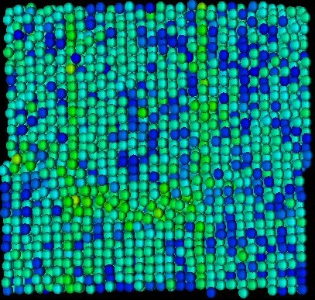
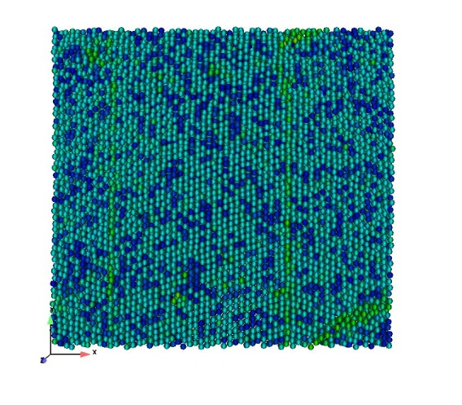
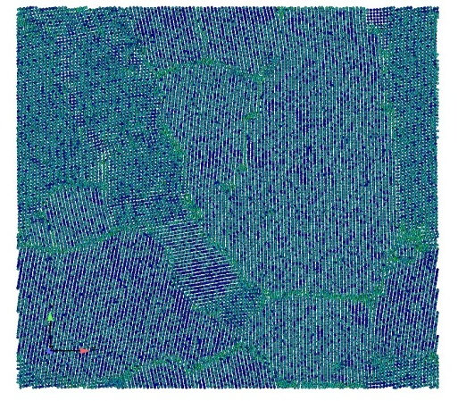
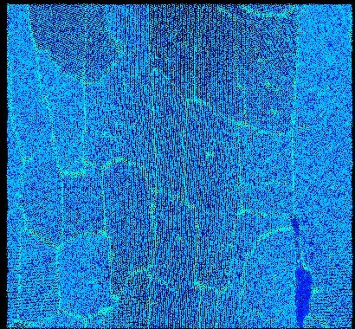
Size Scale effects of dislocation cell
structures with hydrogen effects
6 nm/0.5%H
Strain 0.05
12 nm/0.5%H
Strain 0.05
24 nm/0.5%H
Strain 0.05
48nm/0.5%H
Strain 0.05

Slide 12
The Number of Dislocation Cells vs True Strain

Slide 13
Orientation A [111] with initial crack-note closure
Cycle 2
Cycle 4
Cycle 5
Cycle 6
Cycle 7
Cycle 8

Slide 14
Orientation B – [100] with initial crack: note isotropic like plasticity
Cycle 3
Cycle 4
Cycle 5
Cycle 7
Cycle 8
Cycle 9

Slide 15
Orientation C – [110] with initial crack: distributed plasticity
Cycle 3
Cycle 4
Cycle 6
Cycle 9
Cycle 11
Cycle 12

Slide 16
Orientation D – [101] with initial crack: note shear bands
Cycle 2
Cycle 3
Cycle 5
Cycle 6
Cycle 9
Cycle 10

