Slide 1
Background
1927: Introduction of the Thomas-Fermi model (statistics of electrons).
1964: Hohenberg-Kohn paper proving existence of exact Density Function.
1965: Kohn-Sham scheme introduced.
1970s and early 80s: LDA (local density approximation). DFT becomes useful.
1985: Incorporation of DFT into molecular dynamics (Car-Parrinello)
(Now one of PRL’s top 10 cited papers).
1988: Becke and LYP functionals. DFT useful for some chemistry.
1998: Nobel prize awarded to Walter Kohn in chemistry for
development of DFT.

Slide 3
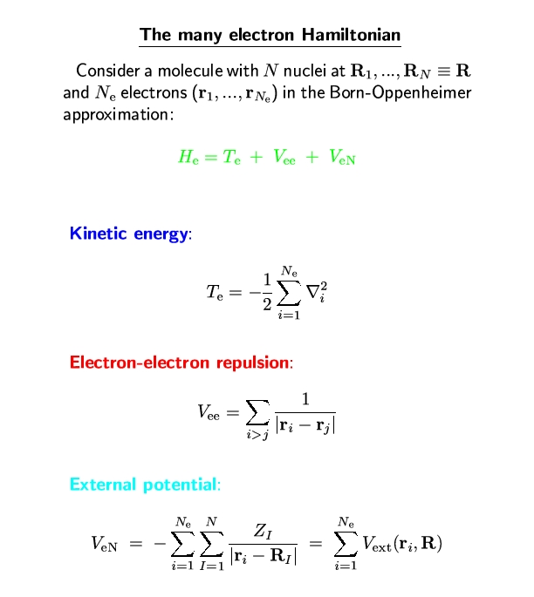
External Potential:

Slide 4
Hohenberg-Kohn Theorem
Two systems with the same number N_{e} of electrons have the same
T_{e} + V_{ee}. Hence, they are distinguished only by V_{en}.
Knowledge of |Ψ₀> determines V_{en}.
Let V be the set of external potentials such solution of
yields a non=degenerate ground state |Ψ₀>.
Collect all such ground state wavefunctions into a set Ψ. Each
element of this set is associated with a Hamiltonian determined by the external
potential.
There exists a 1:1 mapping C such that
C : V Ψ

Slide 5
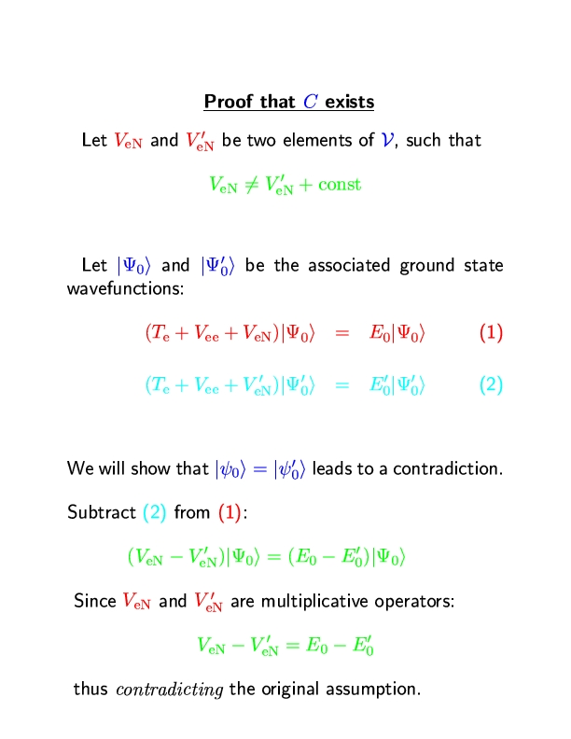

Slide 6
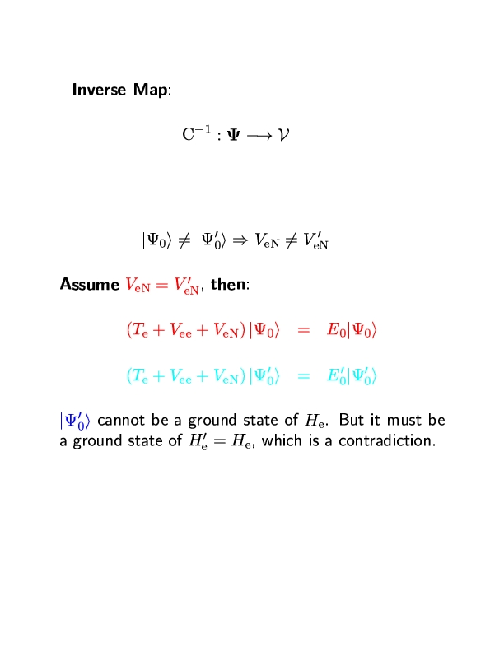

Slide 7
Hohenberg-Kohn Theorem (part II)
Given an antisymmetric ground state wavefunction from the set Ψ, the
ground-state density is given by
Knowledge of n(r) is sufficient to determine |Ψ>
Let N be the set of ground state densities obtained from N_{e}-electron ground
state wavefunctions in Ψ. Then, there exists a 1:1 mapping
D : Ψ N
D⁻¹ : N Ψ
The formula for n(r) shows that D exists, however, showing that D⁻¹ exists
Is less trivial.

Slide 8
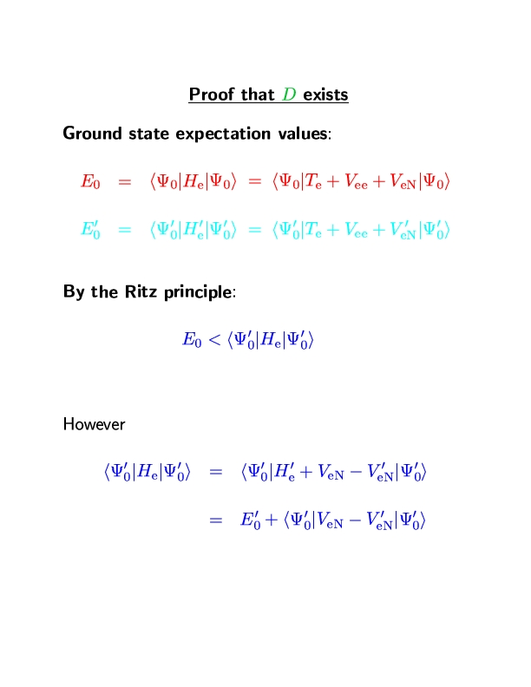
Proof that D⁻¹ exists

Slide 9
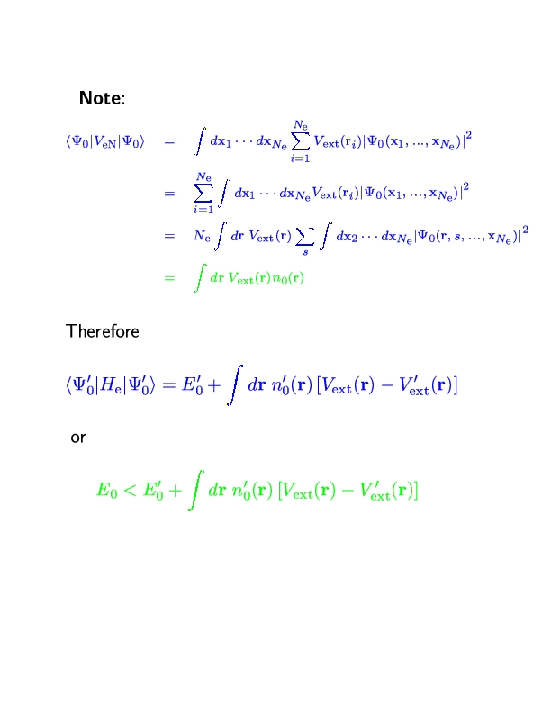

Slide 10
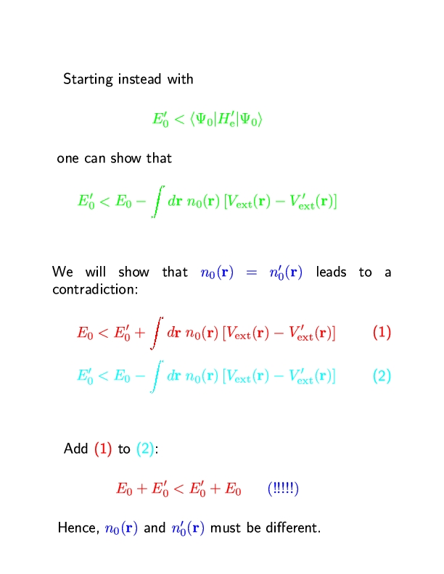

Slide 11
(CD)⁻¹ : N V
The theorems are generalizable to degenerate
ground states!

Slide 12
The energy functional
The energy expectation value is of particular importance
From the variational principle, for |Ψ> in Ψ:
Thus,
Therefore, E[n₀] can be determined by a minimization procedure:

Slide 14
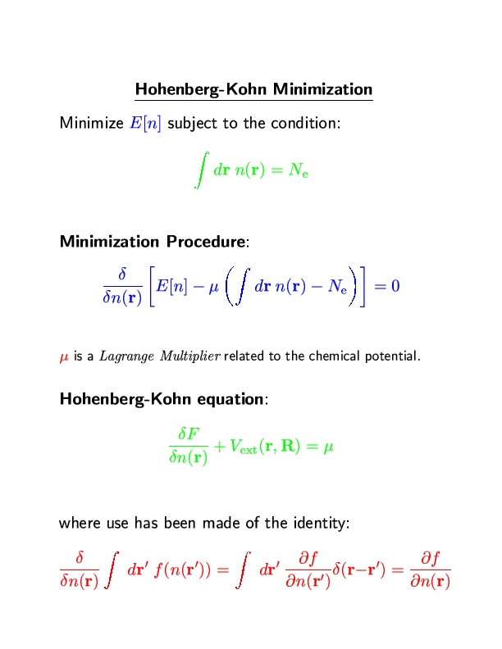

Slide 16
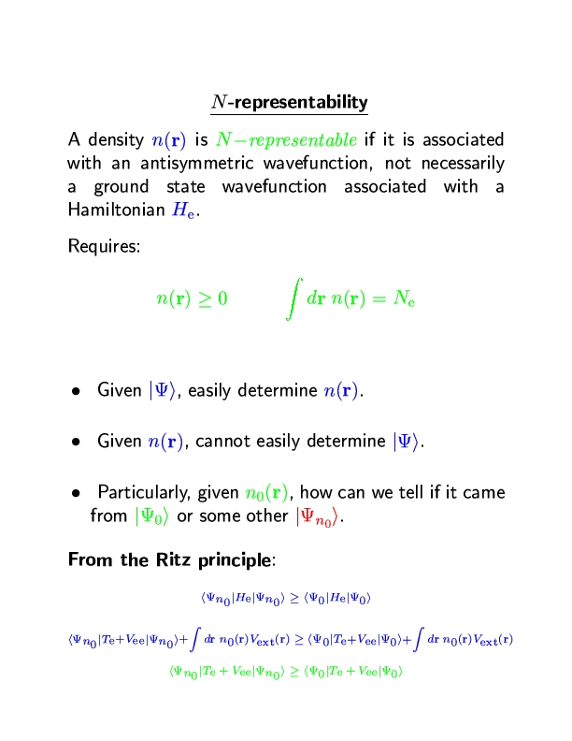

Slide 18
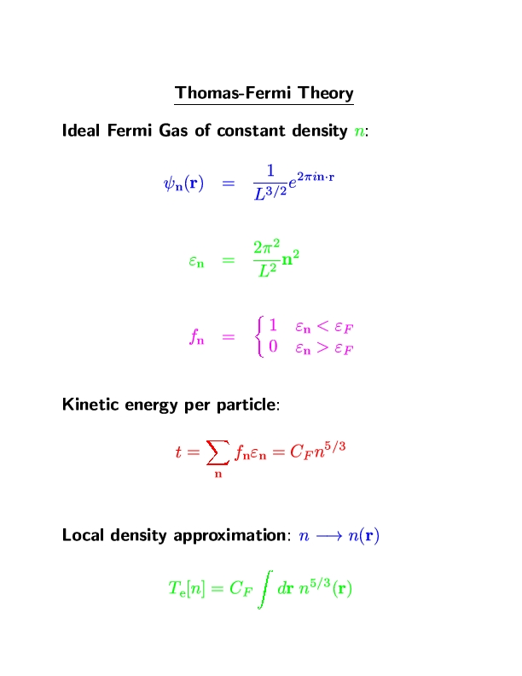

Slide 19
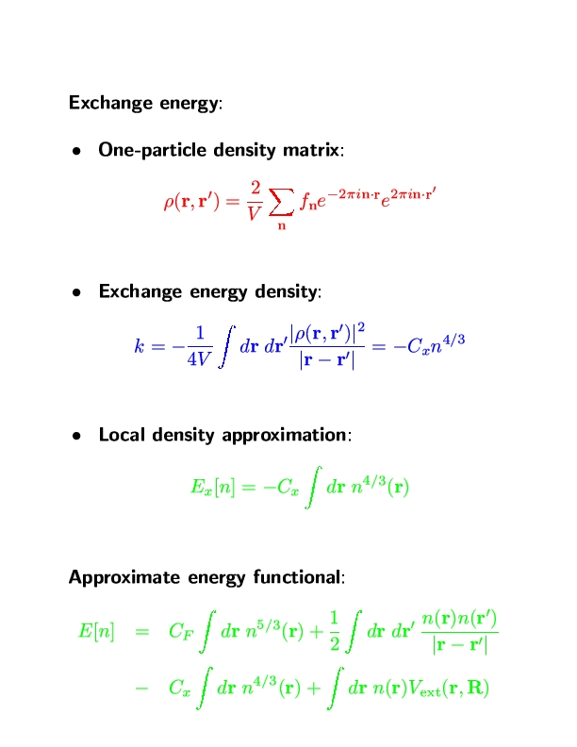

Slide 20
The Kohn-Sham Formulation
Central assertion of KS formulation: Consider a system of N_{e}
Non-interacting electrons subject to an “external” potential V_{KS}. It
Is possible to choose this potential such that the ground state density
Of the non-interacting system is the same as that of an interacting
System subject to a particular external potential V_{ext}.
A non-interacting system is separable and, therefore, described by a set
of single-particle orbitals ψ_{i}(r,s), i=1,…,N_{e}, such that the wave function is
given by a Slater determinant:
The density is given by
The kinetic energy is given by

Slide 23
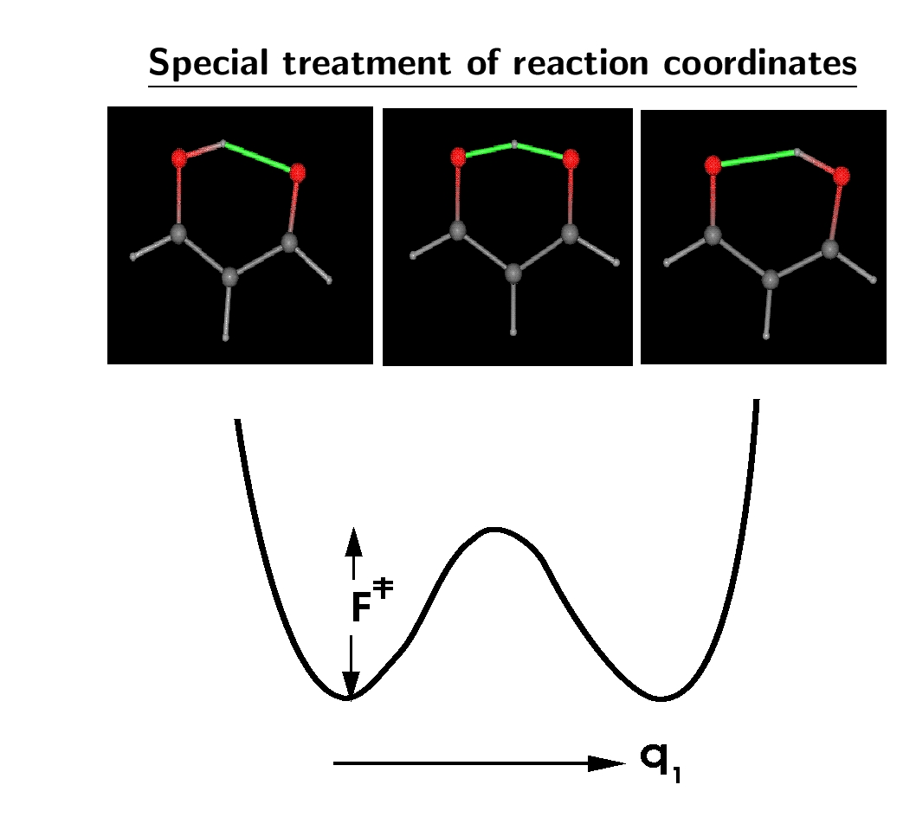
Some simple results from DFT
E_{barrier}(DFT) = 3.6 kcal/mol
E_{barrier}(MP4) = 4.1 kcal/mol

Slide 24
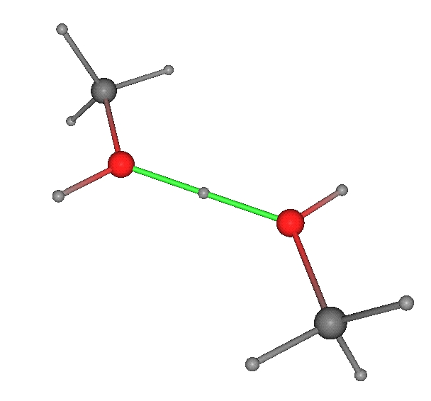
Geometry of the protonated methanol dimer
2.39Å
MP2 6-311G (2d,2p) 2.38 Å

Slide 25
Results methanol
Dimer dissociation curve of a neutral dimer
Expt.: -3.2 kcal/mol

Slide 26
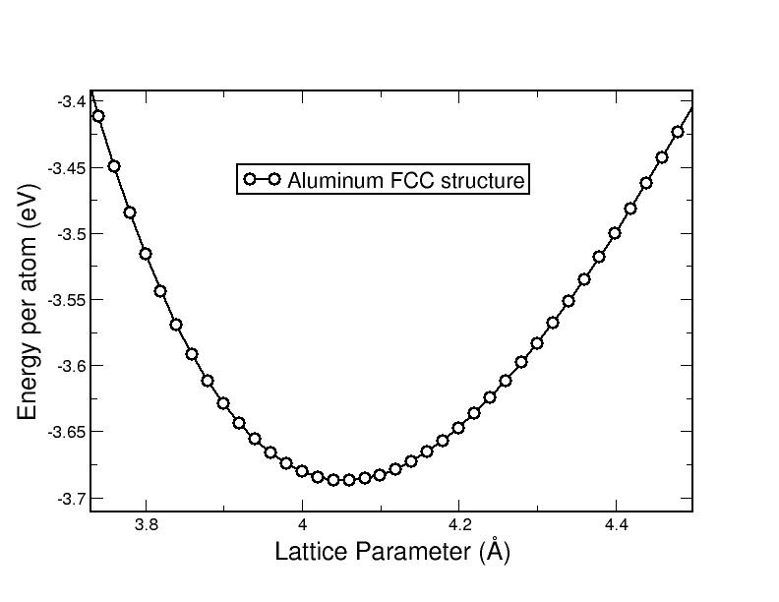

Slide 28
Lecture Summary
Density functional theory is an exact reformulation of many-body
quantum mechanics in terms of the probability density rather than
the wave function
The ground-state energy can be obtained by minimization of the
energy functional E[n]. All we know about the functional is that
it exists, however, its form is unknown.
Kohn-Sham reformulation in terms of single-particle orbitals helps
in the development of approximations and is the form used in
current density functional calculations today.

