Slide 1
ICME and Multiscale Modeling
Mark Horstemeyer
CAVS Chair Professor in Computational Solid Mechanics
Mechanical Engineering
Mississippi State University
mfhorst@me.msstate.edu
Outline
Introduction
Heirarchical Methods

Slide 2
Six Advantages of Employing ICME in Design
ICME can reduce the product development time by alleviating costly trial-and error physical design iterations (design cycles) and facilitate far more cost-effective virtual design optimization.
ICME can reduce product costs through innovations in material, product, and process designs.
ICME can reduce the number of costly large systems scale experiments.
ICME can increase product quality and performance by providing more accurate predictions of response to design loads.
ICME can help develop new materials.
ICME can help medical practice in making diagnostic and prognostic evaluations related to the human body.

Slide 3
Eight Guidelines for Multiscale Bridging
Downscaling and upscaling: Only use the minimum required degree(s) of freedom necessary for the type of problem considered
Downscaling and upscaling: energy consistency between the scales
Downscaling and upscaling: verify the numerical model’s implementation before starting calculations
Downscaling: start with downscaling before upscaling to help make clear the final goal, requirements, and constraints at the highest length scale.
Downscaling: find the pertinent variable and associated equation(s) to be the repository of the structure-property relationship from subscale information.
Upscaling: find the pertinent “effect” for the next higher scale by applying ANOVA methods
Upscaling: validate the “effect” by an experiment before using it in the next higher length scale.
Upscaling: Quantify the uncertainty (error) bands (upper and lower values) of the particular “effect” before using it in the next higher length scale and then use those limits to help determine the “effects” at the next higher level scale.

Slide 4
Multiscale Modeling Disciplines
atoms
grains
electrons
dislocations
retain only the minimal amount of information
Concurrent
continuum
Solid Mechanics: Hierarchical
Numerical Methods: Concurrent
Materials Science: Hierarchical
Physics: Hierarchical
Mathematics: Hierarchical and Concurrent
Hierarchical

Slide 5

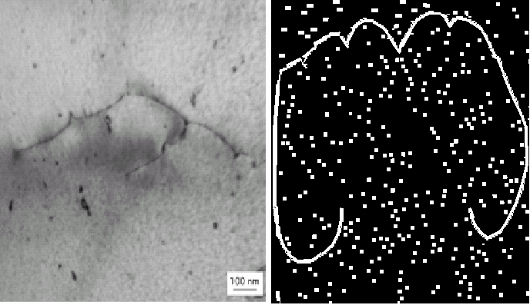
Bridge 13 = FEA
ISV
ISV
ISV
Bridge 12 = FEA
Macroscale ISV Continuum
Macroscale ISV Continuum
Bridge 11 =
void-crack interactions
Bridge 10 =
Void \ Crack Growth
Crystal
Plasticity
(ISV + FEA)
100-500µm
Bridge 9 =
Void \ Crack Nucleation
Bridge 5 = Particle-Void Interactions
10-100 µm
Crystal Plasticity
(ISV + FEA)
Bridge 8 =
Dislocation Motion
Bridge 4 = Particle Interactions
µm
Crystal Plasticity
(ISV + FEA)
Bridge 7 =
High Rate Mechanisms
Bridge 3 = Hardening Rules
100’s Nm
Dislocation
Dynamics (Micro-3D)
Bridge 6 =
Elastic Moduli
Bridge 2 = Mobility
Nm
Atomistics
(EAM,MEAM,MD,MS,
Bridge 1 = Interfacial Energy, Elasticity
Å
Electronics
Principles (DFT)

Slide 6
Multiscale Experiments
1. Exploratory exps
2. Model correlation exps
3. Model validation exps
Structural Scale
Experiments
FEM
Macroscale
Nanoscale
Continuum Model
Cyclic Plasticity
Damage
Experiment
Uniaxial/torsion
Notch Tensile
Fatigue Crack Growth
Cyclic Plasticity
Model
Cohesive Energy
Critical Stress
Analysis
Fracture
Interface Debonding
FEM Analysis
Torsion/Comp
Tension
Monotonic/Cyclic
Experiment
TEM
Microscale
ISV Model
Void Nucleation
Mesoscale
IVS Model
Void Growth
Void/Void Coalescence
Void/Particle Coalescence
Experiment
SEM
Optical methods
ISV Model
Void Growth
Void/Crack Nucleation
Experiment
Fracture of Silicon
Growth of Holes
FEM Analysis
Idealized Geometry
Realistic Geometry
Fem Analysis
Idealized Geometry
Realistic RVE Geometry
Monotonic/Cyclic Loads
Crystal Plasticity

Slide 7

Design Optimization
Optimization under Uncertainty
Analysis
Design Options
Product & Process Performance
(strength, reliability,
weight, cost, manufactur-ability )
Optimal
Product
Process
Product
(material, shape, topology)
Multiscales
Design Objective & Constraints
Experiment
Modeling
Process
(method, settings, tooling)
FEM Analysis
Environment
(loads, boundary conditions)
Cost Analysis
Preference & Risk Attitude
ISV

Slide 8
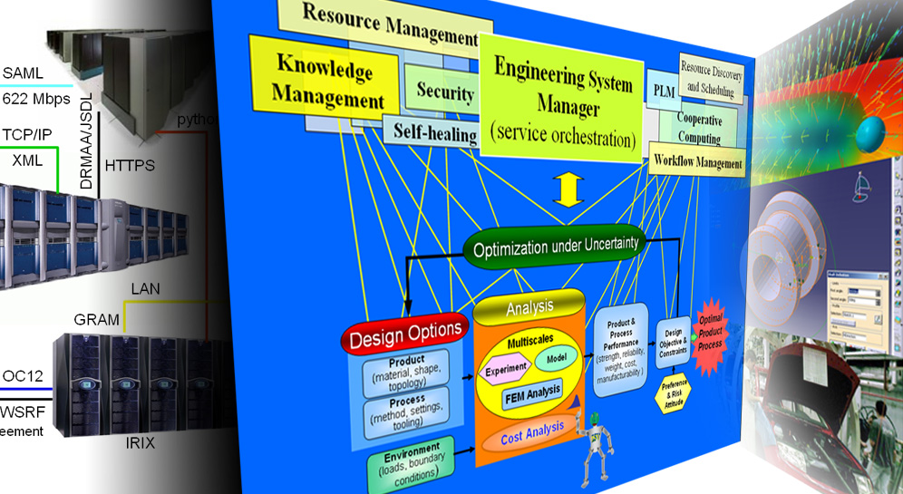
CyberInfrastructure
IT technologies
(hidden from the engineer)
Conceptual design process
(user-friendly interfaces)
Engineering tools
(CAD, CAE, etc.)
Notes:
Strategic Goal #4 Cyberinfrastructure and information systems integration (related to Thrust 4)
Create and demonstrate integrated system of information tools for rapid concurrent design of
engineered components, assemblies, and the associated manufacturing processes incorporating
associated technologies.
Objectives
1. Create and demonstrate the framework for integrating design toolkits and
computational analysis tools with multiscale materials models, including interfaces to industry standard
commercial tools.
2. Create and demonstrate common easy-to-use design environment configurable for multilevel users
with distributed, concurrent, collaborative access.
3. Create means to transparently utilize computational grid resources with distributed computational
and information resources.
4. Create and demonstrate extensible, adaptive design framework with decision support, knowledge
accumulation, and support for incorporating business cost models.
5. Create and demonstrate tools and utilities for rapidly creating rule-based applications.
The cyber-infrastructure addresses concerns/issues at various levels/layers.
At the top, are engineers and the problems they are solving (shown in the center panel above). At this layer, we are addressing issues related to user interfaces and knowledge capture & semantics.
At the second layer (from the top) we are addressing issues related to individual applications and programming of parallel codes (shown in the right panel). These applications need to be engineered so as to allow integration with other application. Knowledge representation is an issue to be addressed here.
At the third layer, we are addressing application integration and interfaces (also shown in the right panel).
At the bottom layer, we are addressing issues related to IT enabling technologies (e.g., Grids, portals, web, security) and organizational issues such as service level agreements.

Slide 9
macroscale
continuum
y
^
y
x
^
x
subscale
piecewise continuous
with discrete entities

